Slide 1
DOSIMETRIC EVALUATION OF TWO DIFFERENT BRACHYTHERAPY TECHNIQUES FOR INOPERABLE UTERINE CERVIX CANCER
Violeta Klisarovska
University Clinic of Radiotherapy and Oncology
Skopje, Macedonia

Slide 2
Objective:
To evaluate an alternative brachytherapy technique for inoperable uterine cervix cancer, without increasing the risk of toxicity and trying to achieve the same local control of the disease.

Slide 3
Material and methods:
Comparative study was undertaken in order to two different high-dose rate intracavitary brachytherapy applicators to be compared: intrauterine tandem/ring applicators and vaginal cylinder.
Presribed doses were 7 Gy at point A for tandem/ring applicators and 7 Gy at 10 mm from the top of the cylinder applicator.
Doses delivered to the rectum, bladder and sigmoid colon were kept below the tolerance limits. Volumes covered by the 100% isodoses, (V100), were compared.

Slide 4
Material and methods:
Analyzed were 40 patients, treated in University Clinic of Radiotherapy and Oncology - Skopje in period from May to July 2016, all with locally advanced cervical cancer and realized percutaneous definitive chemoradiotherapy.
In 13 of them (32.5%) intracavitary brachytherapy was made with tandem/ring applicators (tandem being 4 sm long) and prescribed dose of 7 Gy at point A.
The remaining 27 patients (67.5%) due to lack of conditions for tandem/ring application, brachytherapy treatment was implemented with vaginal cylinder and prescribed dose 7 Gy at 10 mm from the top of the applicator.

Slide 6
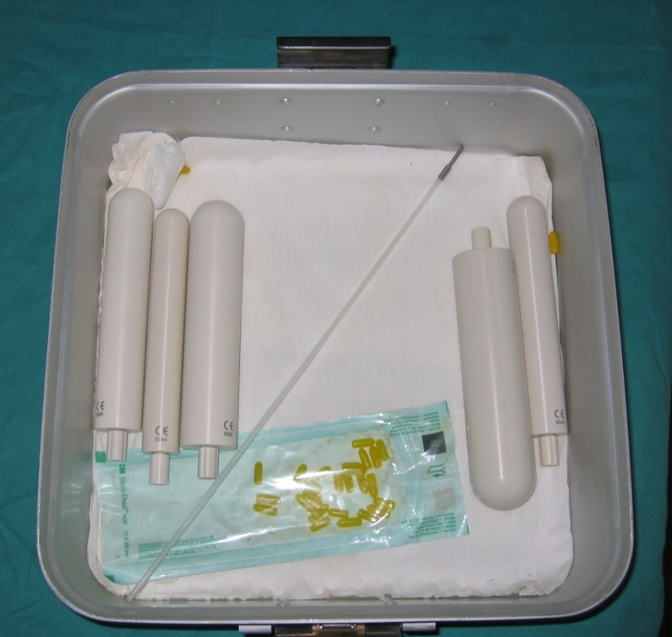
Tandem/ring applicators
Vaginal cylinder

Slide 7
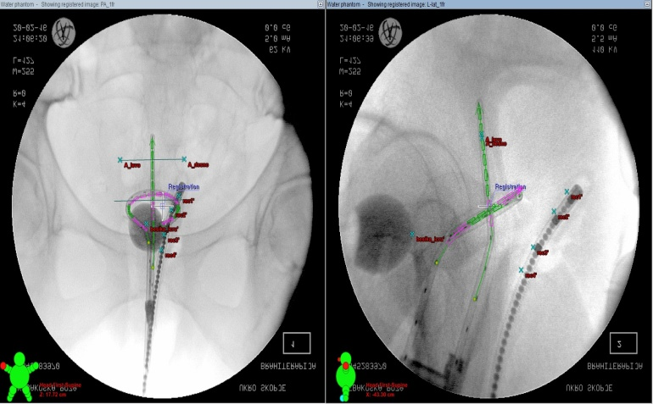
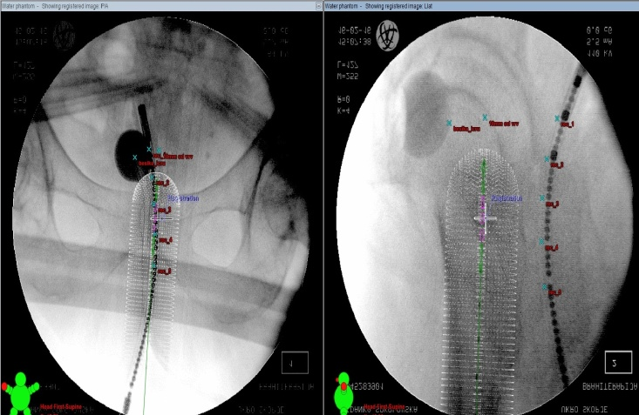
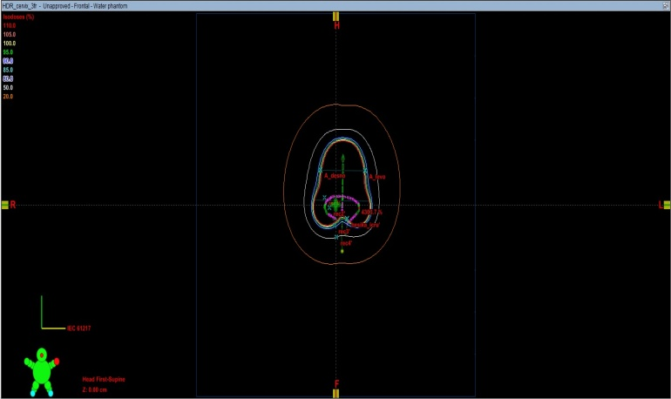
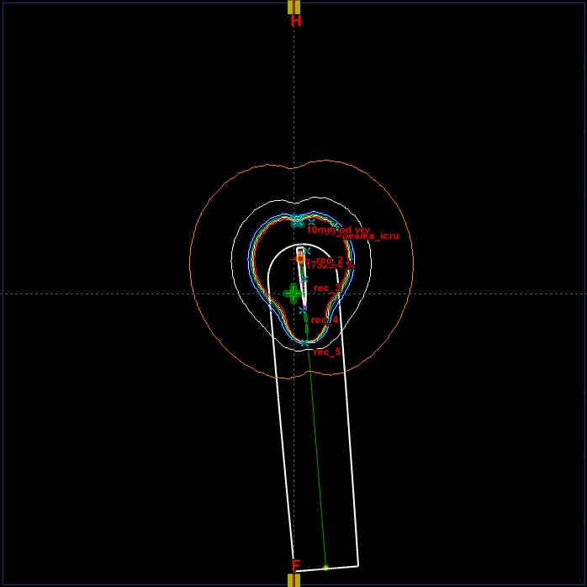

Slide 8
Results:
In order to obtain net tissue which is included in 100% isodose volume, the volumes of cylinder applicators and ring buildups were excluded from the treated volume.
The 100% tissue volumes formed in tandem/ring applications and cylinder applications were on average 50,64 cc and 34.80 ss respectively after they were diminished on average by 7.04 cc and 12.90 cc respectively.
Because the process of finding tissue volume for the cylinder applications had several steps the uncertainty in determining this volume was 1.24%.
Comparing 100% isodose volumes we can conclude that their means differ at the 0.05 level of significance, p value being less than 0.001.

Slide 9
Conclusion:
Vaginal applicator may not be used as an alternative therapy technique for patients affected by uterine cervix cancer who does not allow application of tandem/ring applicators.
Keywords: Cervical cancer, intracavitary brachytherapy, dosimetry

Slide 10
Thank you

