Slide 1
Dosimetric evaluation of two Intracavitary brachytherapy modalities in treatment of inoperable cervical cancer Petar Chakalaroski, Violeta Klisarovska, Lenche Kostadinova, Marija Simonovska University clinic for Radiotherapy and Oncology - Skopje

Slide 2
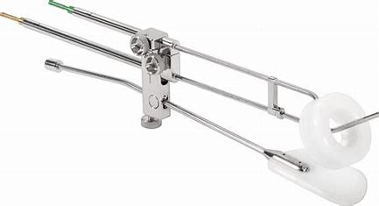
INTRODUCTION:
Brachytherapy comprises an integral part of inoperable cervical cancer definitive treatment. Mostly used is intracavitary brachytherapy (ICB) with it’s primary role of boosting the total dose needed for obtaining disease local control. ICB uses intra-uterine probe and ovoids/ring placed inside the natural cavities combined with after-loading source placement in several applications following external beam radiotherapy treatment (EBRT). Although three-dimensional (3D) ICB planning is used, sometimes plans are calculated with two-dimensional planning (2D), especially when shorter treatment time is needed due to various reasons.

Slide 3
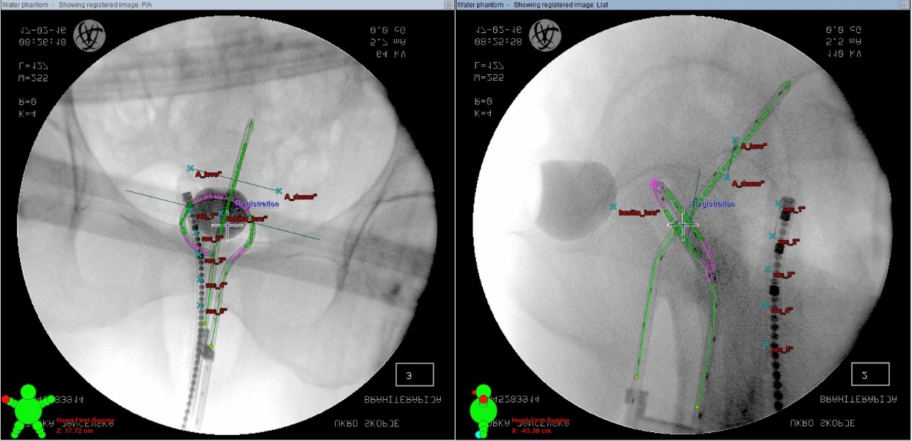
METHODS AND MATERIALS:
20 patients were treated with ICB, with prior EBRT dose of 50.4Gy. 10 patients received high dose rate (HDR) ICB in three applications (once a week) with dose of 7Gy/weekly and total dose reaching 21Gy. 10 patients received their HDR ICB in two applications with dose of 9Gy and total dose of 18Gy. All patients had 2D planning. Organ at risk (OAR) constrains were adequate for 2D planning (70% of the prescribed dose for rectal points and 80% of the prescribed dose for bladder point). Radiobiological equivalent for 2Gy daily dose (EQD2, alpha/beta=10) for 3x7Gy ICB treatment is 29.8Gy and 28.5Gy for 2x9Gy ICB respectively.

Slide 4
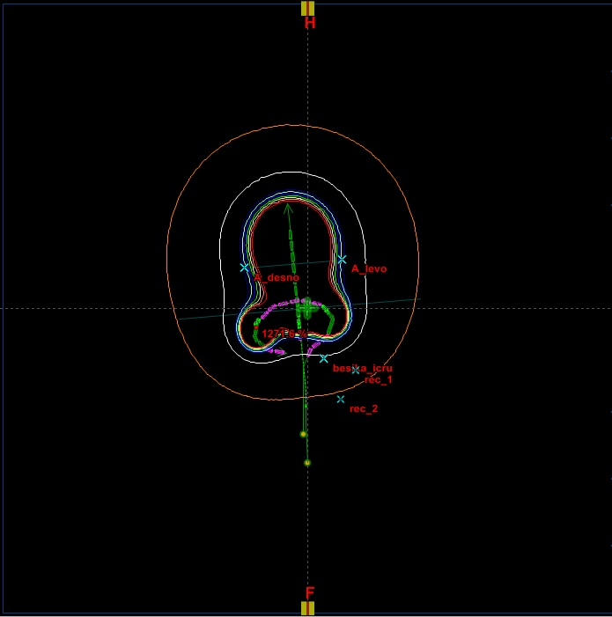
RESULTS:
Organs at risk absorbed doses were evaluated in bladder and rectum. 2x9Gy ICB whole treatment doses for rectum averaged at 4.04Gy, while doses for bladder averaged at 3.93Gy. 3x7Gy ICB doses for rectum averaged at 3.47Gy and averaged at 2.57Gy for bladder.
CONCLUSION:
OAR absorbed doses were comparable and both maintained prescribed the prescribed dose constrains. Keeping in mind that three-dimensional (3D) ICB is the mainstay, yet in some situations where patient conditions differ or when 3D planning resources are limited, both modalities (2x9Gy and 3x7Gy) of 2D HDR ICB can be equally used successfully.

