Slide 1
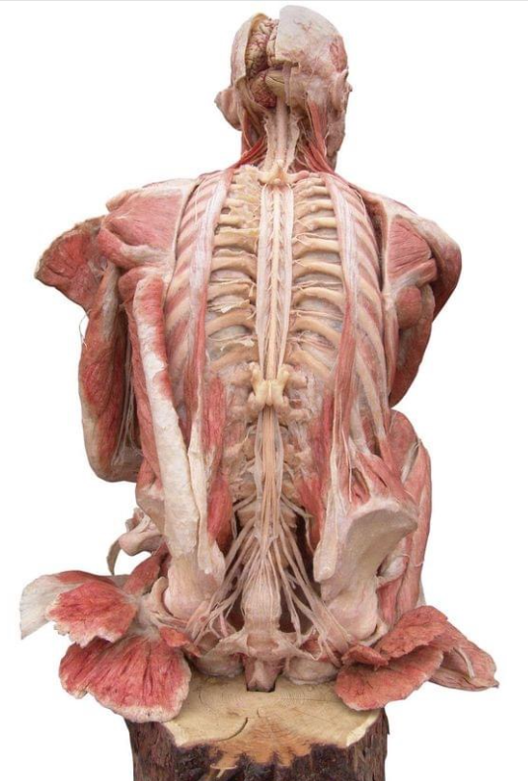
Surgical procedures in patients with single level cervical and lumbar disc herniation, treated at PHI University clinic for neurosurgery Skopje
Doc. d-r Vladimir Rendevski, Prof. d-r Venko Filipce, Prof. d-r Aleksandar Chaparoski, Prof. d-r Vladimir Mirchevski, Doc. d-r Aleksandra Gavrilovska, N. sor. d-r Milenko Kostov, Ass. d-r Robert Shumkovski, Ass. Blagoj Shuntov, Ass. Dr. Tomi Kamiloski, Dr. Fatmir Elezi, Dr. Aleksandar Zupanoski

Slide 2
Biology of the disc

Slide 4
Disc degeneration
In disc degenerative disease there is limited diffusion through the vertebral endplate
Loss of demarcation between nucleus pulposus and anulus fibrossus
Local inflammation
disc bulging
Osteophyte formation
Intervertebral foramen stenosis
Central canal stenosis
Degeneration of the fasset foints

Slide 5
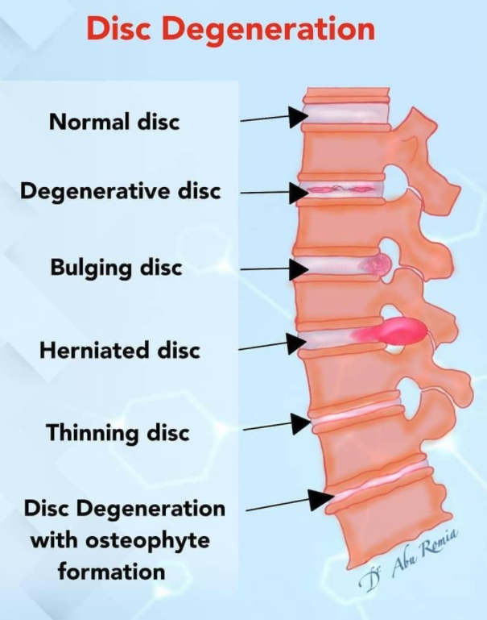

Slide 6
Cervical radiculopathy EPIDEMIOLOGY
It presents like cervicobrachial syndrome, motor/sensory deficit, impairment of the muscle-tendon reflexes
Compression of cervical nerve root (disc herniation, spondylosis, spondylolisthesis, neoplasm, infection, trauma)
True incidence is unknown
Rochester Minessota 1976-1990 annual incidence 107,3/100K men and 63,5/100K women
(Brain. 1994;117(Pt 2):325–35. )
2000-2009 military USA - 1,79 per 100 person-years
Peak 4th and 5th decade
Risk factors: white race, smoking, lumbar radiculopathy
Other risks: lifting heavy objects, frequent diving, driving vibrating equipment, golf
1/3 of patients report onset when sitting, walking or standing

Slide 9
Lumbar radiculopathy
Lumbar radiculopathy is one of the most common complaints
Its prevalence has been estimated to be 3%-5% of the population, affecting both men and women.
Females have a higher risk
Degenerative spondyloarthropathies are the primary cause of lumbar radiculopathy
The most common underlying cause of radiculopathy is irritation of a particular nerve, which can occur at any point along the nerve itself and is most often a result of a compressive force
In the case of lumbar radiculopathy, this compressive force may occur
  in the thecal sac, as the nerve root exits the thecal sac (dorsomedial /dorsolateral disc herniation)
  in the lateral recess, as the nerve root traverses the neural foramina (foraminal disc herniation) or
  Or in the extraforaminal space after the nerve root as exited the foramina (extraforaminal/lateral disc herniation)

Slide 11
Radiculopathy - summarized
Radiculopathy is a common symptom with intraspinal and extraspinal causes
• Mechanical compression is associated to inflammation and immunological triggering
• Conservative treatment is effective and cost effective
• Surgery relieve symptoms faster but same longterm outcome
• Surgery is safe

Slide 12
Clinical examination and clinical signs
FAIR Pace sign: flexion, adduction, and internal rotation with the patient in lateral position with the affected side up for 30sec (all)
Beatty sign: lying on the unaffected side and lifting and holding 10cm the superior knee
Freiberg sign: passive internal rotation of the hip
Laseque sign : pressure over muscle and tendon with hip flexed 90o and knee extended

Slide 13
Treatment
Conservative – 4-6 weeks
Surgical
Absolute indication for surgery – signs of newly developed neurologic deficit

Slide 15
Our Cases
2019 statistics
  196 cases including cervical, lumbar and thoracic degenerative disc disease, spinal tumors, vascular malformations, infections
2020 statistics during the COVID 19 crisis
  152 cases

Slide 16
Standard of care in surgical treatment
In cervical disc herniation on one level most commonly we use – Medtronic PEEK prevail cage for ACDF procedures or standard PEEK cage with plate (ACDFP)
In lumbar disc herniation – open or minimally invasive microdiscectomy

Slide 17
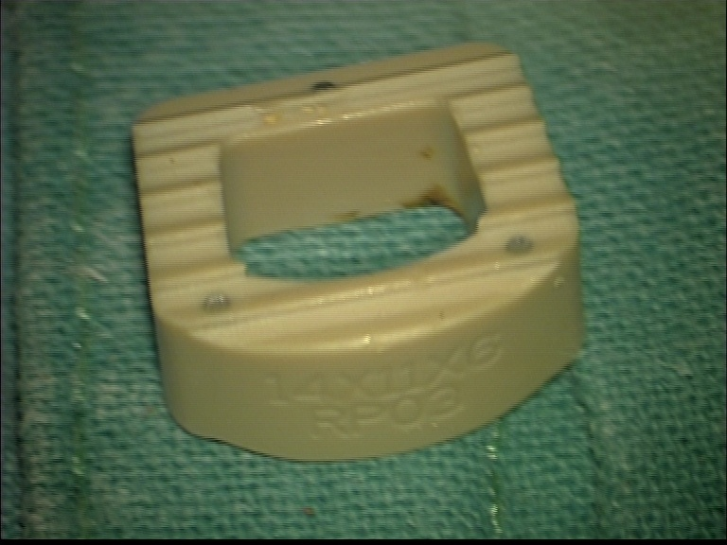
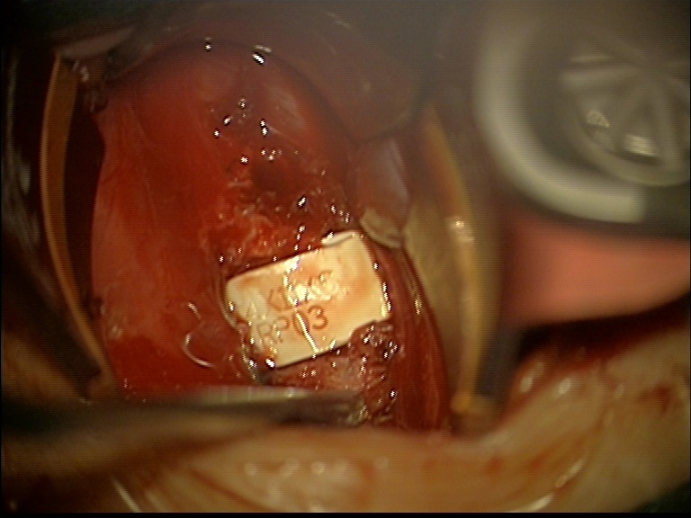
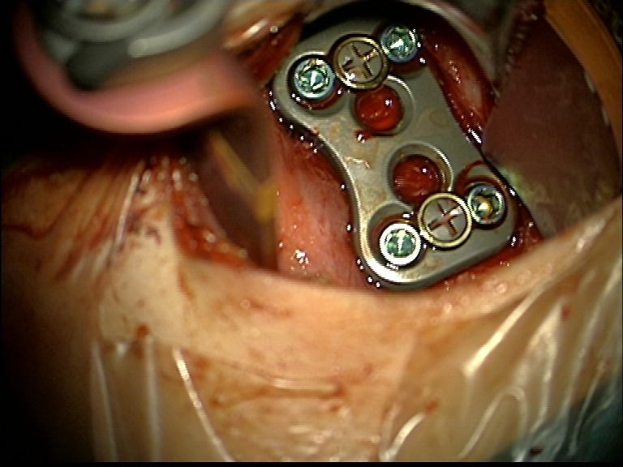
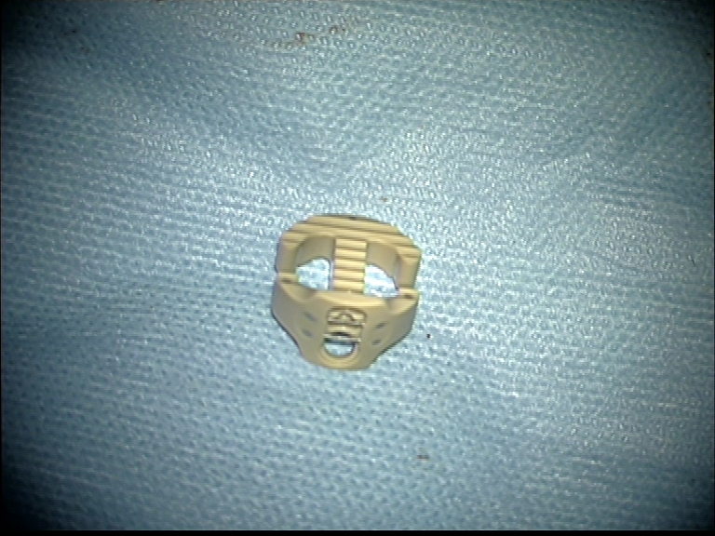
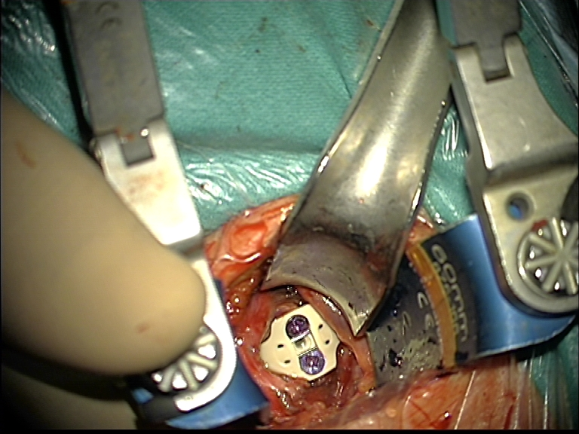
PEEK cages

Slide 18
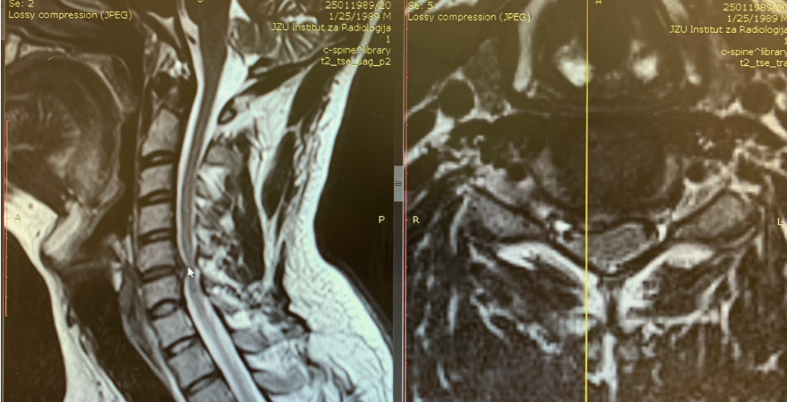
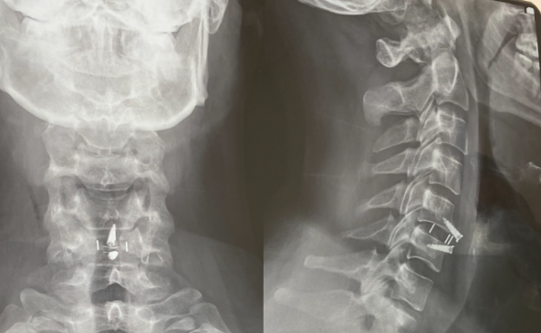
Cervical disc herniation

Slide 19
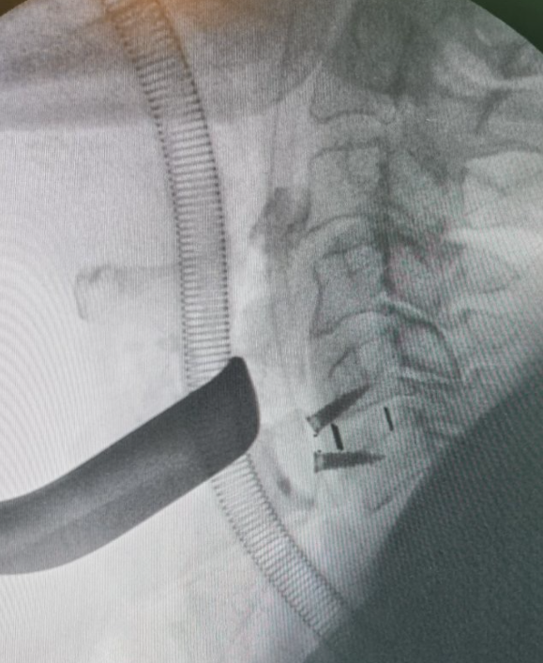
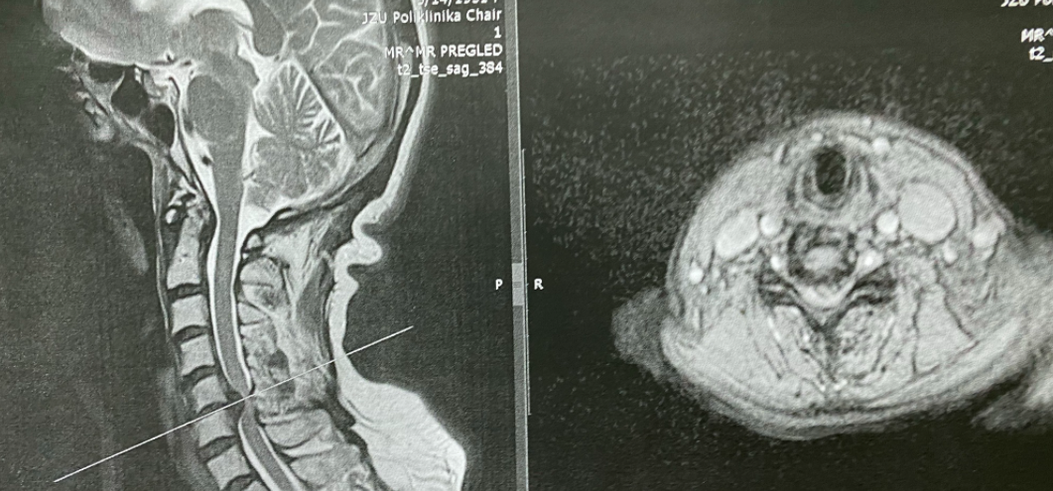

Slide 20
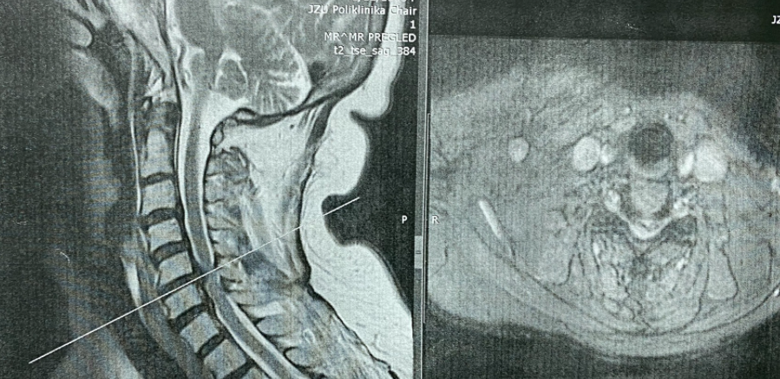
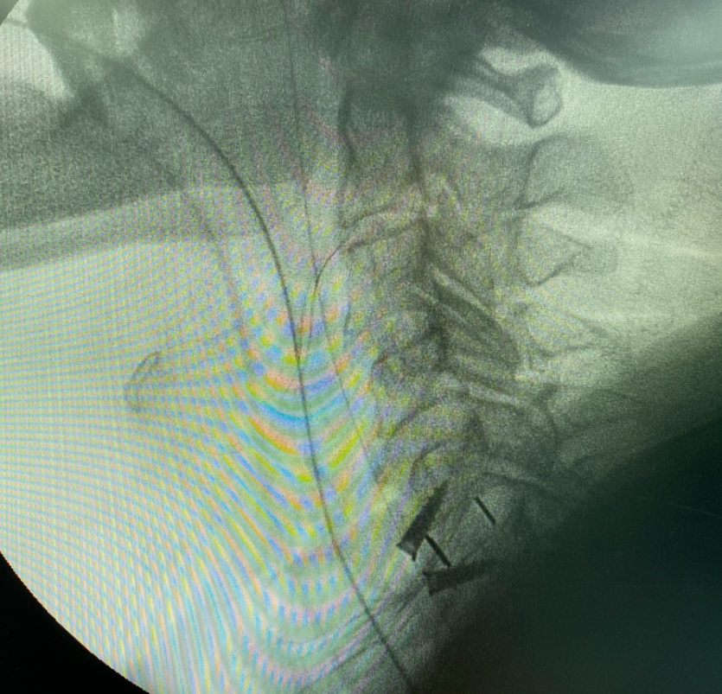
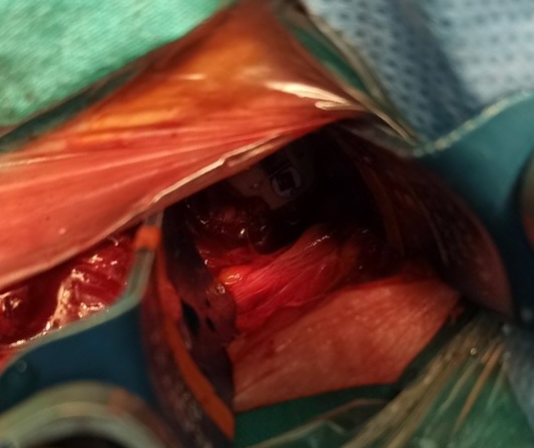

Slide 21
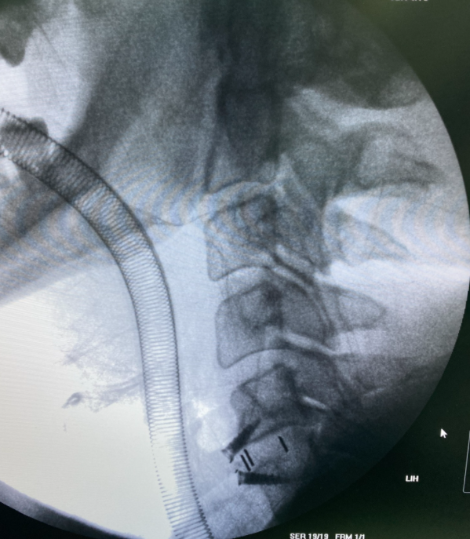
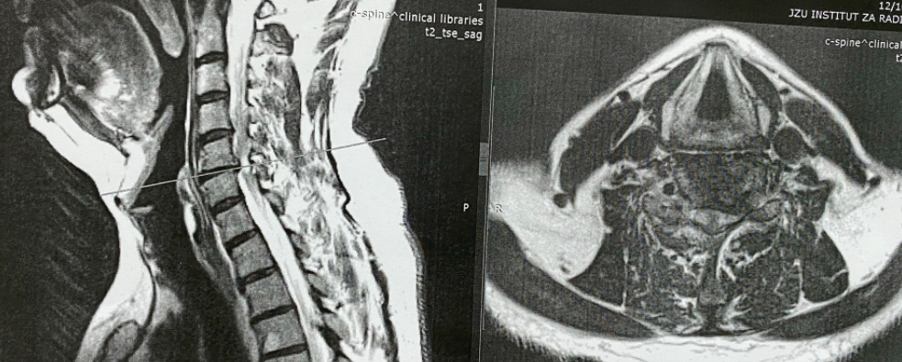

Slide 22
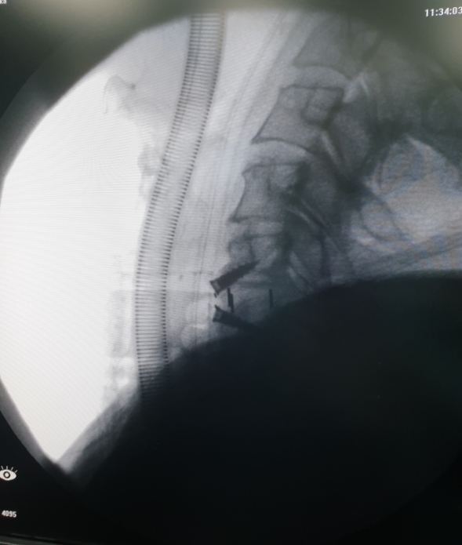
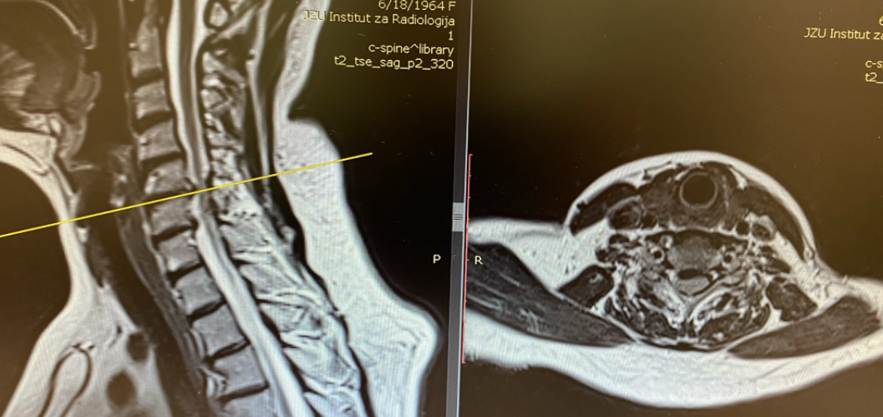

Slide 23
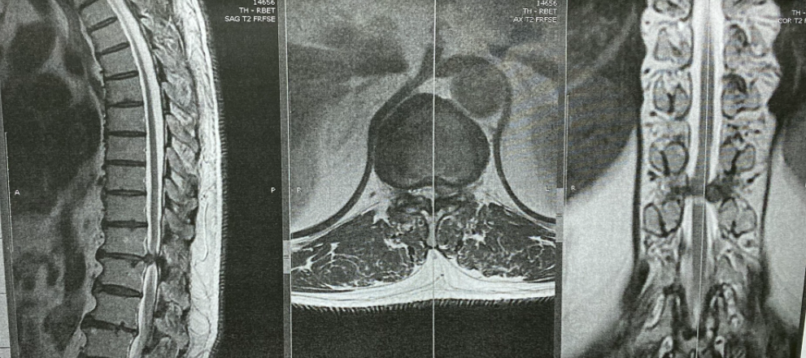
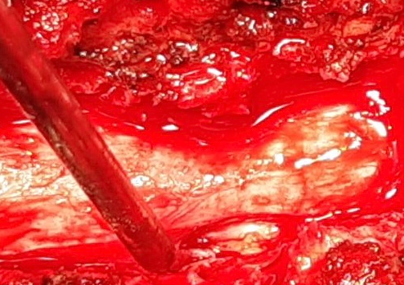
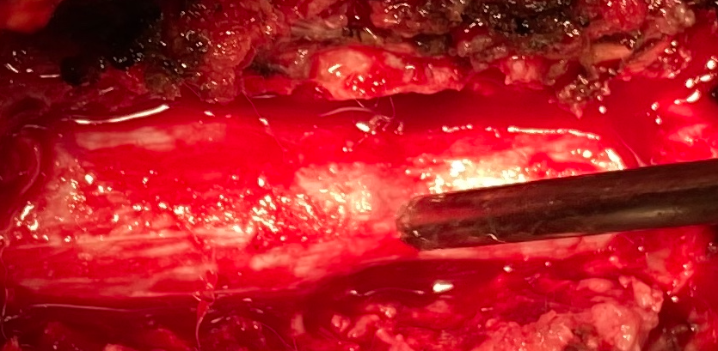
Thoracic disc disease
Lateral approach with partial costotransversectomy

Slide 24
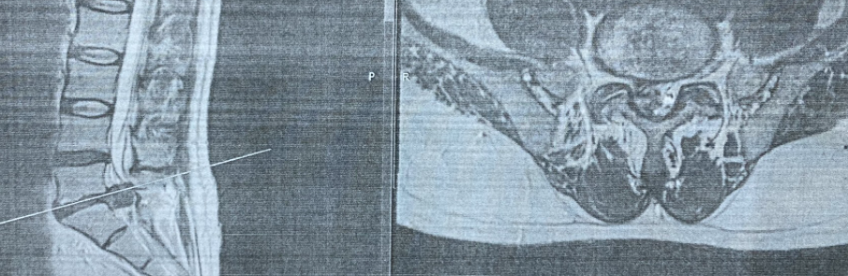
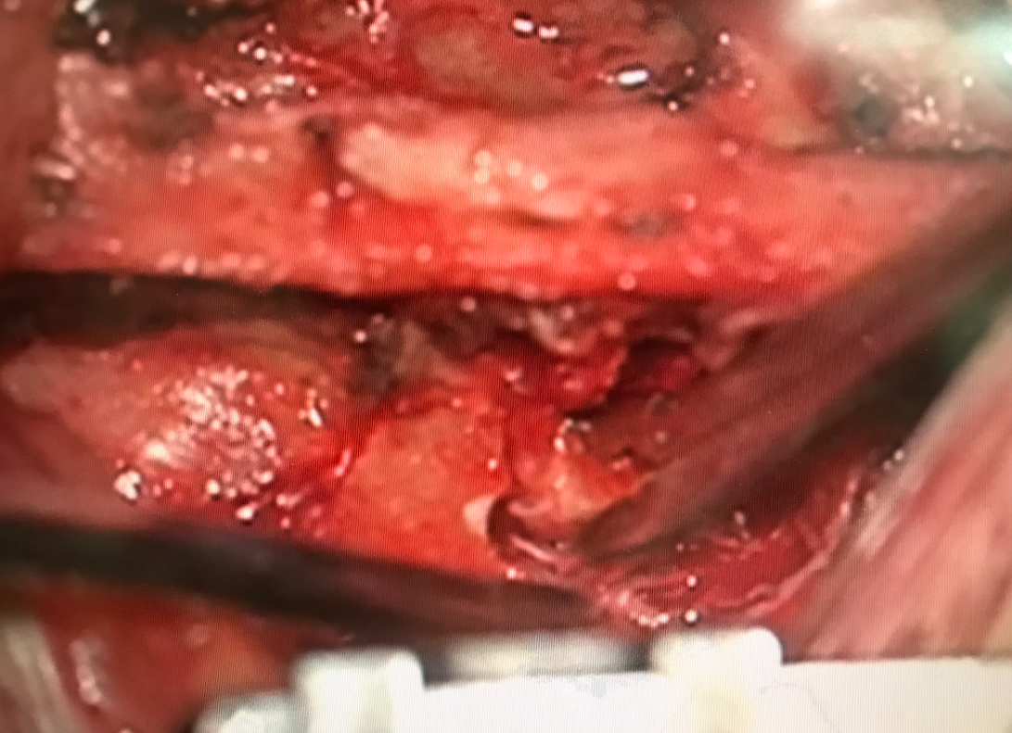
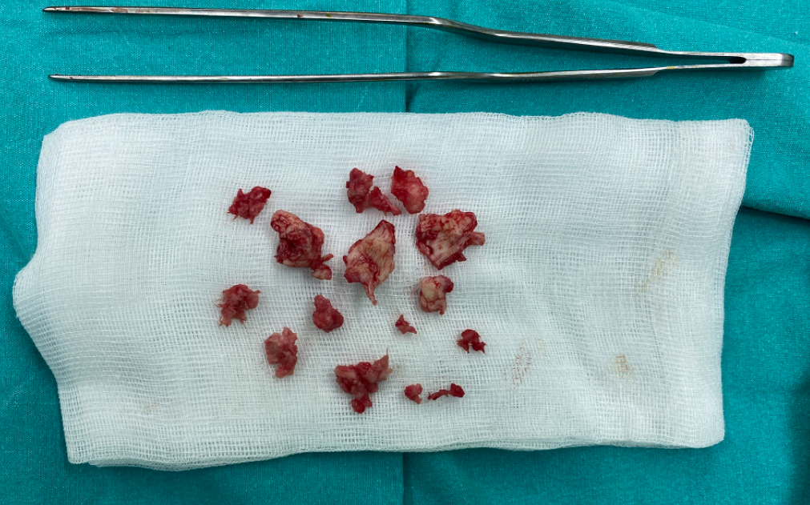
Lumbar disc disease

Slide 25
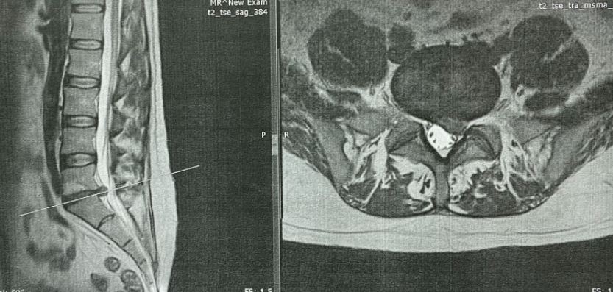
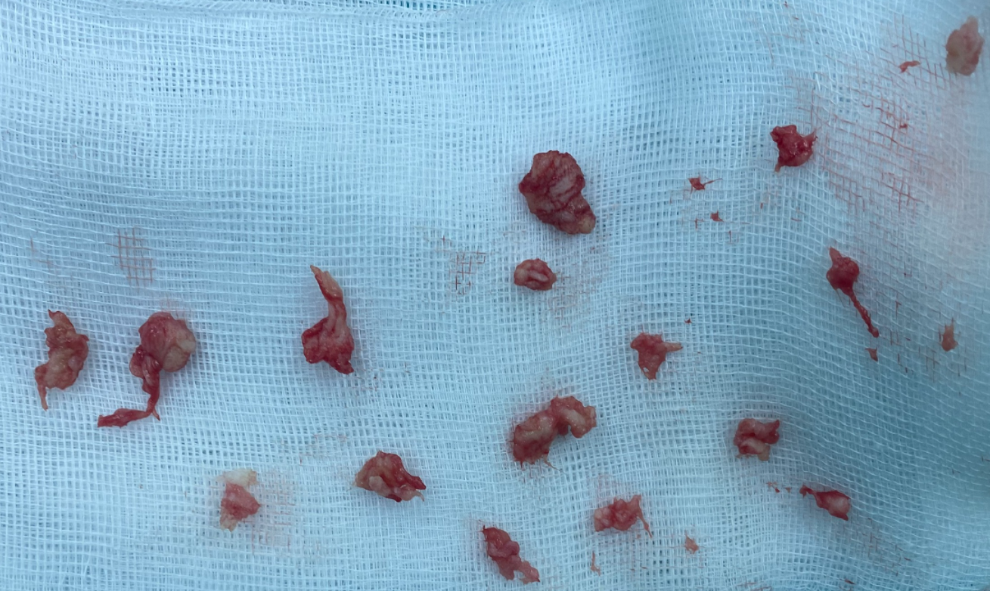

Slide 26
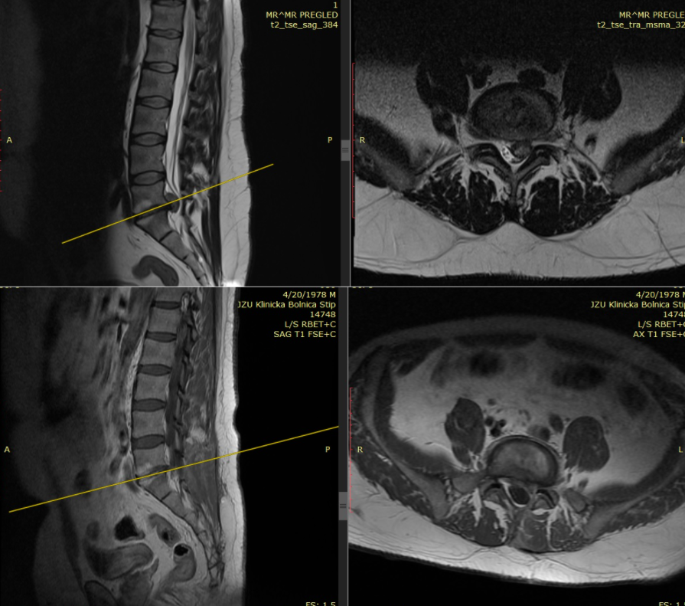
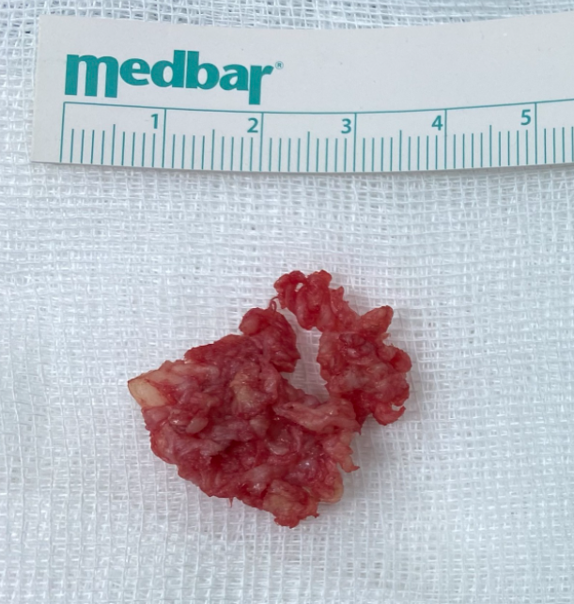

Slide 27
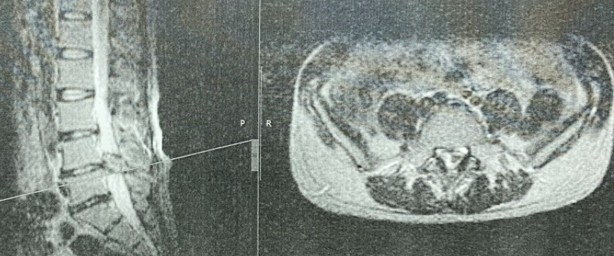
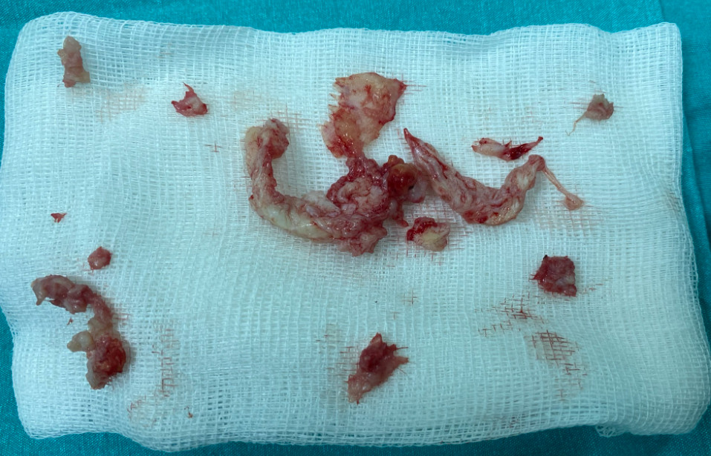

Slide 28
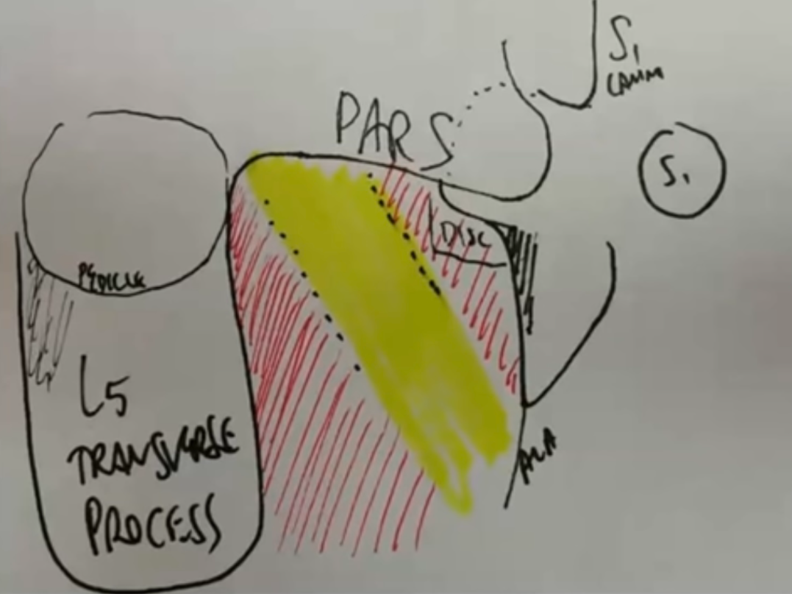
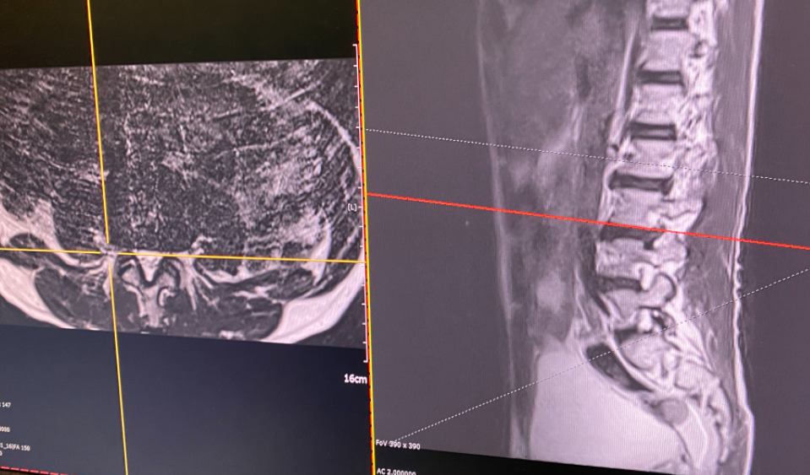
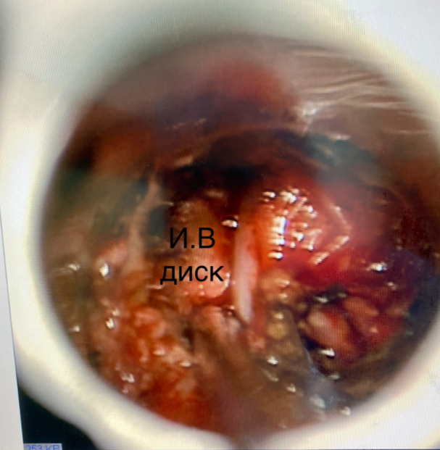
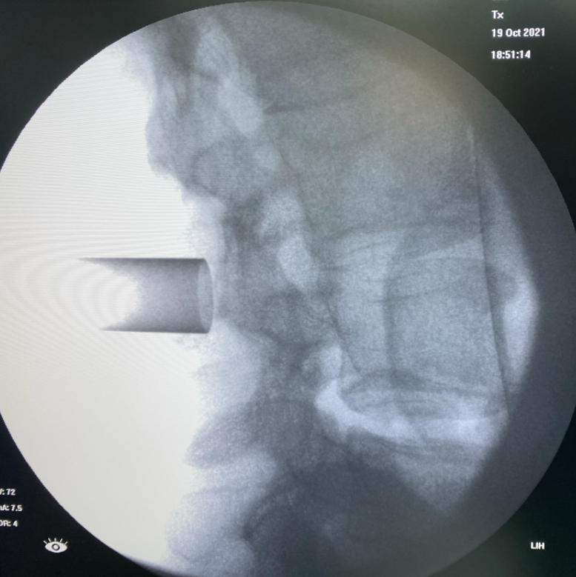
Far lateral lumbar disc herniation

Slide 29
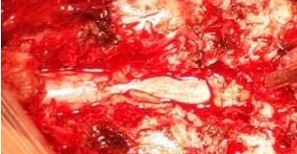
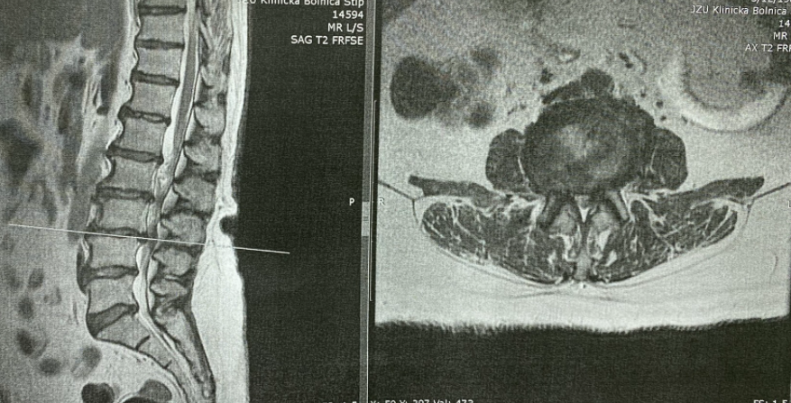
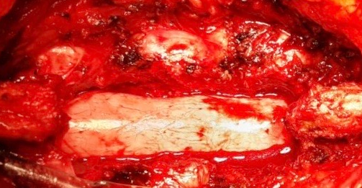
Lumbar spinal stenosis

