Slide 1







Woody plants of the National Park Mavrovo, Republic of Macedonia
Bojan Simovski MSc
Ss. Cyril and Methodius University in Skopje
Faculty of Forestry in Skopje
Department of Botany and Dendrology
Skopje, Republic of Macedonia
International Scientific Conference
Sofia, Republic of Bulgaria
1-2.X 2013

Slide 2
Brief Introduction
The National Park Mavrovo in the Republic of Macedonia is characterized by great floristic richness, in particular woody plants and forest communities.
Part of this plant treasure has encountered in rare, endemic and Tertiary relic species (Simovski 2011).
In the conducted field research mainly during the period 2009-2012 within the Park are determined 149 woody species, which is more than 45% of the Macedonian dendroflora.
This represents the dendrofloral richness of the Park.

Slide 3
Past and Recent Data
From previous research, it is important to mention the data of Em (1959, 1961, 1962, 1967, 1974, 1985), Dzhekov (1962, 1985), Rizovski (1978, 1985, 1996, 1999), Nikolovski (1991), Micevski (1985, 1993, 1995, 1998, 2001, 2005), and certain new data of Matevski (2011), Acevski and Simovski (2009, 2010, 2011), Simovski (2011, 2012), particularly those conducted within the Park.

Slide 4
Study area
The territory of the National Park Mavrovo, Republic of Macedonia.
It is important to note the largest part of the study area was conducted in a national park established more than 60 years ago, with minimal human activities and highlighting the native woody plants as a species and as a part of forest communities.

Slide 5
Study area
The National Park Mavrovo range of 3 mountain massifs- Shar Planina, Korab and Bistra, with an area of about 73,000 ha in north-westernmost part of the Republic of Macedonia.

Slide 6
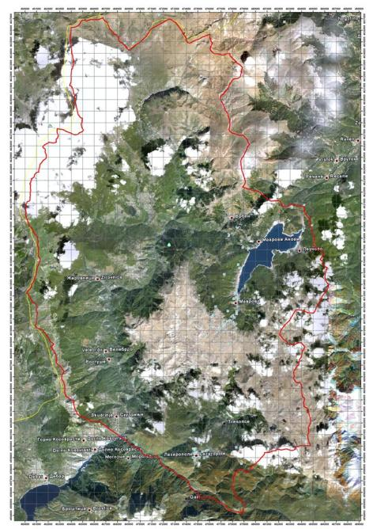
The National Park Mavrovo is the largest of all national parks in Macedonia.
By declaring the area as a national park the forest vegetation and overall vegetation covers special treatment under the protection and improvement. Namely, today there is reduced volume of excessive and illegal logging and grazing in the forests. Therefore, the forest vegetation is found today in different development stages of progressive succession.

Slide 7
Material and methods
Main goals: Inventarization of the woody plants in the study area, classification according to their taxonomy and some morpho-ecological characteristics.
Main subjects: Determination and overall number of woody species, their taxa, common names, shape according to habitus, phytogeographic (distribution) type, ecological valency and as a part of the forest communities.

Slide 8
Material and methods
Nomenclature according to Em, Rizovski, Dzhekov.
Standard phytocoenological method of Braun-Blanquet.
Prodromus phytocoenosum Jugoslaviae (1986).
Topographic maps S=1:25000, satellite and aero photo imagery, GPS measurements and more, in the most part provided by forestry-geomatic laboratory techniques in GIS Lab at the Ss. Cyril and Methodius University in Skopje, Faculty of Forestry in Skopje.

Slide 9
Environmental conditions
Orographic characteristics
  2,158 m altitude differentiation
Hydrographic characteristics
  Various river flows (Adriatic and Aegean)
Soil characteristics
  9 soil types and 5 subtypes
Climate characteristics
  6 climate types

Slide 10
Results and Discussion

Slide 11
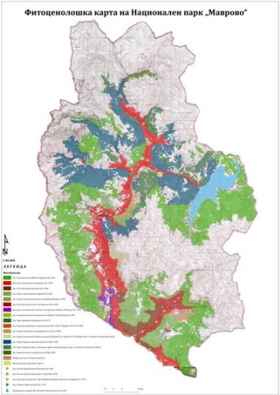
Results and Discussion

Slide 12
Results and Discussion
    Table for the overview of the woody plants in NP Mavrovo
Ordinal number | Scientific name | Common name | Form according to habitus | Phytogeographic (distribution) type | Ecological valency | Phytocoenological representation (Forest community) | Sociability
1 | 2 | 3 | 4 | 5 | 6 | 7 | 8
Determined are 149 species, i.e. more than 45% of the overall Macedonian dendroflora.

Slide 13
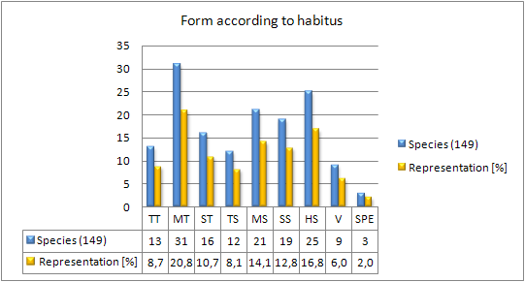
Results and Discussion

Slide 14
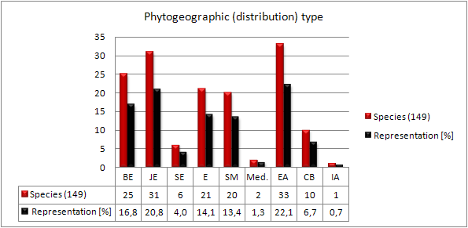
Results and Discussion

Slide 15
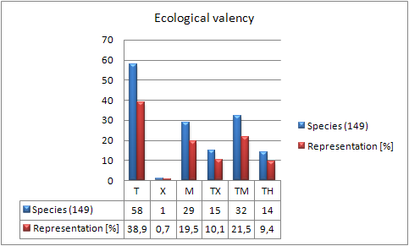
Results and Discussion

Slide 16
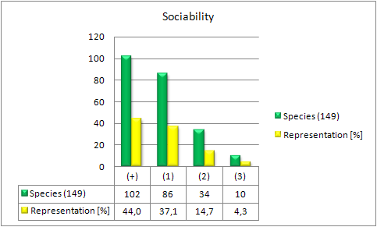
Results and Discussion

Slide 17
Some specific dendrological characteristics
Abies borisii-regis
In all communities where fir is found in the upper part of the crown shows large fruitfulness, fertile branches are literally packed with cones with seeds. The occurrence of abundant fir fertility for this time of the year is important, both from the aspect of monitoring the phaeno-phases and propagation, also for collection of quality seeds. In addition, the fir is found in two forms in terms of bark - form shape with smooth bark and form shape with rougher bark.

Slide 18
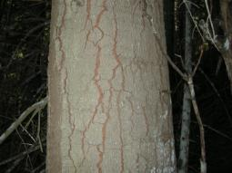
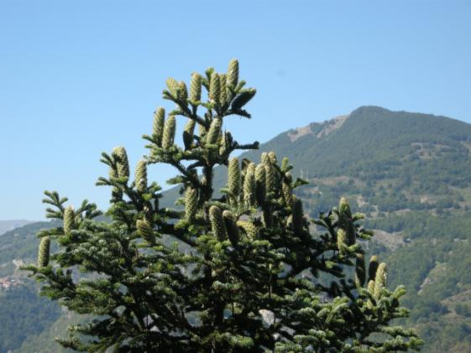
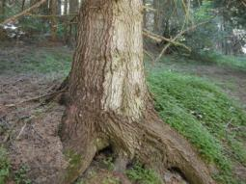
Large fruitfulness of Abies borisii-regis Mattf., mountain massif Bistra (2010)

Slide 19
Results and Discussion
Very shade tolerant species.
Reproduces by seed under the cover of the parental stand. It possesses high ability to have a long time to rest waiting the favourable moment for expansion in height.
In the struggle for light in natural successive processes the fir manages to overcome many species, particularly the beech as a shade tolerant species too (in high density beech forests the fir’s offspring successfully adapt to site conditions). Concerning some of the heliophile species which thrive with the fir at higher altitudes, such as some oaks, pines, spruce, the fir has overwhelming power to develop and grow above their canopy, particularly when the forest cover is dense. This is very important because the expansion and the destruction role of the fir refer to fir related forests composed of these species as edificatory.

Slide 20
Results and Discussion
Impact on:
Submontane beech forest (ass. Festuco heterophyllae-Fagetum Em 1965)
Montane beech forests (ass. Calamintho grandiflorae-Fagetum Em 1965)
Beech-fir forest communities (ass. Abieti-Fagetum macedonicum Em /1962/ 1985)
Spruce-fir forest (ass. Abieti-Piceetum scardicum Em /1958/ 1985)
Pure fir forests (ass. Fago-Abietetum meridionale Em 1973)
Juniper thickets in zone of high-montane pastures

Slide 21
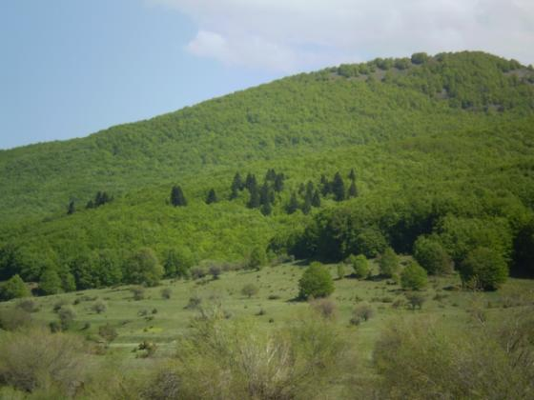
Expansion of Abies borisii-regis Mattf. in ass. Calamintho grandiflorae-Fagetum Em 1965,
National Park Mavrovo (2010)

Slide 22
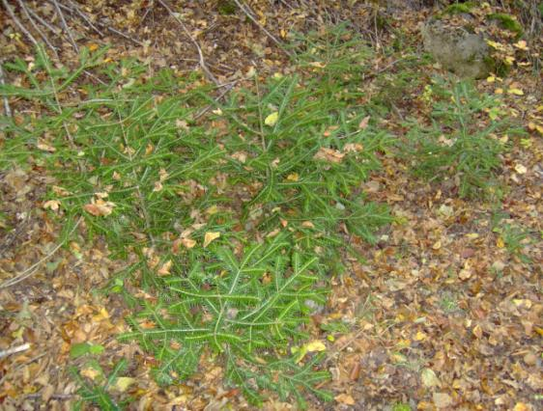
Offspring of fir in ass. Abieti-Fagetum macedonicum Em (1962) 1985, mountain massif Bistra (2008)

Slide 23
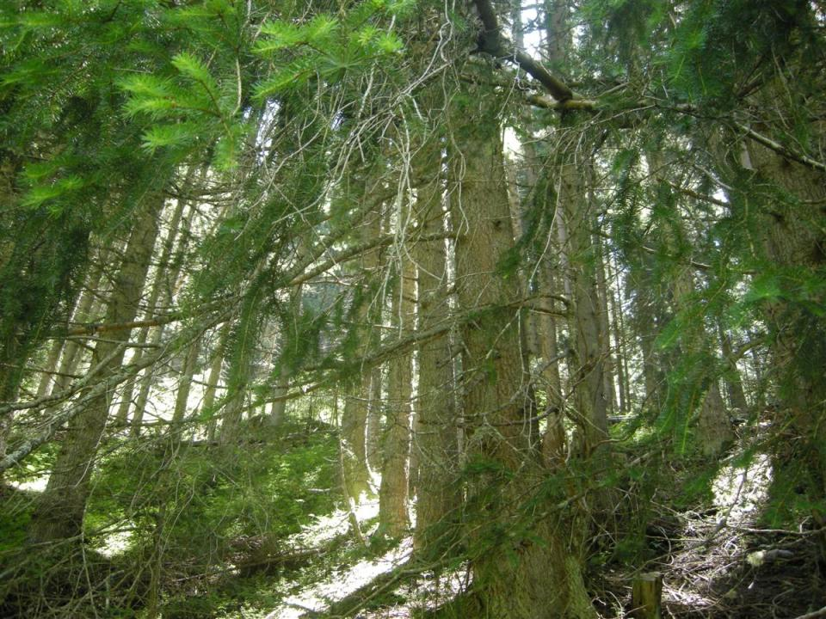
Expansion of the fir in ass. Abieti-Piceetum scardicum Em /1958/ 1985),
National Park Mavrovo (2010)

Slide 24
Results and Discussion
Area under fir and forests with fir in the National Park Mavrovo
Enlargement of the fir’s territory for about 73% in a period of 25 years (Acevski, Simovski 2012).

Slide 25
Some specific dendrological characteristics
Picea abies
Location: r. Adzhina Reka, within the spruce-fir forest (Ass. Abieti-Piceetum scardicum Em /1958/ 1985).
The site represents the southernmost border point of distribution of its European range in Macedonia.

Slide 26
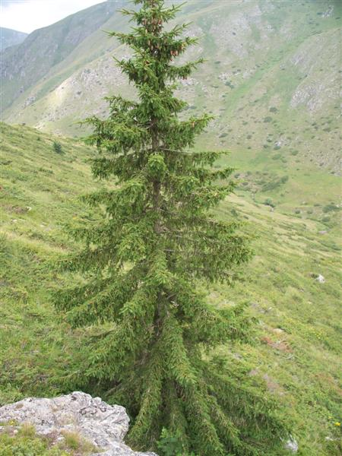
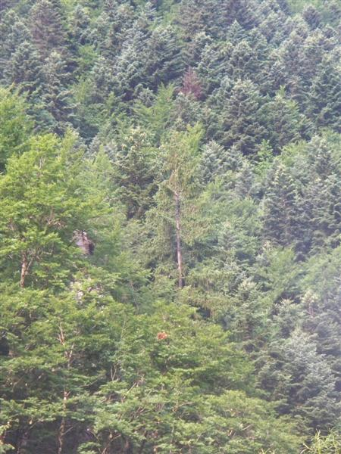
The spruce in ass. Abieti-Piceetum scardicum Em /1958/ 1985) and its whitering,
National Park Mavrovo (2010)

Slide 27
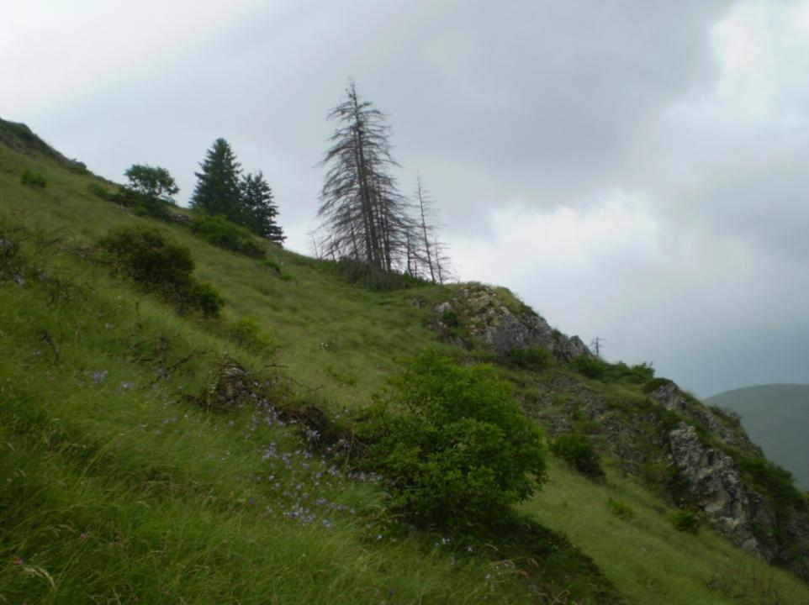
The spruce in ass. Abieti-Piceetum scardicum Em /1958/ 1985) and its whitering,
National Park Mavrovo (2010)

Slide 28
Some specific dendrological characteristics
Pinus peuce
Location: r. Adzhina Reka, near the spruce-fir forest (Ass. Abieti-Piceetum scardicum Em /1958/ 1985).
Evidently, an adult Macedonian pine tree aged 30-40 years, with a height of about 10 m and reached reproductive maturity and its immediate surroundings offspring of 150-200, with great vitality.
The Macedonian pine is the Balkan endemic species and Arcto-Tertiary relic in Macedonia.

Slide 29
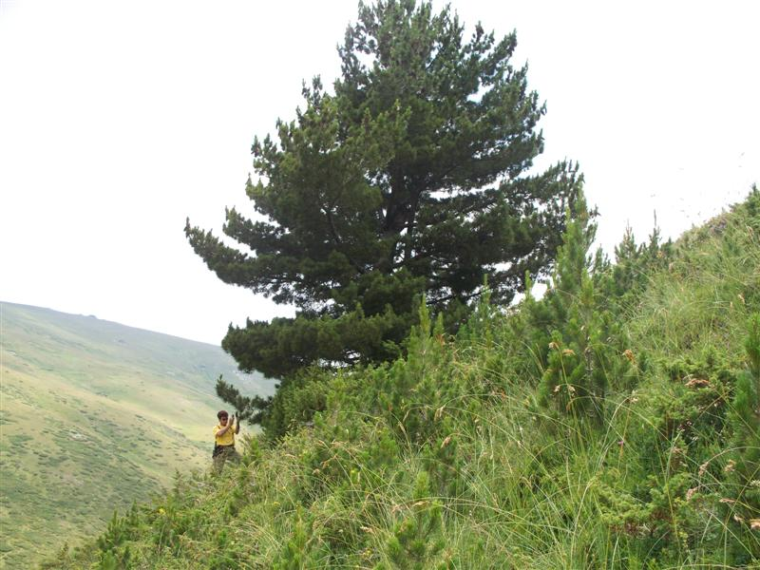
Pinus peuce (Macedonian pine),
National Park Mavrovo (2010)

Slide 30
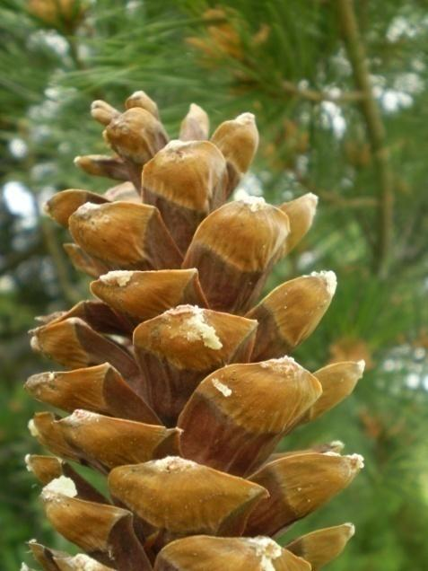
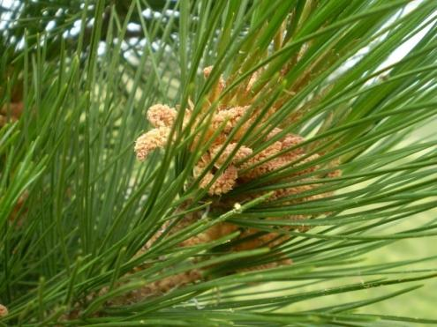
The Macedonian pine,
National Park Mavrovo (2010)
Mature cones (left); flower,
National Park Mavrovo (2010)

Slide 31
Some specific dendrological characteristics
Pinus nigra
Location: Strezimir (Border Police Checkpoint), within the black pine grove (Ass. Abieti-Fagetum subass. Pinetosum nigrae nomen nudum /J. Acevski et B. Simovski 2011/).
From a scientific standpoint, a very interesting phenomenon that deserves more intensive research to determine the reason for its spread (primary or secondary origin). Here black pine (Pinus nigra) has no competition from other species, and adjacent to well-developed mesophilic beech-fir forests, and even individual trees encountered by spruce (Picea abies).
Location: St. Panteleimon, near Mavrovo lake, near the village Nikiforovo. Old trees of black pine.

Slide 32
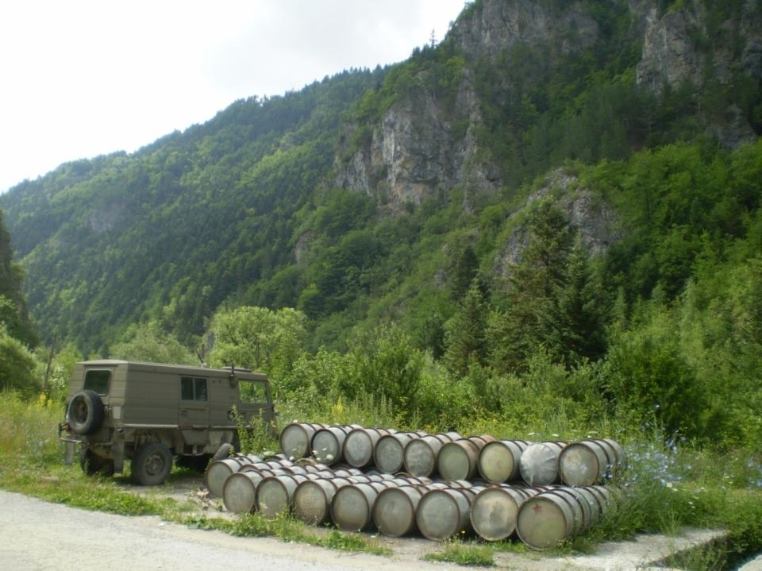
The Black pine grove, Strezimir,
National Park Mavrovo (2010)

Slide 33
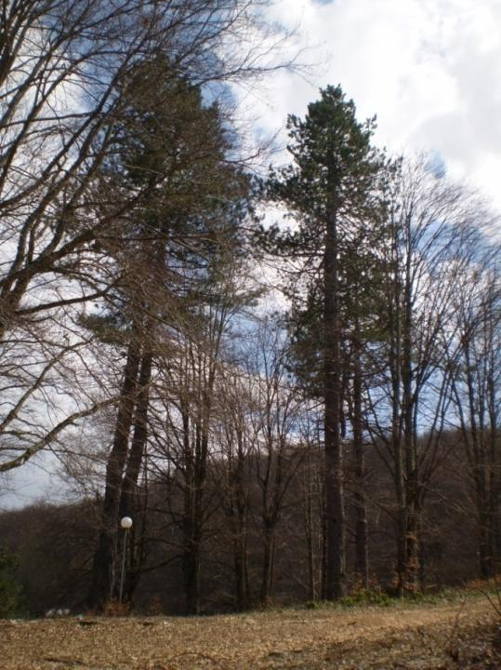
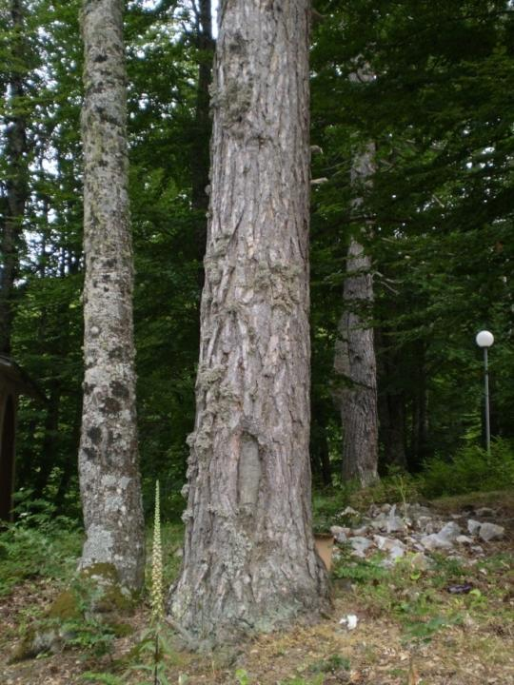
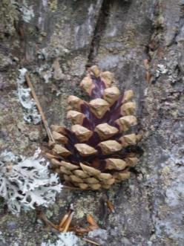
The old Black pine trees, Panteleimon,
National Park Mavrovo (2010)

Slide 34
Some specific dendrological characteristics
Juniperus foetidissima, J. foetidissima f. retinospora
Location: atop the village Selce, place called Golubarnik, above the forest road to the crest, within Ass. Querco-Ostryetum carpinifoliae Ht. 1938, hardly accessible terrain. Old specimens of stink juniper and its form.
Location: Village Galichnik. Old specimens of stink juniper.

Slide 35
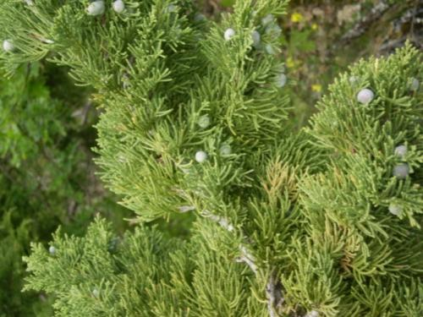
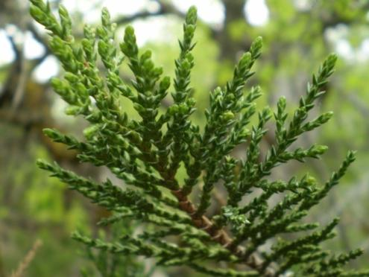
Juniperus foetidissima
J. f. var. retinospora

Slide 36
Some specific dendrological characteristics
Berberis vulgaris
Location: r. Adzhina Reka, near spruce-fir forest (Ass. Abieti-Piceetum scardicum Em (1958) 1985).
Significant occurrence of the phenomenon, because the common barberry as steppe floral element is recorded in a forest community with expressed mosephilic species: Norway spruce (Picea abies) and Balkan fir (Abies borisii-regis).

Slide 37
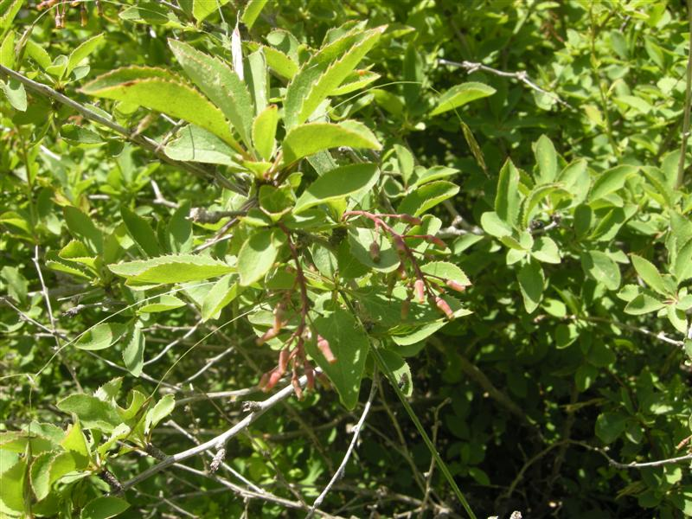
Berberis vulgaris near ass. Abieti-Piceetum scardicum Em (1958) 1985,
National Park Mavrovo (2010)

Slide 38
Some specific dendrological characteristics
Fagus sylvatica ssp. moesiaca f. quercoides
Location: Koritnik, place called Solishta, in line to the forest road and river.
A very rare occurrence of Balkan beech to create bark (ash-gray, “eternally” smooth) similar to that of the oaks (roughly in the form of cracked tiles and / or grooves), conditioned by environmental factors - site conditions.

Slide 39
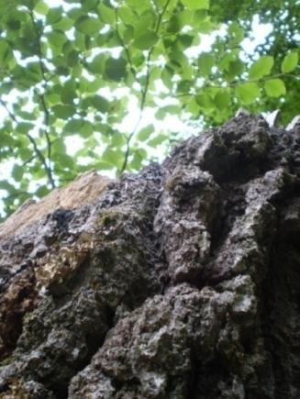
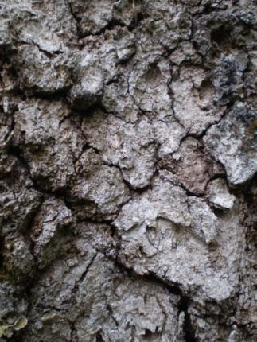
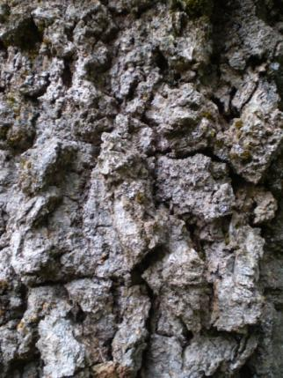
Fagus sylvatica ssp. moesiaca f. quercoides,
National Park Mavrovo (2010)

Slide 40
Some specific dendrological characteristics
Ostrya carpinifolia
Location: atop the village Selce, place called Golubarnik, above the forest road to the crest, hardly accessible terrain, within Ass. Querco-Ostryetum carpinifoliae Ht. 1938.
Many old trees of Ostrya carpinifolia (hop-hornbeam), observed in a forest of virgin forest character.

Slide 41
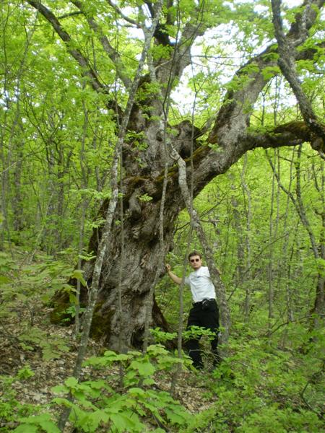
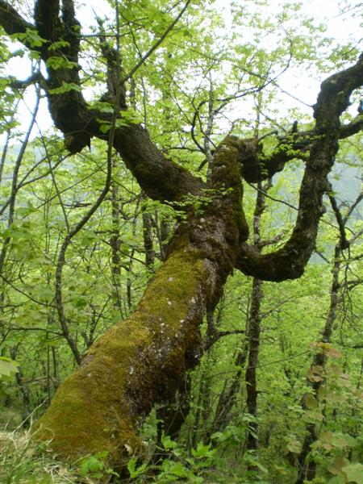
Old specimens of Ostrya carpinifolia,
National Park Mavrovo (2010)

Slide 42
Some specific dendrological characteristics
Acantholimon androsaceum
Location: place called Mal Brzovec atop the village Tresonche, on stone blocks of carbonate, on territory of distribution of mountain pastures.
This site represents the northernmost range of Acantholimon in Macedonia.

Slide 43
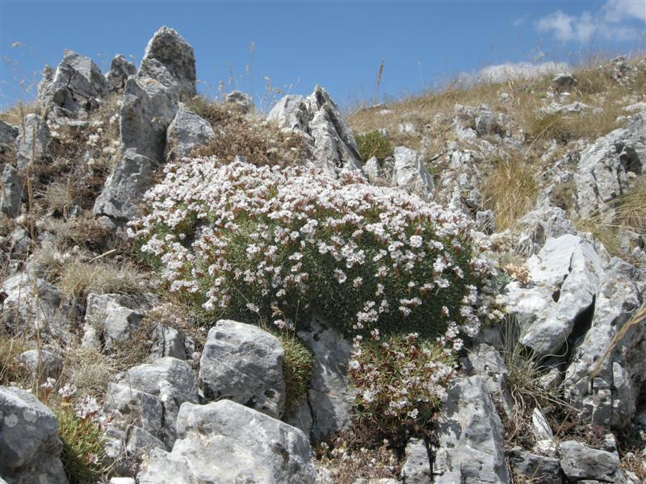
Acantholimon androsaceum,
National Park Mavrovo (2010)

Slide 44
Some specific dendrological characteristics
Cotoneaster mariana
Location: atop the village Volkovija in pure fir forest (Ass. Fago-Abietetum meridionale Em 1973), on wide-open area.
It represents a new site of the Macedonian Cotoneaster in Macedonia and was first found within the Park.
Macedonian Cotoneaster is a Macedonian endemic species. Previously only recorded in three sites: on Galichica, on limestone rock, then at the location Venec, near Sveti Nikole and near v. Vitolište, Mariovo.

Slide 45
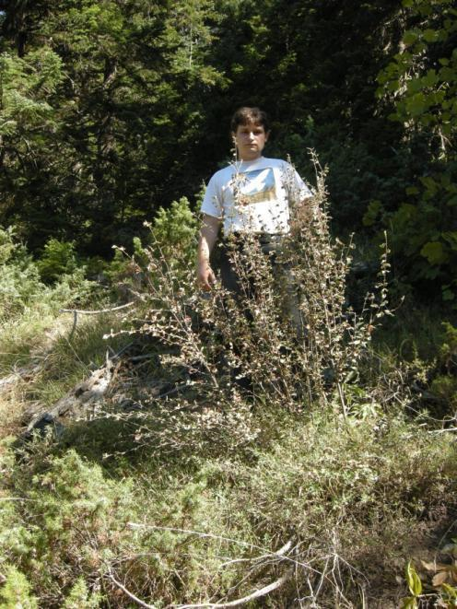
Cotoneaster mariana,
National Park Mavrovo (2010)

Slide 46
Some specific dendrological characteristics
Aesculus hippocastanum
Location: r. Garska Reka, place called Tri Cheshmi, within Ass. Aesculo hippocastani-Ostryetum Em 1965.
Old horse chestnut trees, Balkan endemic species and arctotercier relic in Macedonia.

Slide 47
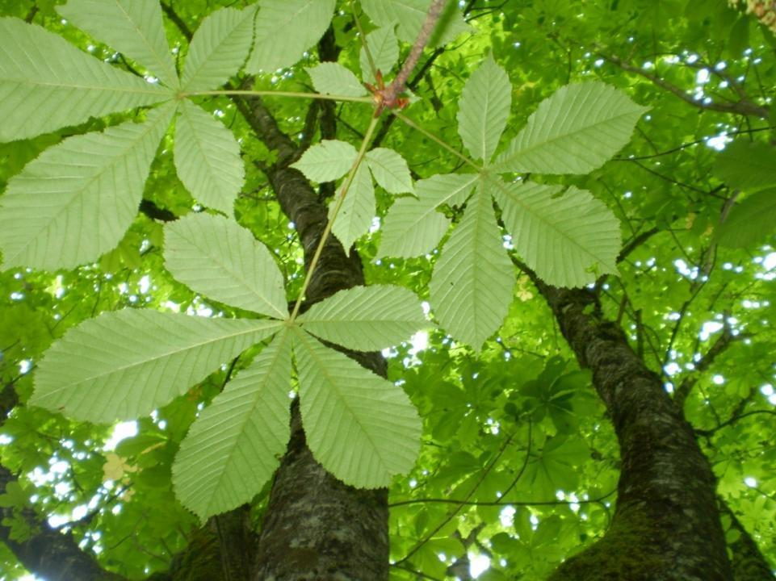
Aesculus hippocastanum,
National Park Mavrovo (2010)

Slide 48
Some specific dendrological characteristics
Arceuthobium oxycedri on Juniperus sabina
Location: atop the village. Selce, place called Golubarnik above the forest road to the crest, hardly accessible terrain, within Ass. Querco-Ostryetum carpinifoliae Ht. 1938.
This half-parasite was observed for the first time as parasite on creeping juniper (Juniperus sabina).

Slide 49
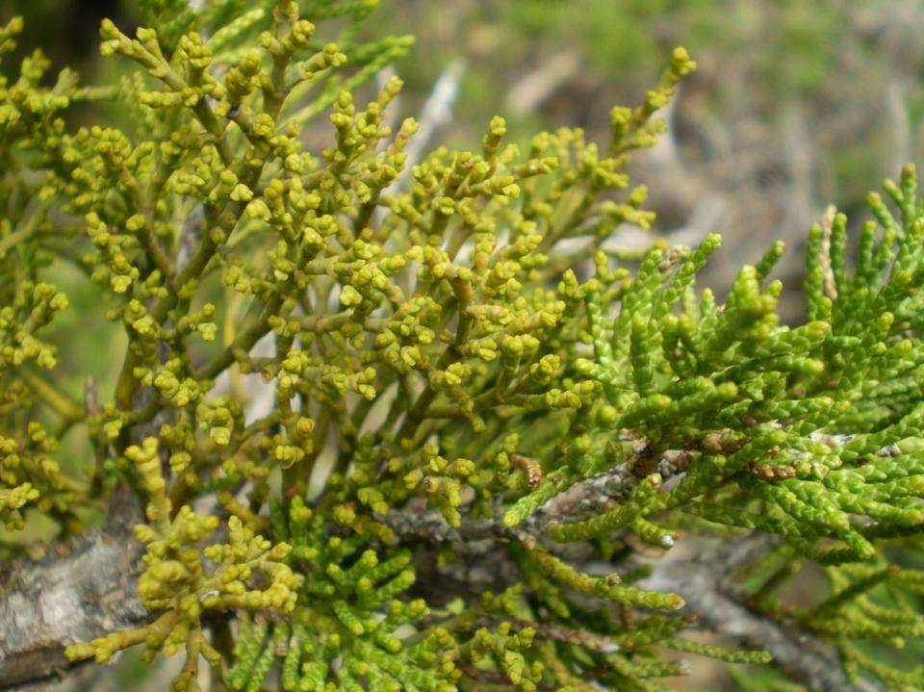
Arceuthobium oxycedri on Juniperus sabina,
National Park Mavrovo (2010)

Slide 50
Some specific dendrological characteristics
Fraxinus excelsior
Location: Village Volkovija in the zone of pure fir forest (Ass. Fago-Abietetum meridionale Em 1973).
Many adults and vital specimens of common ash are forming a small grove.

Slide 51
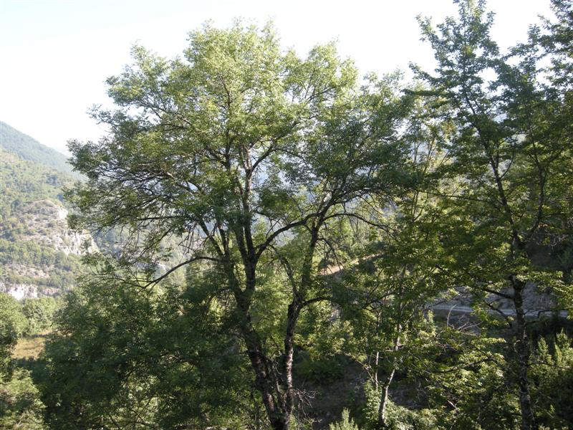
Old trees of Fraxinus excelsior,
National Park Mavrovo (2010)

Slide 52
Artificial stands and non-native dendroflora
Although a national park, on the territory of the NP Mavrovo there are artificially-planted areas in the immediate vicinity of the settlements, intended to protect against erosion processes. These areas / stands are raised in order for a short period to provide protection from erosion to the settlements. Newly planted forest stands now are in the form of forest plantations, age 30-40 years, which completely fulfilled the function for which they are raised, reducing the erosive processes. Such stands are raised with the following species: Pinus nigra, Pinus sylvestris, Pinus peuce and Picea abies.

Slide 53
Conclusions
The native dendroflora of the National Park Mavrovo consists of 149 species, which is more than 45% of the Macedonian dendroflora, classified in:
  66 genera,
  5 sub-genera,
  39 families,
  3 sub-families,
  24 orders,
  2 sub-classes,
  2 classes and
  1 division.

Slide 54
Conclusions
Concerning the form according to habitus, the trees are represented with 40,3%, shrubs 34,9%, semi-shrubs 16,8%, vines 6%, and half-parasites-epiphytes with 2%.
According to phytogeographic (distribution) type, woody plants are of 9 distribution types, i.e. Euro-Asian 22,1%, South European 20,8 and Balkan endemic species with 16,8%.

Slide 55
Conclusions
The ecological valency is represented mostly by termophilic species 38,9%, termo-mezophilic 21,5%, and mezophilic with 19,5%.
According to phytogeographic (distribution) type, woody plants are of 9 distribution types, i.e. Euro-Asian 22,1%, South European 20,8 and Balkan endemic species with 16,8%.

Slide 56
Conclusions
Certain rare woody plants represented in NP Mavrovo and on a small number of sites in Macedonia are: Euphorbia glabriflora, Acantholimon androsaceum, Cotoneaster mariana, Aesculus hippocastanum.
Some of the native Tertiary relic species represented in the Park are: Pinus peuce, Pinus heldreichii, Acer heldreichii, Aesculus hippocastanum, Salix retusa, Salix reticulata, Salix herbacea, Myricaria germanica.

Slide 57
Conclusions
Woody species of the Park with northernmost distribution range in Macedonia: Tamarix parviflora, Aesculus hippocastanum, Rhamnus rhodopaea, Salix amplexicaulis, Juniperus oxycedrus, Acantholimon androsaceum.
Woody species of the Park with southernmost distribution range in Macedonia: Juniperus sabina, Picea excelsa, Pinus peuce, Myricaria germanica, Betula pendula, Salix retusa, Salix reticulata, Salix herbacea, Empetrum hermaphroditum.
Woody species of the Park with easternmost distribution range in Macedonia: Prunus coccomilia, Laburnum alpinum, Acer obtusatum.
Woody species of the Park with westernmost distribution range in Macedonia is Juniperus foetidissima.

Slide 58
Conclusions
Determined are new finding sites of Pinus peuce and Cotoneaster mariana.
It is determined for the first time Arceuthobium oxycedri to parasite on Juniperus sabina.
Found are certain dendrological phenomena, i.e. beech with oak-like bark, fir with smoother and roogher bark, presence of steppe floral elements on typical mezophilic sites- Berberis vulgaris nearby spruce-fir forest etc.

Slide 59
Conclusions
Some of Picea abies trees are whitering, and the Abies borisii-regis population is expanding, not only regarding to the spruce, but in all forest communities represented in.
It is noted the territorial expansion of some pioneering species over the montane pastures: Juniperus communis, Juniperus nana, Juniperus x intermedia, Juniperus oxycedrus, Juniperus sabina, Cytisus leucanthus, Daphne alpina ssp. oleoides. This is a result of the reduced anthropo-zoogenic influence. Therefore, these species now form coppice forests- thickets and heats, as a part of the progressive stand dynamics.

Slide 60
Conclusions
Found are trees as a part of forests with virgin forest characteristics, with large dimensions and old: Aesculus hippocastanum, Ostrya carpinifolia, Juniperus foetidissima, Acer pseudoplatanus, Fagus sylvatica ssp. moesiaca, Abies-borisii regis.
In the “urbanized” areas are found some ornamental trees and shrubs, which are not a subject to this research.
On some localities are found artificial stands (7) as a biological erosion control measurement, represented by 4 fast-growing evergreen trees: Pinus nigra, Pinus sylvestris, Pinus peuce and Picea abies.

Slide 61
References
Acevski J., Simovski B., 2012. Forest associations of the National Park Mavrovo in the Republic of Macedonia. In: Horodnic, S.-A., Duduman, M.-L., Palaghianu, C. (eds.): Proceedings of the International Conference Integrated Management of Environmental Resources - Suceava, November 4-6th, 2011. Editura Universitătii „Ştefan cel Mare” Suceava, Romania, 17-27.
Acevski J., Simovski B., 2010. Forest communities of the NP Mavrovo (report). Environmental protection, economical development and promotion of sustainable ecotourism in National Park Mavrovo. UCODEP (Oxfam Italia). Skopje.
Acevski J., Simovski B., 2009. Natural succession processes of the old Macedonian pine (Pinus peuce Gris.) forests at the locality Begova Cheshma in the National Park Pelister. Forest Review of the Faculty of Forestry in Skopje. Skopje. 42:140-146. (In Macedonian)
Džekov S., 1988. Dendrology. 538p. UKIM, Skopje. (in Macedonian)
Еm, H., 1973/74. Tannenwald in Mazedonien- Fago-Abietetum meridionale ass. n. Jahrbuch der Land- und Forstwirtschaftliche Fakultät der Universität in Skopje. 26:41-58. (in Macedonian)
Em H., 1962. Šumske zajednice četinara u NR Makedoniji. Biološki glasnik 15:1-33.
Em H., 1961. Die Verbreitung der Weisstanne (Abies alba Mill.) in der VR Mazedonien. Forest Review. Skopje. 6:3-8. (in Macedonian)
Gudeski A., Rizovski R., 1968. Der niedrigste Fundort der Tanne in SR Mazedonien. Forest Review. Skopje. 3-4: 44-47. (in Macedonian)
National Park Mavrovo, 1975/1985, Forest management plans. (In Macedonian)
Naučno veće vegetacijske karte Jugoslavije, 1986, Prodromus phytocoenosum Jugoslaviae – ad mappam vegetationis m 1:200000. Bribir-Ilok.
Simovski B., 2011. Dendrofloristic characteristics of the National Park Mavrovo. MSc (thesis), Ss. Cyril and Methodius University in Skopje, Faculty of Forestry in Skopje, Republic of Macedonia. (in Macedonian)
Trajkov, P., 2011. Forests of the NP Mavrovo (report). Environmental protection, economical development and promotion of sustainable ecotourism in National Park Mavrovo. Oxfam Italia. Skopje.

Slide 62


Slide 63



International Scientific Conference / Sofia, Republic of Bulgaria / 1-2.X 2013
Woody plants of the National Park Mavrovo, Republic of Macedonia
Bojan Simovski MSc
Ss. Cyril and Methodius University in Skopje
Faculty of Forestry in Skopje
Department of Botany and Dendrology
Skopje, Republic of Macedonia
bsimovski@sf.ukim.edu.mk

