Slide 1

The impact of TNF-α in prognostication of poor neurological outcome in patients after
intracerebral hemorrhage (ICH)
Vladimir Rendevski,
Boris Aleksovski,
Aleksandar Caparoski,
Venko Filipce,
Ana Mihajlovska Rendevska

Slide 2
Focus
To asses the main drivers for poor outcome after ICH based on peripheral biochemical markers (TNF-α, glutamate and glucose) and radiological variables (both at admission and five days after), for modeling purposes of prognostication.
Detect and propose significant predictors for poor prognosis
Long-term perspective: contributing in clinical decision making and evidence-based medicine

Slide 3
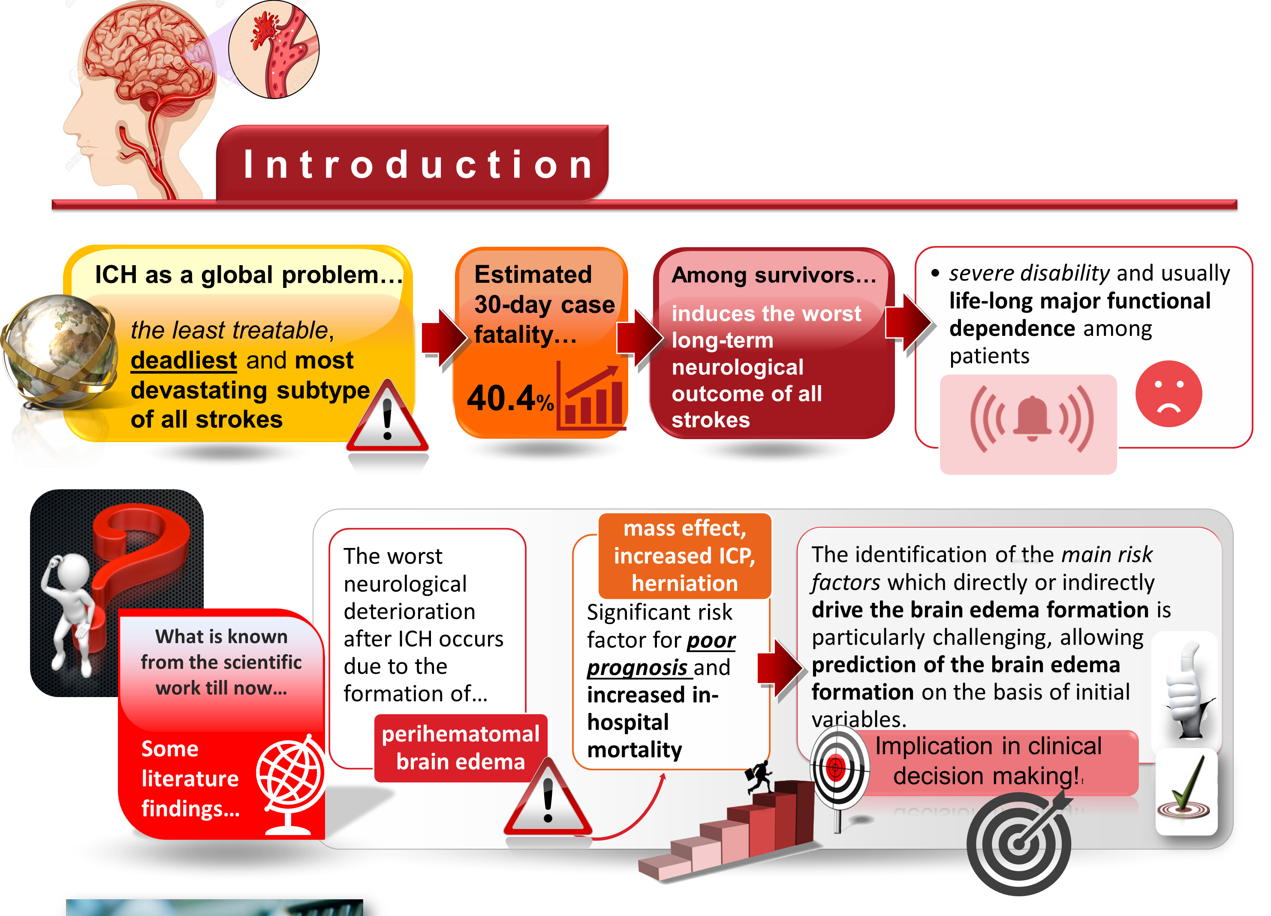

Slide 4
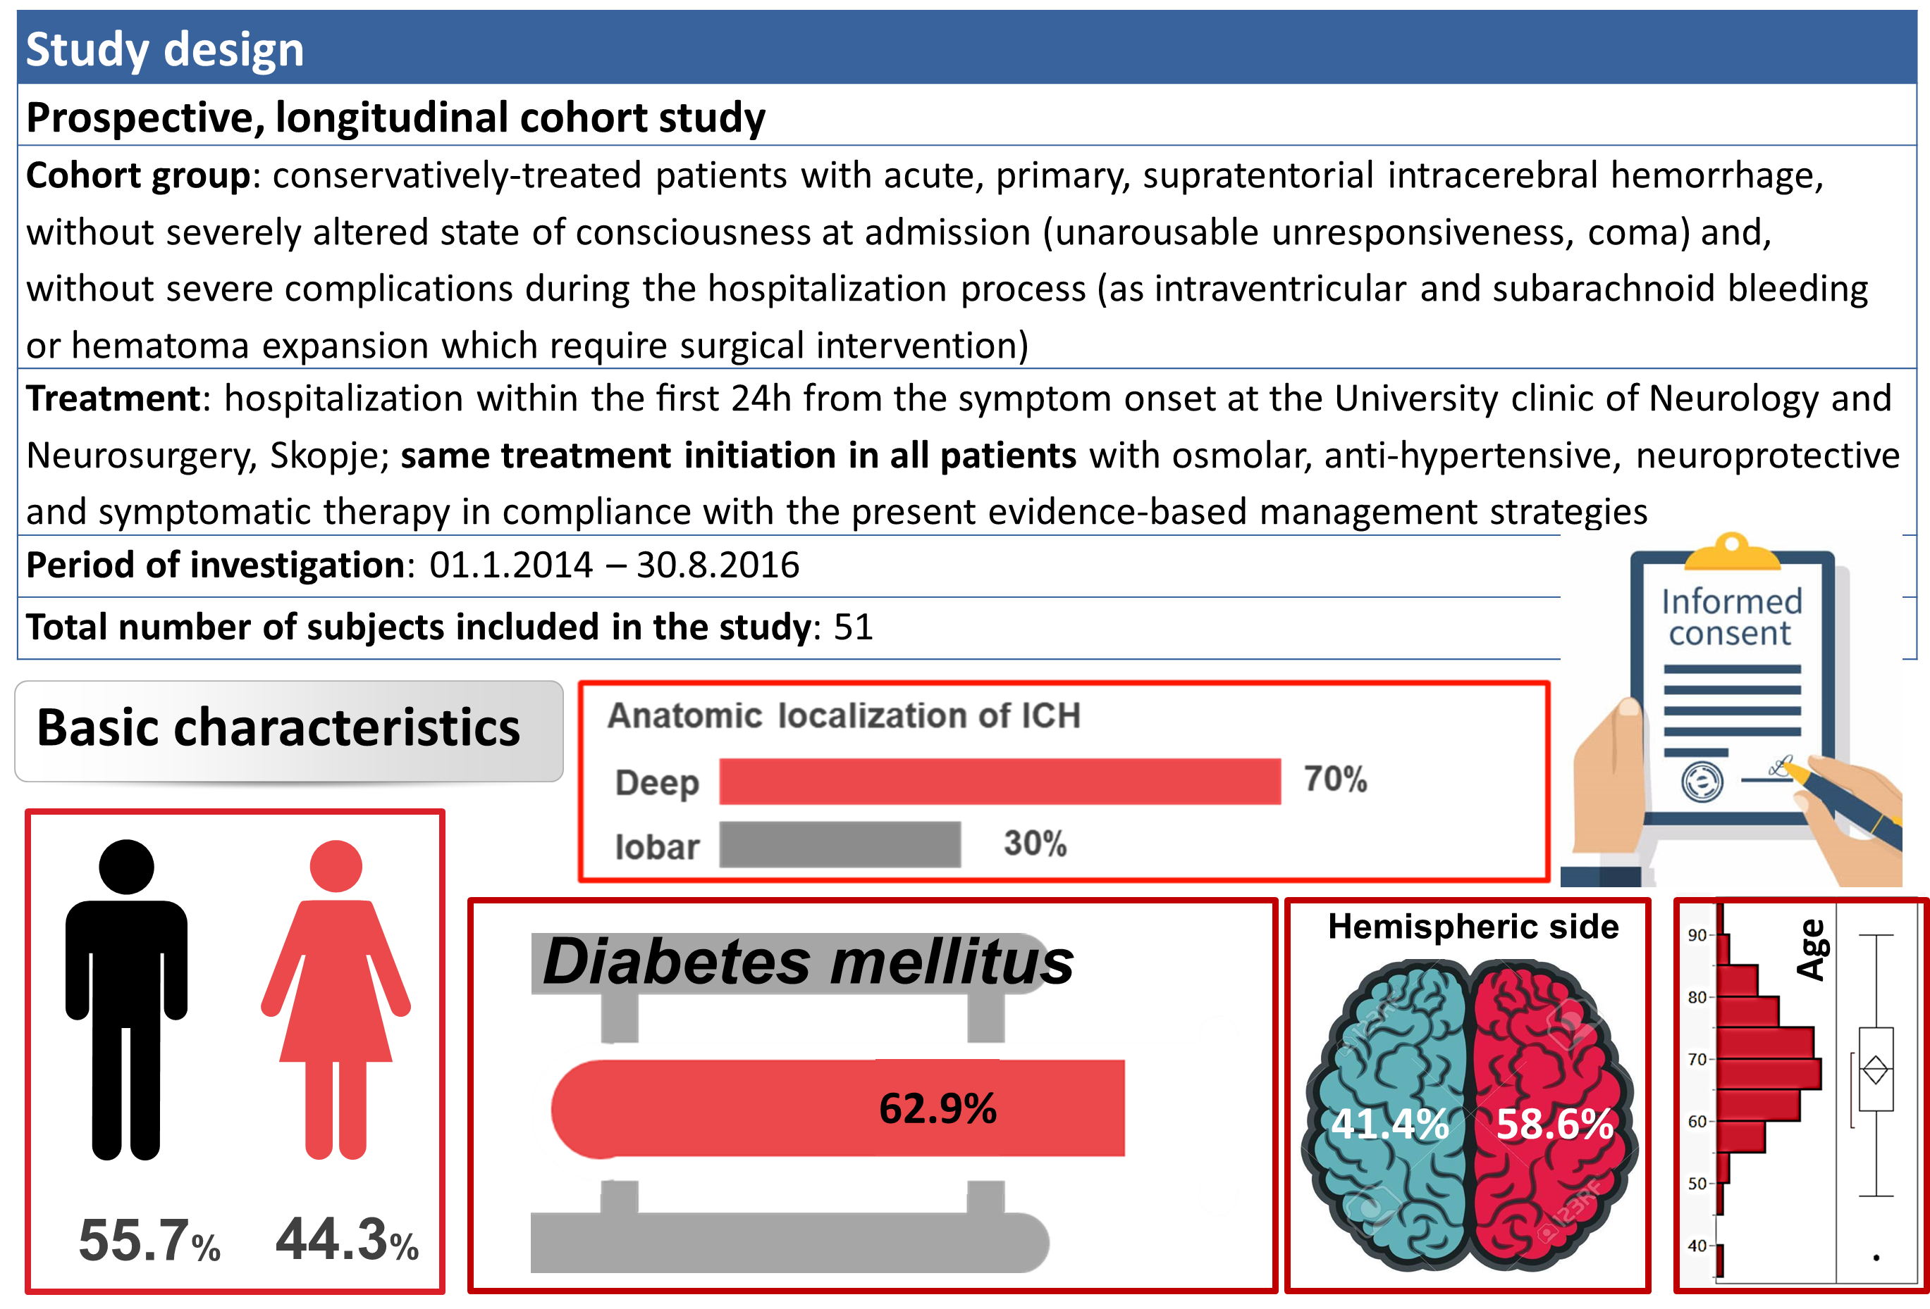

Slide 5

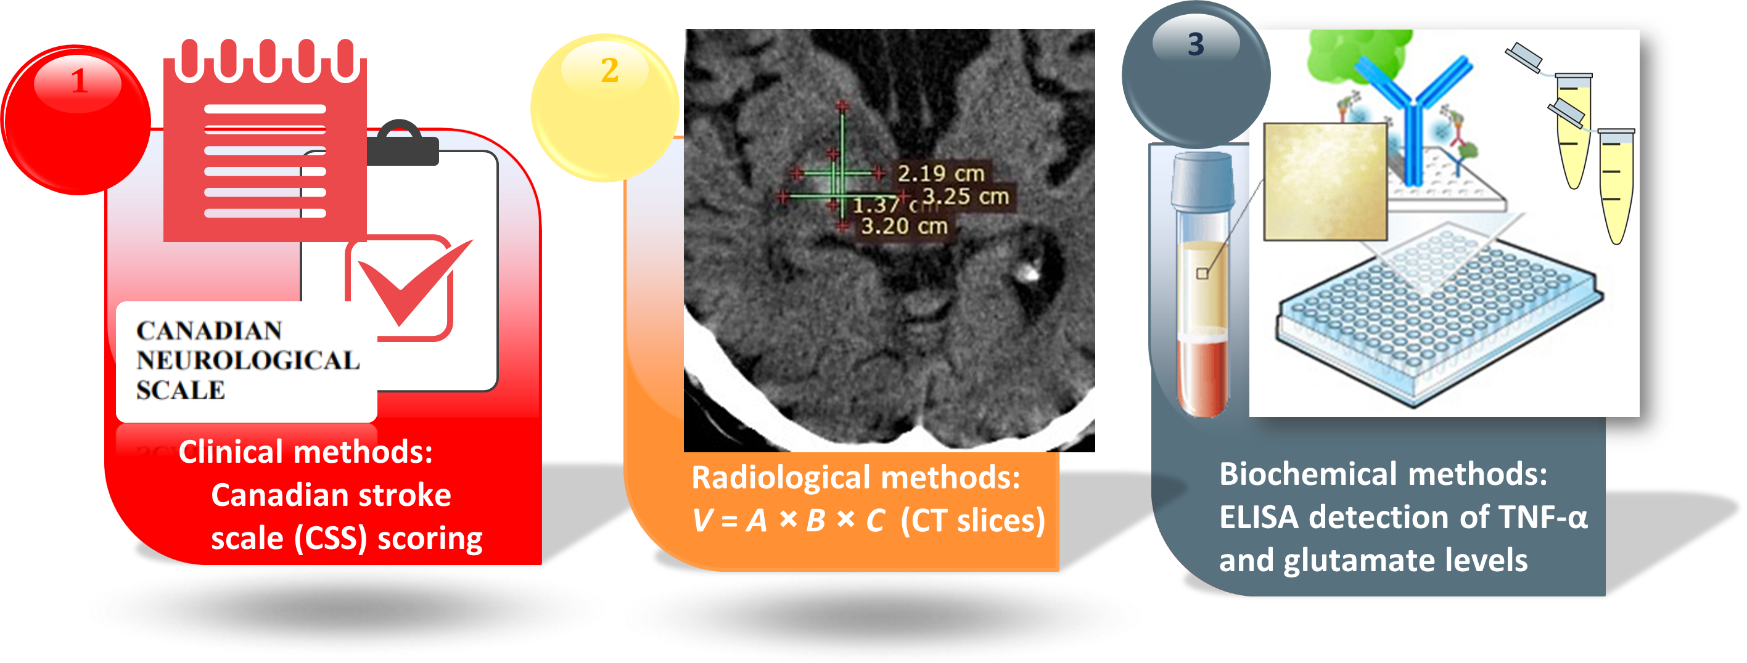
Comprehensive statistical approach, 3D modelling, edema quantification, estimation of significant predictive factors

Slide 6
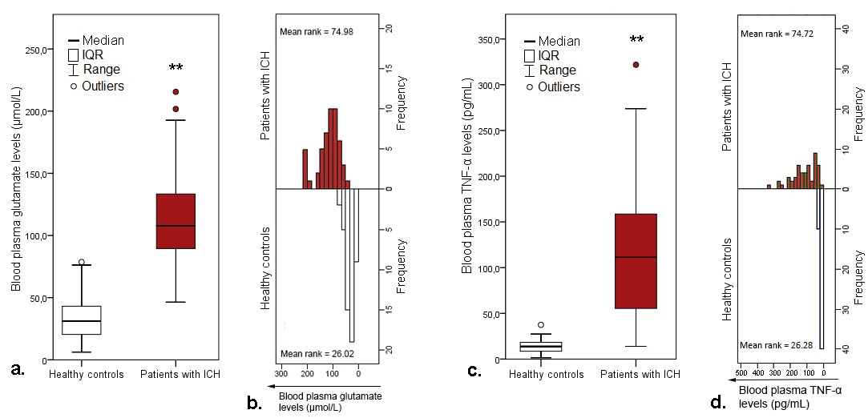

Patients with ICH have significantly higher blood plasma glutamate and TNF-a levels at admission
Very good separations of the values between the groups
The results stress the importance of these mediators in the pathology of the ICH

Slide 7
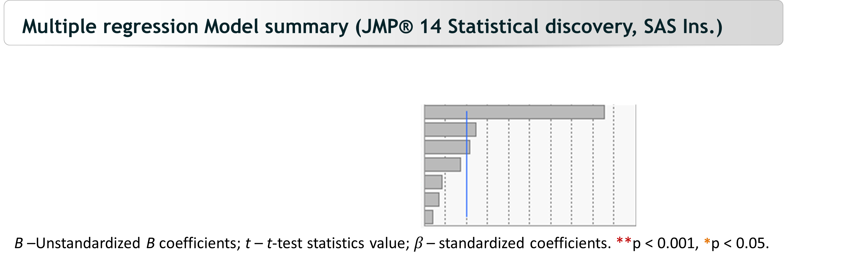
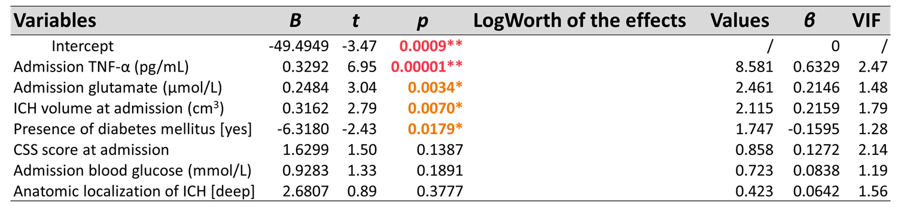
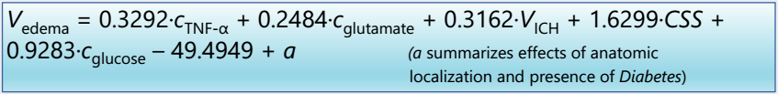
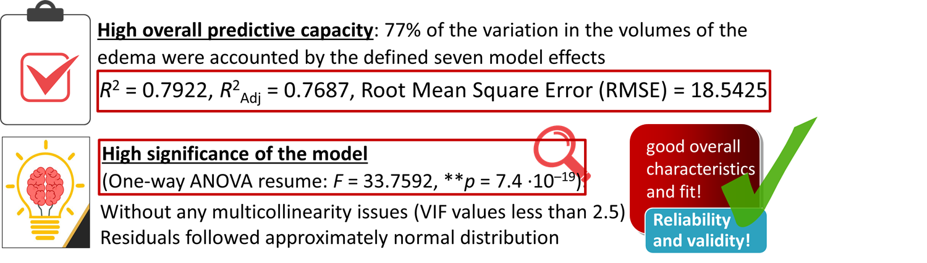
TNF-α with the strongest effect

Slide 8
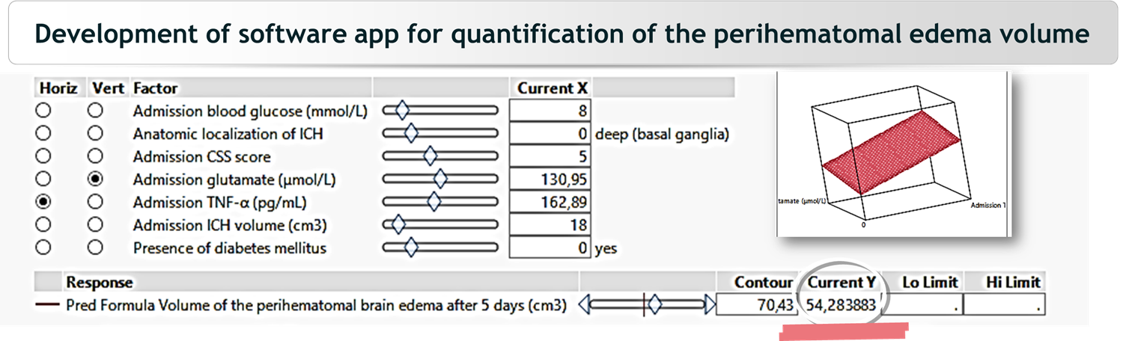
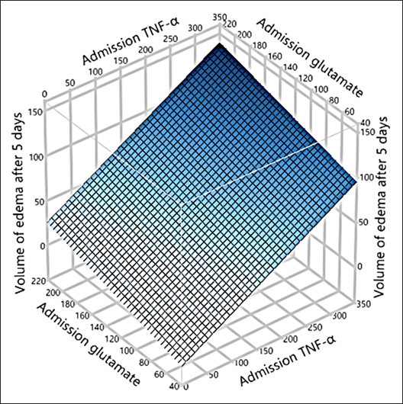
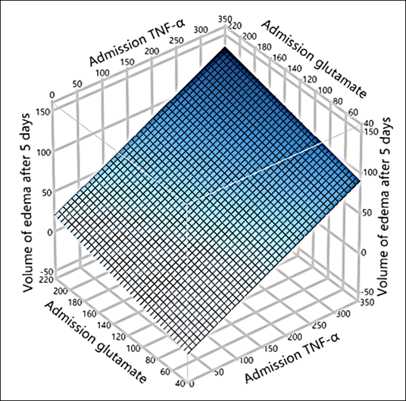


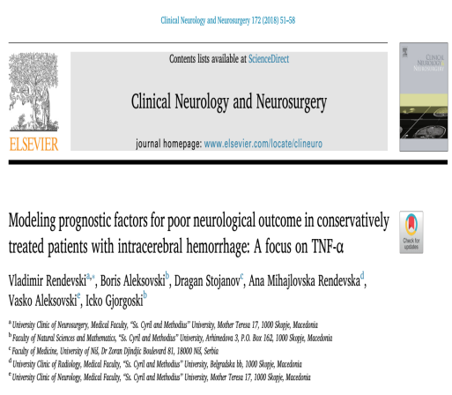

Slide 9
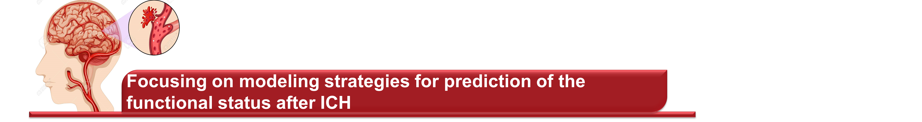



To predict the 3-month functional status (CSS scores), on the basis of admission biochemical, radiological and clinical variables
Variables | B coef. | t-test | P | LogWorth of the effects | Std Beta | VIF
Intercept | 2.6655 | 4.38 | <0.0001** | / | 0 | /
TNF-α levels | -0.5595 | -3.59 | 0.0009** | 3.068 | -0.5360 | 1.7658
Diabetes (yes) | 0.0840 | 1.79 | 0.0799 | 1.097 | 0.2145 | 1.1305
Glutamate levels | -0.4037 | -1.26 | 0.2129 | 0.672 | -0.1748 | 1.5092
Initial ICH volume | -0.1022 | -0.81 | 0.4197 | 0.377 | -0.1548 | 2.8533
Edema volume after 5 days | 0.0739 | 0.55 | 0.5879 | 0.231 | 0.1069 | 3.0275
Gender (male) | 0.0096 | 0.24 | 0.8121 | 0.090 | 0.0296 | 1.2072
the only significant predictive risk factor for functional disability (low CSS scores)
the highest effect size (LogWorth of the effects and the standardized Beta coefficients).

Slide 10

Model characteristics and fit
-a function for modeling of the neurological response after ICH, on the basis of the detected TNF-α levels at admission (R² = 0.862, adjusted R² = 0.859)
Prediction formula

Slide 11
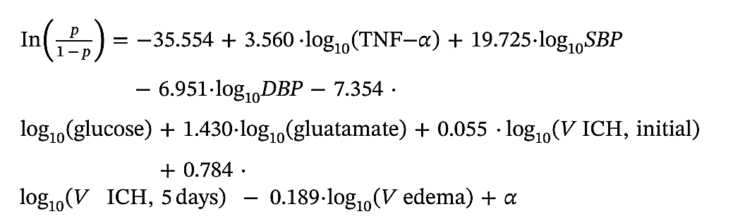


Prognostication of the neurological outcome after ICH: binary logistics
Probability function for poor outcome
Admission TNF-levels assessed as the only significant predictive risk factor for poor neurological outcome
Model with 82.6% sensitivity and 81.5% specificity and high discrimination power (ROC AUC = 0.841).
Increase of 1 unit of log₁₀(TNF-α) was associated with 35 times higher odds for poor outcome

Slide 12
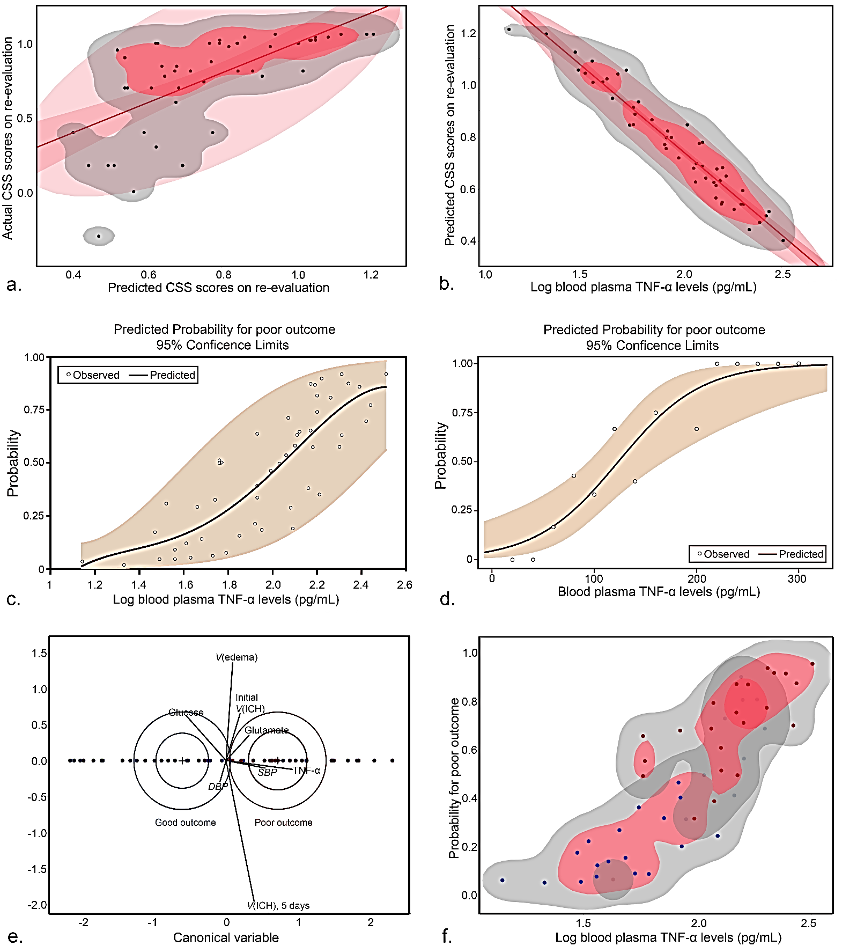
Modeling of the poor outcome after ICH as a response to the detected TNF-α levels at admission

Slide 13
The value of >110.35 pg/mL of the initial TNF-α levels at admission estimated as an optimal cutoff point associated with poor prognosis

Slide 14
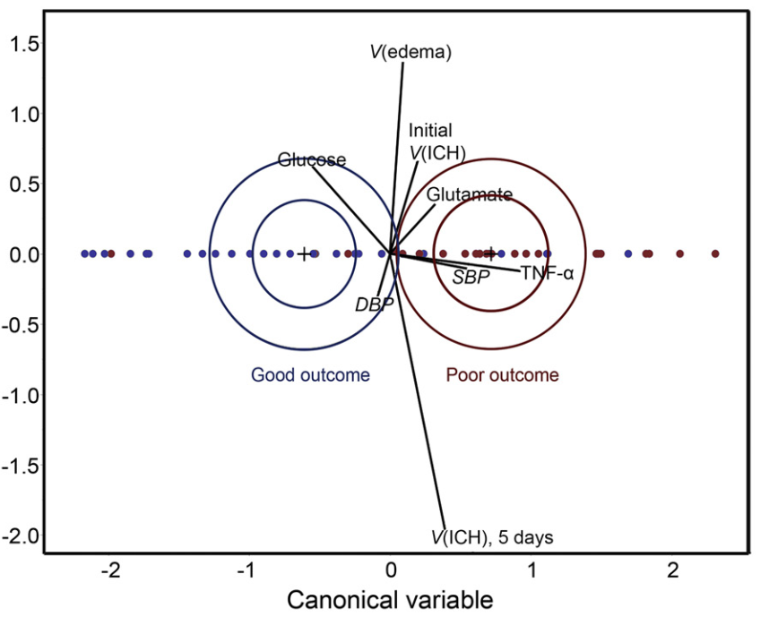


Canonical Discriminant Analysis
How well the radiological and biochemical markers included in our study can predict the neurological outcome after ICH?
TNF-α - AGAIN with highest canonical weight and the highest loading, showing a significant degree of positive association with the poor outcome.

Slide 15
Summary
Prognostic models mainly based on clinical evaluation, have remained inherently confounded by subjective scoring assessments and limited accuracy
In all of the constructed models, TNF-α was estimated as the only significant predictive risk factor, both in terms of prognostication of the functional status and the 3-month neurological outcome
TNF-α based models might be appropriate as a key component that assists more objective prognostication and management of patient’s care in clinical decision making, as rapid initial diagnosis and concentrated management are crucial for secondary prevention of further devastating neurological impairments after ICH.

Slide 16

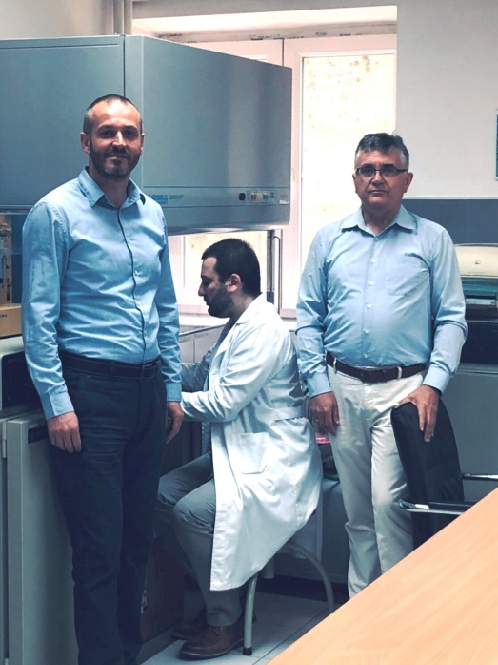

Contributors
Rendevski V.
Aleksovski B.
Caparoski A.
Filipce V.
Shuntov B.
Stojanov D.
Mihajlovska Rendevska A.
Aleksovski V.
Gjorgoski I

