Slide 1

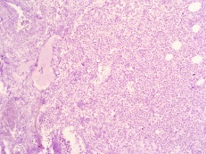
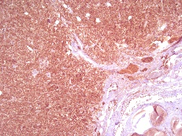
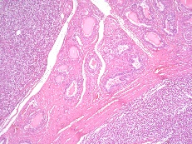
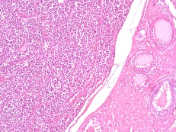
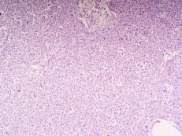
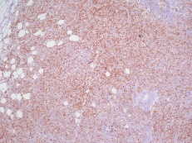
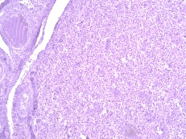
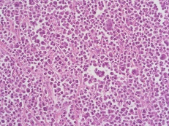
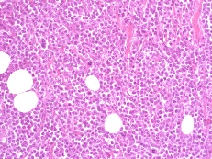
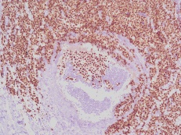
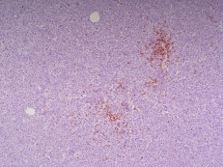
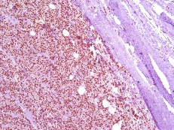
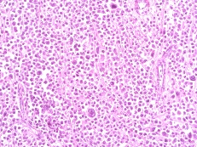
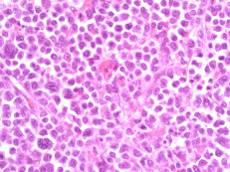
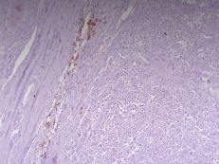

Case report:
Plasmacytoma of the testis as initial presentation of multiple myeloma
Tanevska Zrmanovska Aneta¹, Krsteska B.¹, Petrushevska G.¹
¹ Institute of Pathology, Faculty of Medicine, Ss Cyril and Methodius University, Skopje
Objectives:
Extramedullary plasmacytoma represents 5% of plasma cell neoplasms. Plasmacytoma of the testis is extremely rare and may occur as isolated tumor or in concomitance with multiple myeloma.
We report a case of testicular plasmacytoma in 77 year old male patient.
Methods:
The physical examination and ultrasonography revealed enlarged left testicle. Based on a clinical diagnosis, an inguinal orchidectomy was performed. On gross examination the testicle measured 7x4x4cm and was entire occupied by a solid white fleshy tumor. Formalin fixed, paraffin embedded tissue samples were stained with H&E (Fig.6-11) and immunohistochemically with CD138 (Fig.12), MUM1 (Fig.14), CD79 (Fig.13), CD3 (Fig.4), CD20 (Fig.5), CD117 (Fig.2), PLAP (Fig.1), OCT 3/4 (Fig.3) and Ki 67 (Fig.15).
Fig.1 PLAP x 10
Fig.12 CD138 x 5
Fig.2 CD117 x 10
Fig.13 CD79 x 5
Fig.6 H&E x 5
Fig.7 H&E x 10
Fig.3 OCT 3/4 x 10
Fig.14 MUM1 x 10
Fig.4 CD3 x 10
Fig.8 H&E x 20
Fig.9 H&E x 20
Fig.15 Ki 67 x 10
Fig.5 CD20 x 10
Fig.16 IgA x 10
Fig.10 H&E x 20
Fig.11 H&E x 40
Results:
Microscopic examination revealed a malignant neoplasm composed of atypical plasma cells with pale eosinophilic cytoplasm and polymorphic and polychromatic nuclei which diffusely obliterated underlying testicular parenchyma and infiltrating the epididymis and surrounding peri testicular fibrous tissue. Immunohistochemically the cells were positive for CD138 (Fig.12), MUM1 (Fig.14) and CD79 (Fig.13) and negative for CD3 (Fig.4), CD20 (Fig.5), OCT 3/4 (Fig.3), CD117 (Fig.2) and PLAP (Fig.1) with Ki67 (Fig.15) 80%. After period of two and half months the diagnose of multiple myeloma was established with bone marrow aspiration showed 60% plasma cells, flow cytometry with CD38 and CD138 (Fig.14) plasma cells and serum protein immunoelectrophoresis IgA idiotype (Fig.16). Patient died after two-week therapy with corticosteroids or four months after initiate diagnose of plasmacytoma of testis.
Conclusion:
Testicular plasmacytoma is extremely rare presentation of extramedullary plasmacytoma. Taking into account the additional data obtained about the patient we concluded that in our case it was the first manifestation of systemic disease referred as multiple myeloma. According to the revied literature of reported cases of solitary testicular plasmacytomas the majority were the IgA idiotype with incidence 46,7% opposite 25% cases in classical myeloma. Our patient presented with IgA idiotype, confirming the majority of cases with testicular plasmacytoma.

