Slide 1


ultrasound in pregnancy - opportunities and challenges for assessment of neurological development
Assistant professor Vesna Livrinova
University Clinic of Gynecology & Obstetrics, Skopje

Slide 2



“АУТИЗАМ И АДХД- ИСТРАЖУВАЊА, ИНОВАЦИИ И НАДМИНУВАЊЕ НА ПРЕДИЗВИЦИТЕ- МЕДИЦИНСКИ И РАЗВОЈНИ ПЕРСПЕКТИВИ”

Slide 3
Facts about developing human brain
the rate of about 250,000 nerve cells per minute
the brain's 100 trillion or so interconnections provide the physical basis for its speed and sophistication
does the genetic material of the fertilized egg already contain a full set of building specifications for the human brain?
the set of instructions is so closed and specific
? chance or random mutations
? the influence of the environment have played a role

Slide 4
ESSENTIAL STAGES
(1) proliferation of a vast number of undifferentiated brain cells
(3) aggregation of similar types of cells into distinct regions
(4) formation of innumerable connections among neurons, both within and across regions
5) competition among these connections, which results in the selective elimination of many and the stabilization of the 100 trillion or so that remain
(2) migration of the cells toward a predetermined location in the brain and the beginning of their differentiation into the specific type of cell appropriate to that location

Slide 5
Brain development seven stages:
Neurogenesis,
Cell migration,
Cell differentiation,
Cell maturation,
Synaptogenesis,
Cell death and pruning,
Myelogenesis

Slide 6
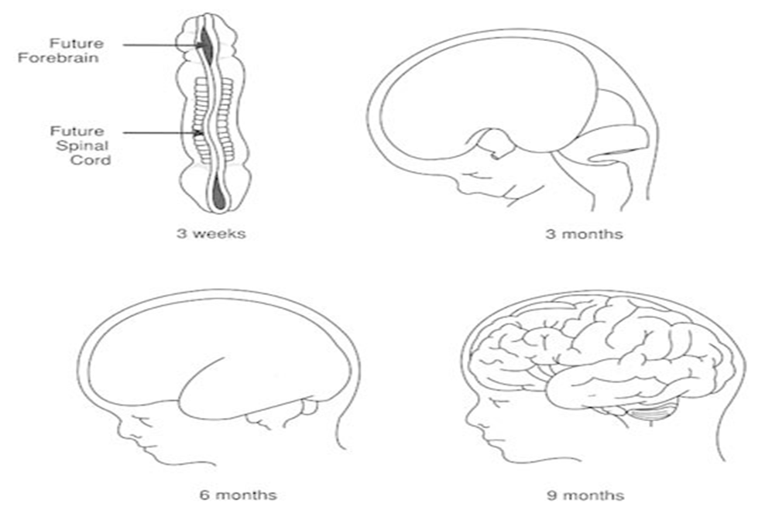
Facts about developing human brain
from 5 weeks after conception onward to about 18 months of age
no more neurons are added
the aggregation of cell types into distinct regions is roughly complete
the pruning of excess connections—clearly a process of great importance for the shape of the mature brain—continues for years
At about the midpoint of pregnancy
the number of brain cells in the cerebral cortex increases rapidly
by the seventh month, the fetus is emitting its own brain waves
the brainwaves that occur during sleep, controlled by the hypothalamus, begin occurring around week 28
when the developing brain suffers environmental insults
it shows a remarkable capacity to recover ,go on to develop normally, provided the harmful circumstances are corrected within the first 3 months or so after birth

Slide 7
The third trimester
is marked by the rapid development of neurons in the brain and explosive growth
The cerebrum will begin to develop grooves and ridges and separate into the left brain and right brain
The cerebellum is the fastest-growing part of the brain in the third trimester
This is the part responsible for motor control, move more, wiggling fingers and toes, stretching and kicking
the fetal sensory system shows integration and functionality during this period

Slide 8
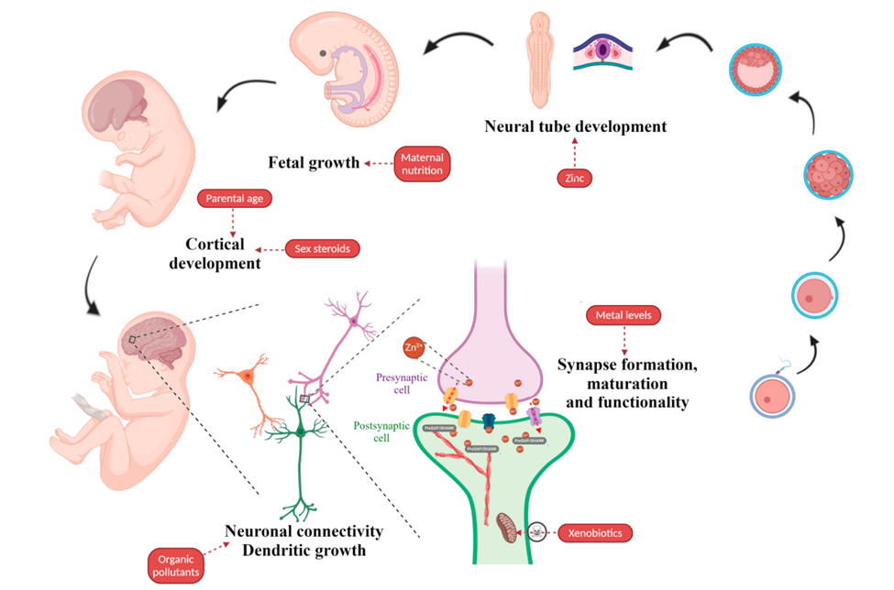

Slide 9
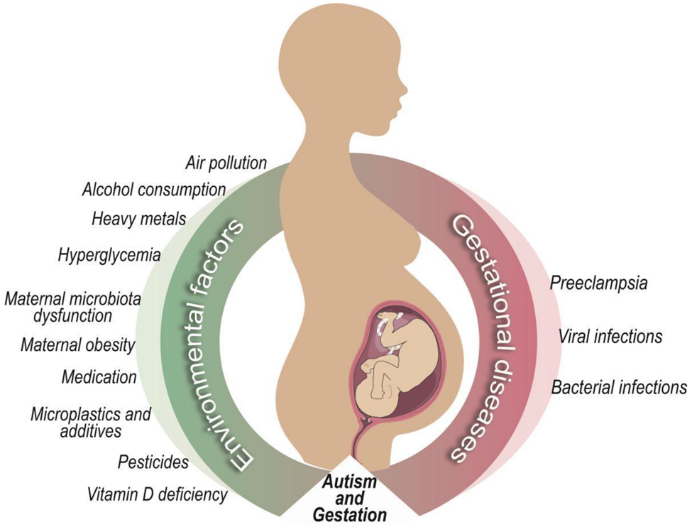
antidepressant and anticonvulsant

Slide 10
FACTs about ASD
Autism spectrum disorder (ASD) is a neurodevelopmental disorder that affects social
interaction and communication, with restricted interests, activity and behaviors
ASD is highly familial - genetic background strongly contributes to the development of this condition.-only a fraction of the total number of genes -focusing on synapse formation and functionality
parental conditions and in utero and perinatal factors may contribute to ASD etiology
epigenetic changes, including DNA methylation and micro-RNA alterations,-acting in concert to determine ASD onset.

Slide 11
FACTs about ASD
ASD appears to have a
multifactorial etiology to which developmental (in utero and early childhood), environmental and genetic aspects contribute, in as-yet unknown and different ways
has correlated advanced paternal age (APA) with the development of bipolar disorder, schizophrenia, ADHD and ASD
a 10-year increase in maternal and paternal age is associated with a 20%

Slide 12
Perinatal risk factors -the most studied ASD risk factors the most difficult to determine and predict in advance
caesarean section delivery, induced labor, management age less than 36 weeks and fetal distress
significant associations between ASD risk and umbilical cord complications
injury or trauma at birth, multiple births, maternal hemorrhage, low birth weight, neonatal anemia,
genital malformation, ABO or Rh blood group incompatibility and hyperbilirubinemia
examined 60 obstetric factors

Slide 13
ultrasound in pregnancy
4D sonography -the somatic and motor development of the fetus
has led to very important conclusions concerning fetal behavior
for the assessment of normal neurobehavioral development
4D ultrasound, by obtaining real time images, allows spatial observations of fetal face (e.g. smiling, crying, mouthing and blinking)

Slide 14
Fetal movement
It is known that fetal movements occur much earlier than the time that mothers can feel them, even during the embryonic period
The pattern, the quantity and the quality of fetal movements are growing rapidly throughout pregnancy, starting with gross, asynchronized movements of the whole embryo and leading to organized and detailed movements, as well as facial expressions toward the end of the pregnancy
to find the relationship of fetal behavior and developmental processes during specific periods of gestational age
in order to make possible the distinction between normal and abnormal brain development, and also to enable early diagnosis of various structural or functional abnormalities of the fetal nervous system

Slide 15
KURJAK ANTENATAL
NEURODEVELOPMENTAL TEST (KANET)
Timely diagnosis of brain impairment is the main reason
many studies regarding the anatomical and functional integrity of the fetal nervous system
understanding of fetal behavior
KANET is a new scoring system for the assessment of fetal neurobehavior

Slide 16
KANET SCORE
is based on prenatal evaluation of the fetus by 3D/4D ultrasound
scoring system is a combination of some parameters consisting of
fetal general movements (GMs)
postnatal Amiel-Tison Neurological Assessment at Term (ATNAT) signs
can be visualized prenatally by using 4D ultrasound

Slide 17
parameters incorporate in the KANET test
isolated head anteflexion, overlapping cranial sutures, head circumference
isolated eye blinking, facial alterations, mouth opening (yawning or mouthing)
isolated hand and leg movements and thumb position
Gestalt perception of
GMs (overall perception of the body and limb movements with their qualitative assessment)

Slide 18
KANET SCORE
KANET is a combination
of assessments of fetal behavior, GMs and three out of four
signs which have been postnatally considered as symptoms
of possible neurodevelopmental impairment (neurological
thumb, overlapping sutures and small head circumference

Slide 19
Standardization of KANET TEST
KANET test was standardized in Osaka, Japan on the 24th of October 2010
in order for the test to become reproducible and easily applied by fetal medicine reproducible and easily applied by fetal medicine
reproducible and easily applied by fetal medicine
According to the Osaka Consensus Statement
the KANET should be performed in the 3rd trimester of pregnancy, between 28 and 38 weeks

Slide 20
Performing kanet test
The duration of the examination should be between 15 and 20 minutes
fetuses should be examined while they are awake
fetus is in the sleeping period; the assessment should be postponed for 30 minutes or for the following day
At a minimum period of 14 to 16 hours

Slide 21
Performing kanet test
In cases of grossly abnormal or of borderline score, the test should be repeated every 2 weeks until delivery
Special attention should be paid to the facial movements and to eye blinking
which are prenatally very informative and important
‘the face is the mirror of the brain’
The frequency of facial and mouth movements should be 0 to 5 and more than 5

Slide 22
8 KANET parameters
isolated anteflexion of the head
facial expressions–grimacing, tongue expulsion,–
isolated hand movements, hand to face movements, fist and finger movements
GMs
Comparison of KANET and ATNAT moderate correlation
eye blinking
mouth movement such as yawning, jawing, swallowing

Slide 23
conclusion
these preliminary results were promising and stated that
further studies are needed before the test could be
recommended for wider clinical practice
One of the greatest challenges of obstetrical ultrasonography
is the better understanding of fetal neurological function
Neurological problems, such as CP are poorly understood
and often falsely attributed to intrapartum events, while for
the majority of CP cases it has been proven that the causative
pathway starts long before delivery

Slide 24

Kanet score

Slide 25
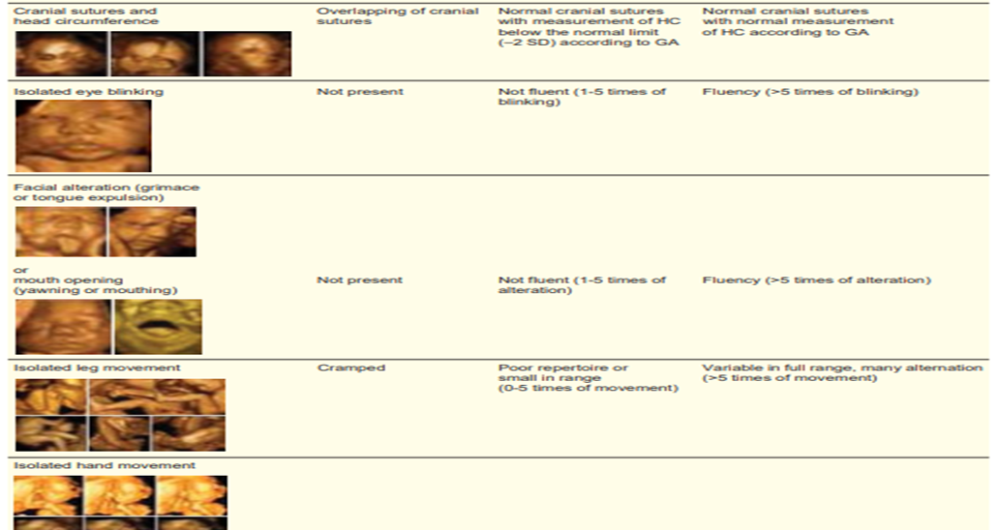

Slide 26
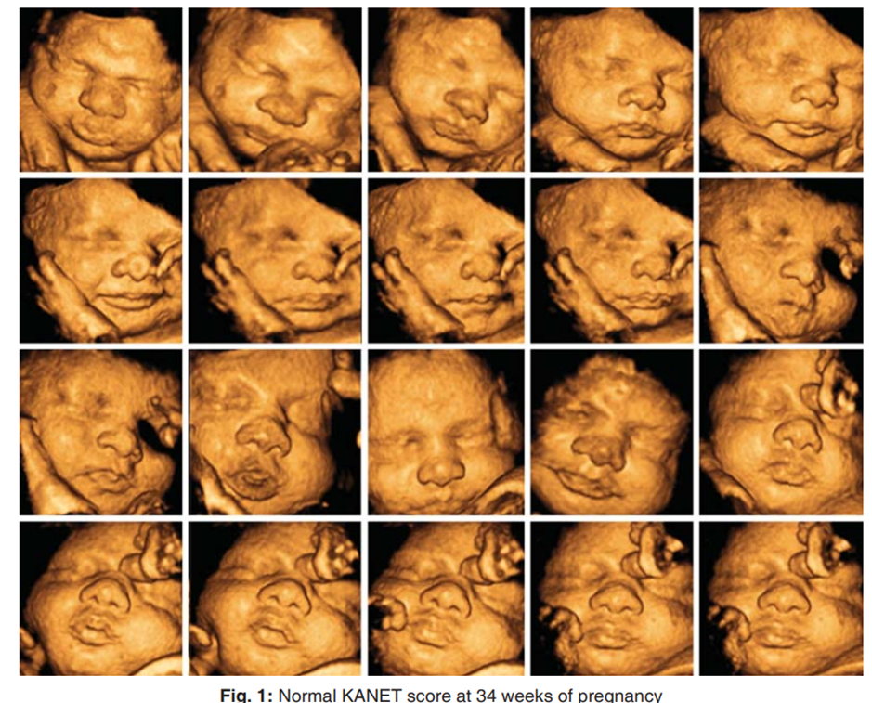

Slide 27
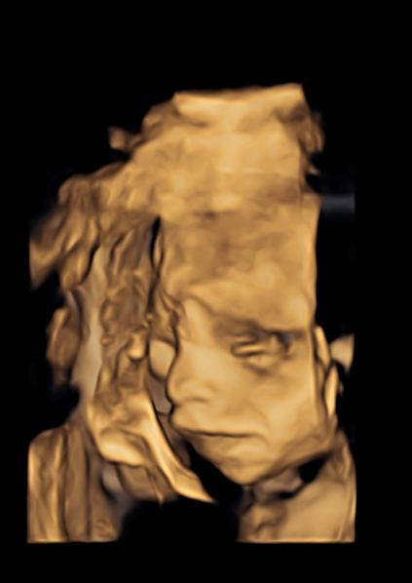
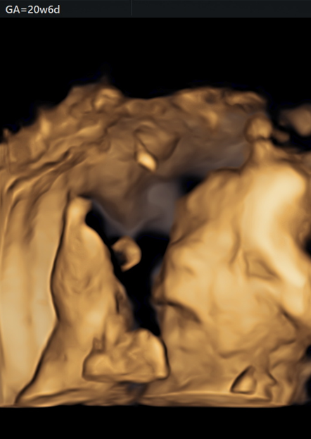
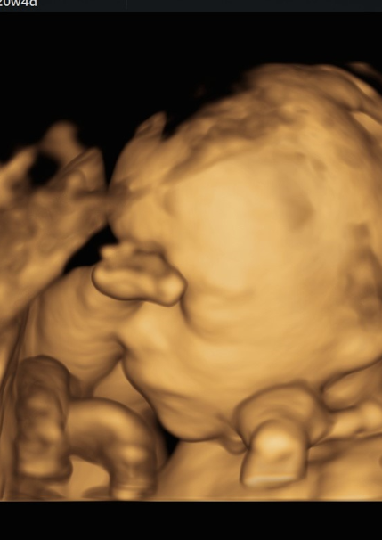
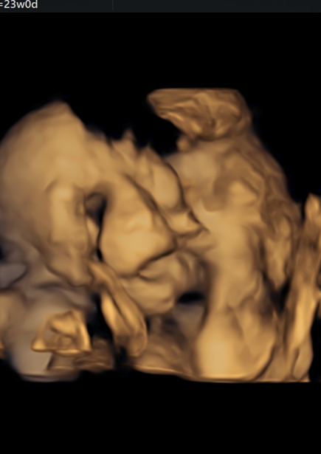

Slide 28
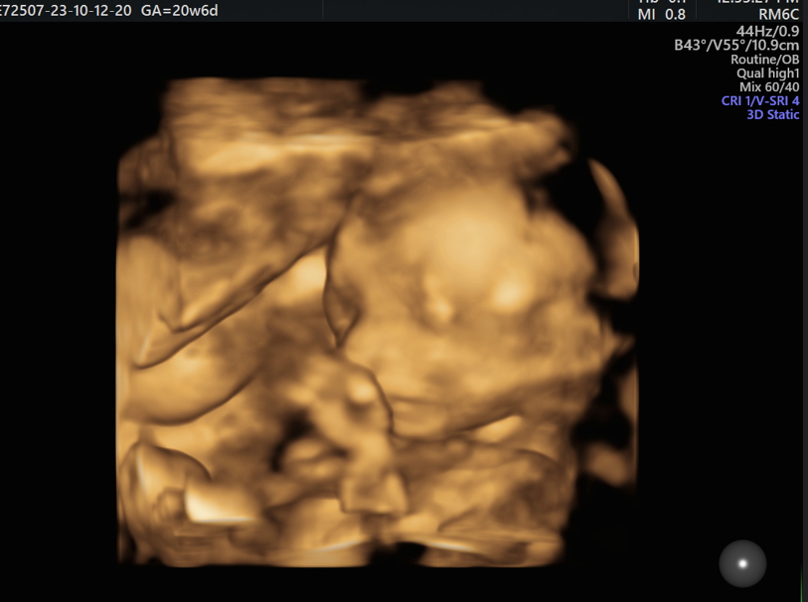
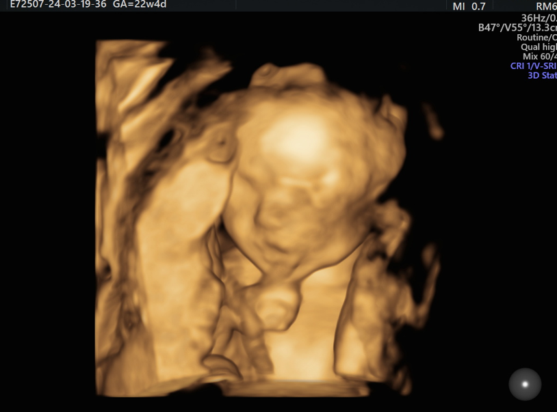

Slide 29



