Slide 1
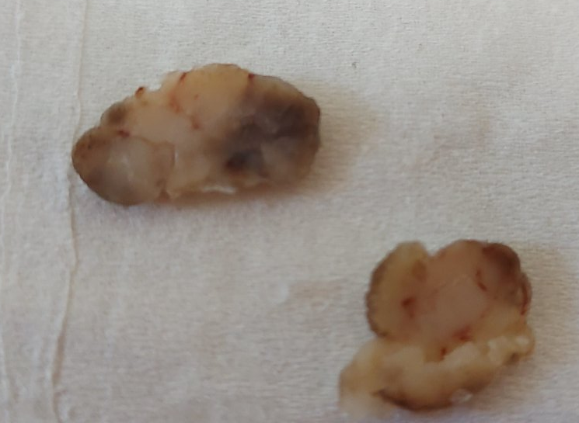
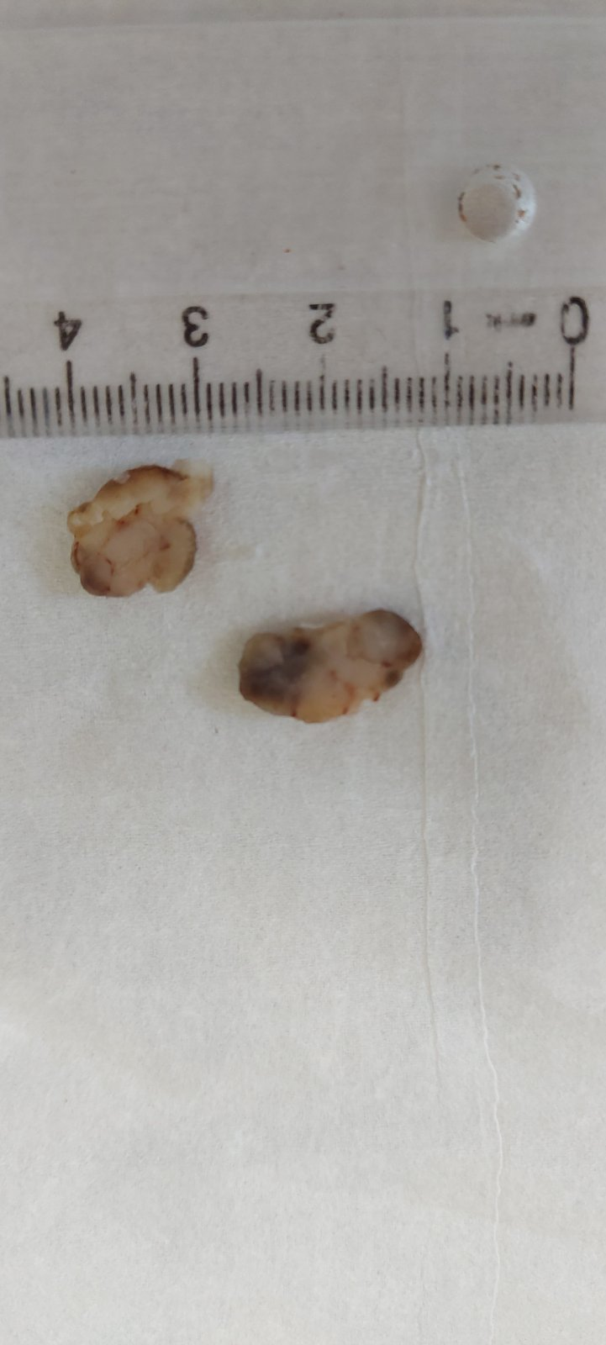
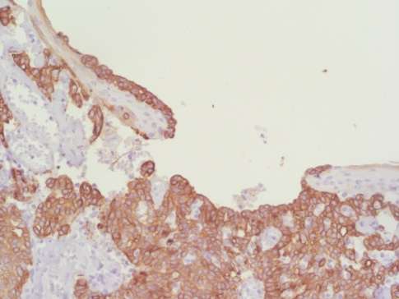
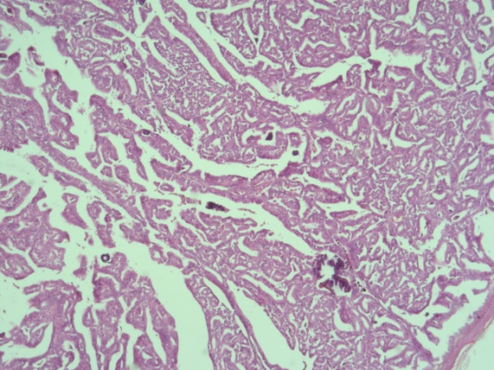
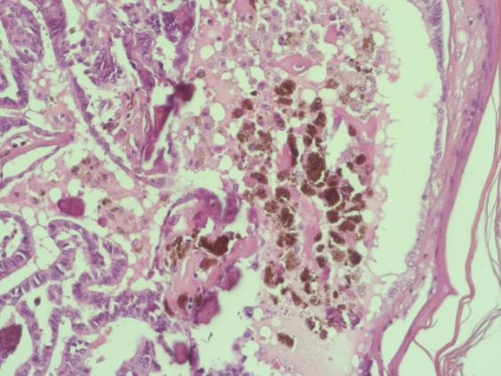
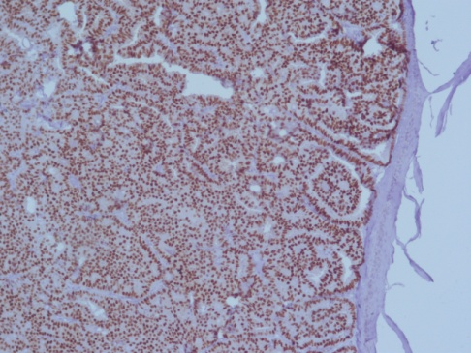
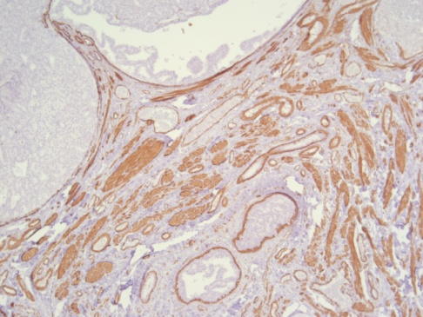
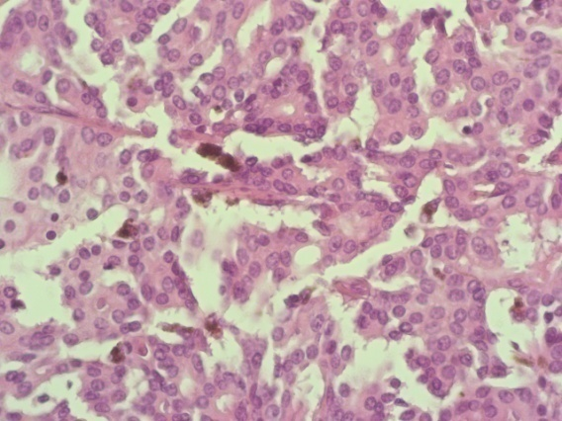
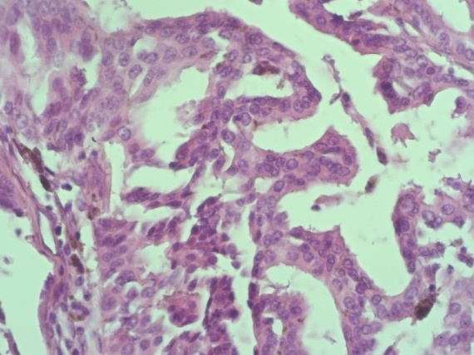




Tumor cells were positive for CK7, with strong and diffuse nuclear stain for ER, with complete absence of myoepithelial cell on SMA stain. Melan A and S-100 were negative. Although rare, a diagnosis of pigmented papillary carcinoma was made.
Pigmented papillary carcinoma of male nipple mimicking melanoma
Blagica Krsteska, Boro Ilievski, Rubens Jovanovic, Gligor Ristovski, Slavica Kostadinova-Kunovska
Institute of pathology, Faculty of Medicine, University „Ss. Cyril and Methodius“ in Skopje, North Macedonia
BACKGROUND & OBJECTIVES
Melanoma in nipple-areola complex is extremely rare and in differential diagnosis must be distinguished between Paget disease, melanoma from extramammary sites and invasive carcinomas. We present a case of invasive papillary carcinoma of male nipple with melanin laden tumor cells.
A 71-year old male patient presents with lobulated grayish tumor of the right nipple measuring 2x1,3cm elevated above the skin surface 1cm. The lesion was surgically removed with skin excision 0,7x0,5x0,5cm. The specimen was formalin-fixed and paraffin-embedded, routinely stained with hematoxylin and eosin. Additional immunohistochemical analysis was performed with CK7, ER, SMA, S-100, and Melan A.
Figure 1. Gross specimen
CK7
CONCLUSION
Pigmented carcinomas of breast are rare. When they are localized in areolar region the diagnosis should be carefully made to exclude lesions with melanocytic differentiation.
The pigmentation should be considered also as a result by proximity to epidermis.
The distinction between benign and malignant papillary lesions is quite difficult in most cases.
The prognosis of patients with solid papillary carcinoma is relatively favorable.
METHODS
ER
Figure 2. Papillary architecture and microcalcificationas
Figure 3. Subepithelial melanophages
RESULTS
The gross specimen on cut surface revealed solid, white to brown tumor, well demarcated at the base and ulceration of overlying epidermis. (Figure 1)
Histomorphology:
  papillary structures with tall columnar cells overlying fibrovascular cores
  micropapillary formations
  areas of solid and cribriform growth pattern
  microcalcifications were diffusely present. (Figure 2)
There were accumulated melanophages in subepithelial tissue and melanin granules were also found in tumor cells. (Figure 3, 4)
SMA
CONTACT
Figure 4. Melanin granules in tumor cells

