Slide 1
Asthma in adolescents, consequences of transition from pediatric to adult pulmonology
Oliver Zafirovski, Deska Dimitrievska, Marija Zdraveska
PHI University Clinic of Pulmology and Allergy – Skopje
Medical faculty, UKIM, Skopje, Macedonia

Slide 2
Asthma is a complex,
heterogenous medical condition
which is very common in children and adults.

Slide 3
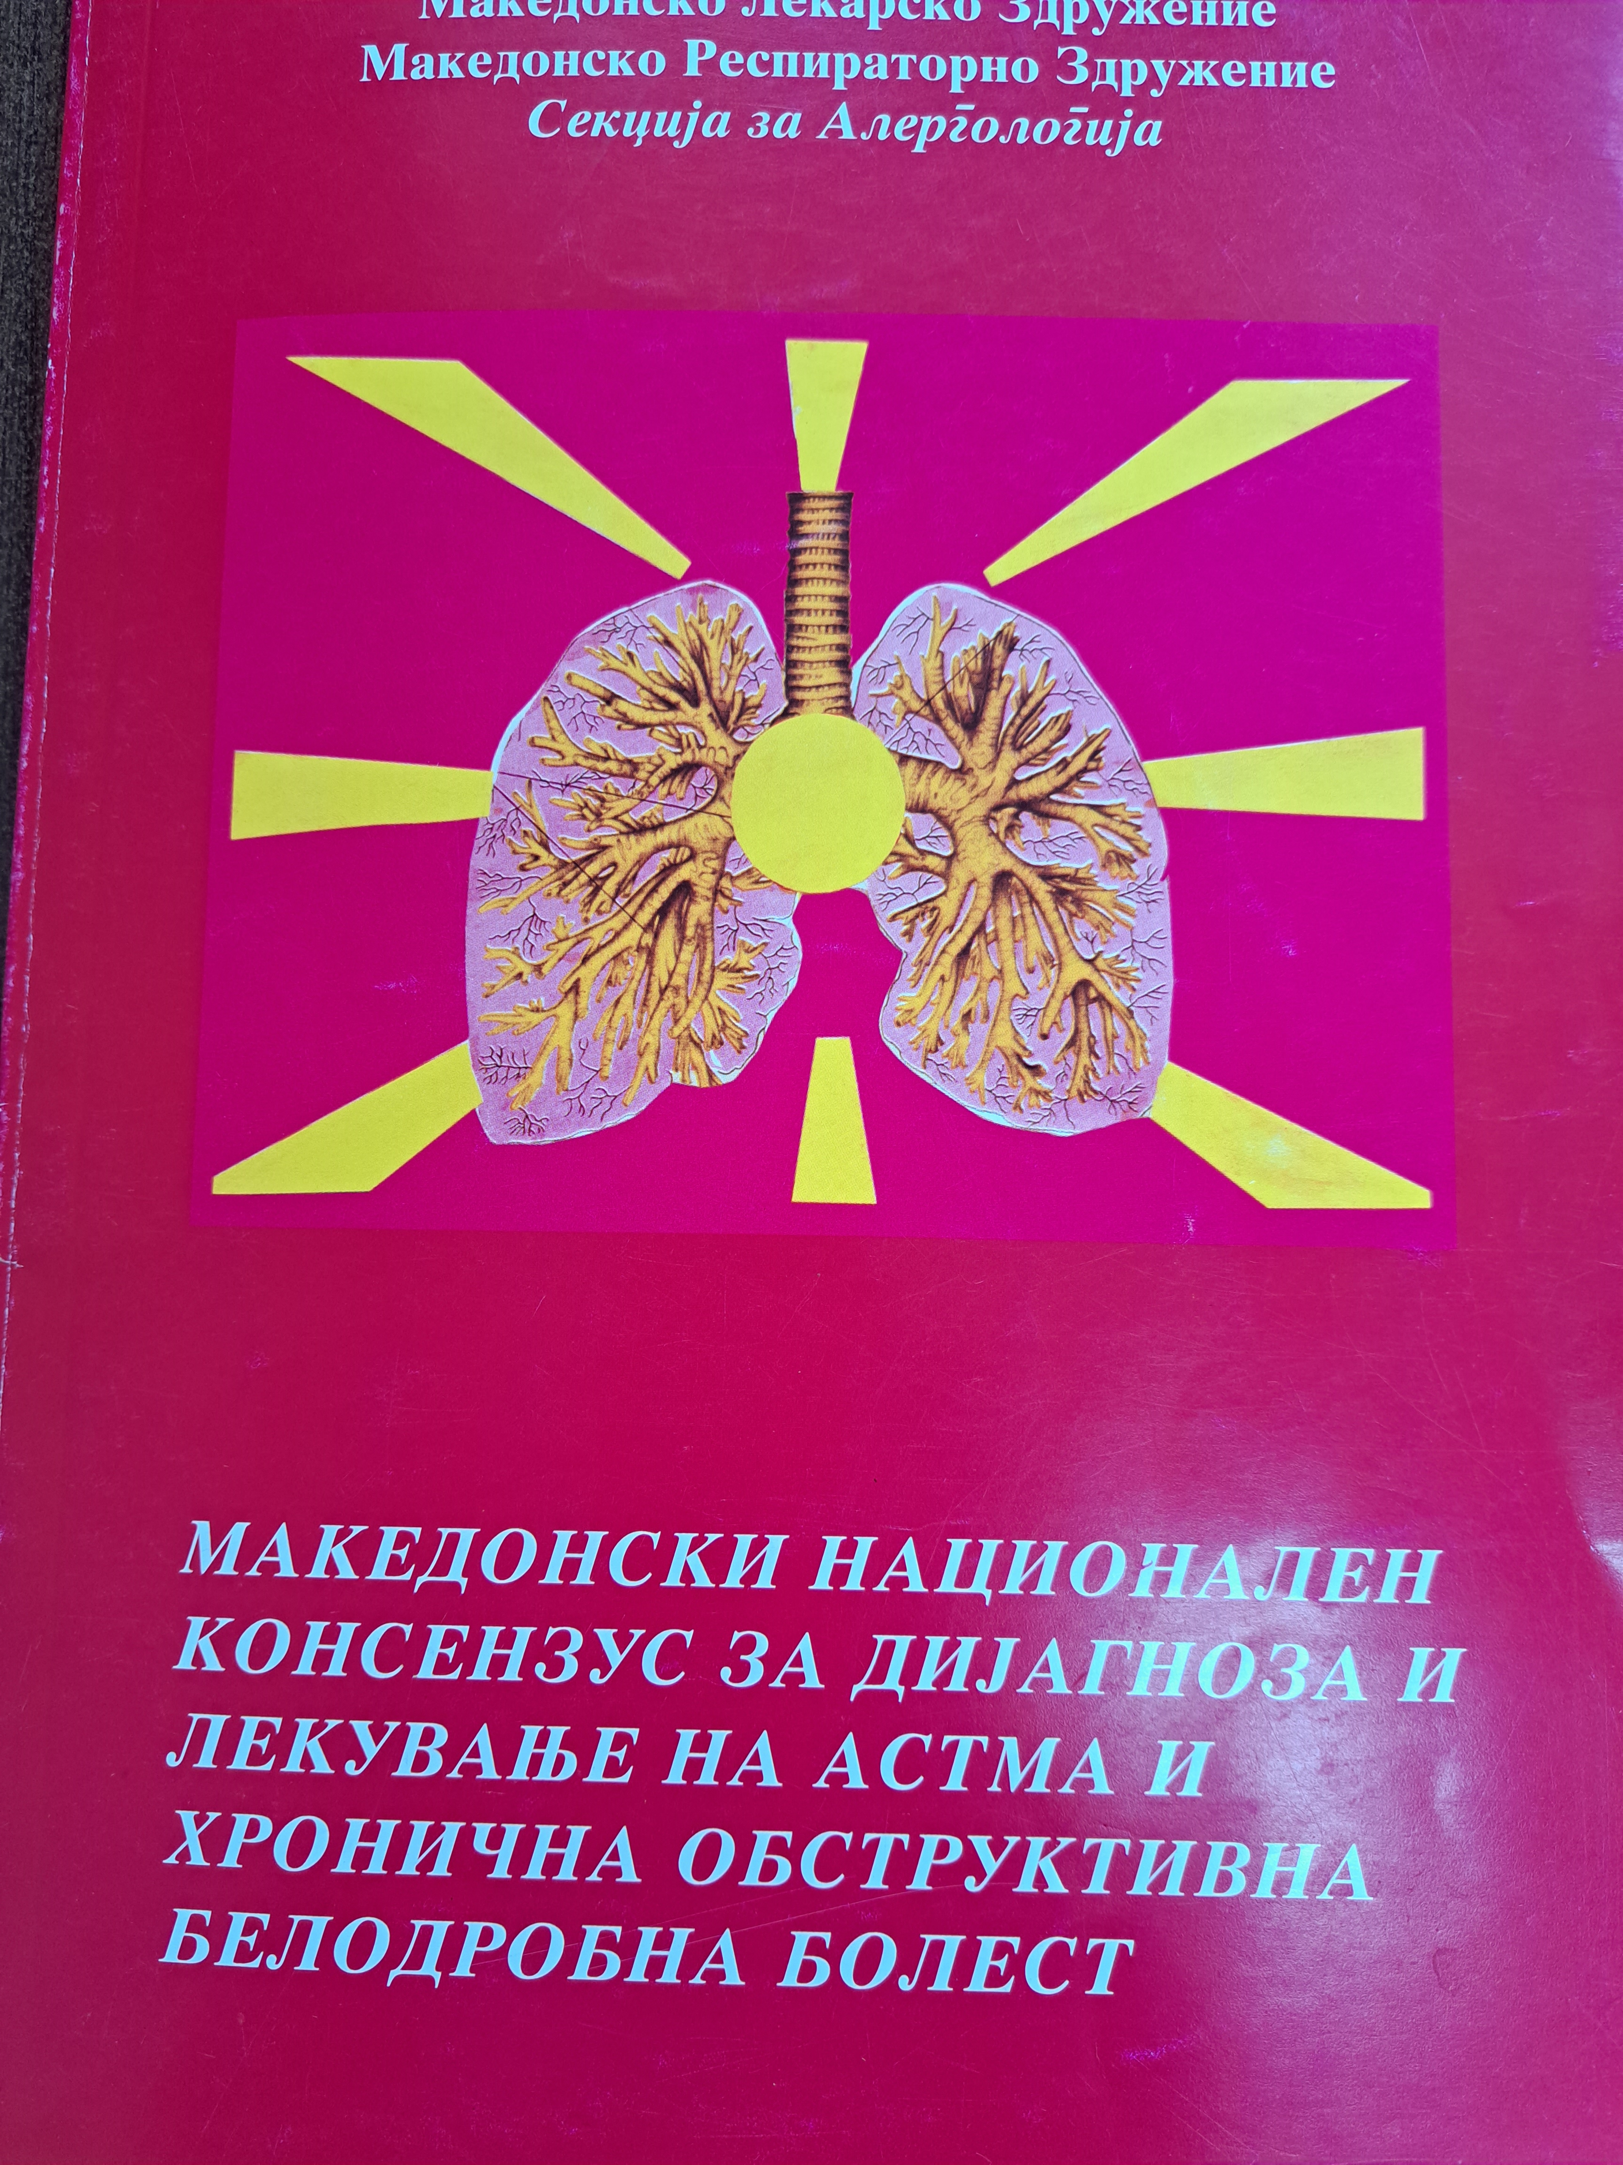
Epidemiology (1-29% GINA-2023)
Asthma is the most common chronic medical condition in children, affecting over 7 billion children in the
United States of America and about 300 million people worldwide. The number of deaths annually related
to asthma is about 400,000.
Most asthma-related deaths occur during asthma exacerbations. The mortality associated with asthma exacerbations
highlights the importance of studying asthma and the conditions that limit its occurrence.
Macedonia
Registry of patients with asthma……..No
Total noumber of diagnosed …………..No
Prevalence: - 3.8% WHO
- 4% (Prof. Gjorcev 1999)

Slide 4
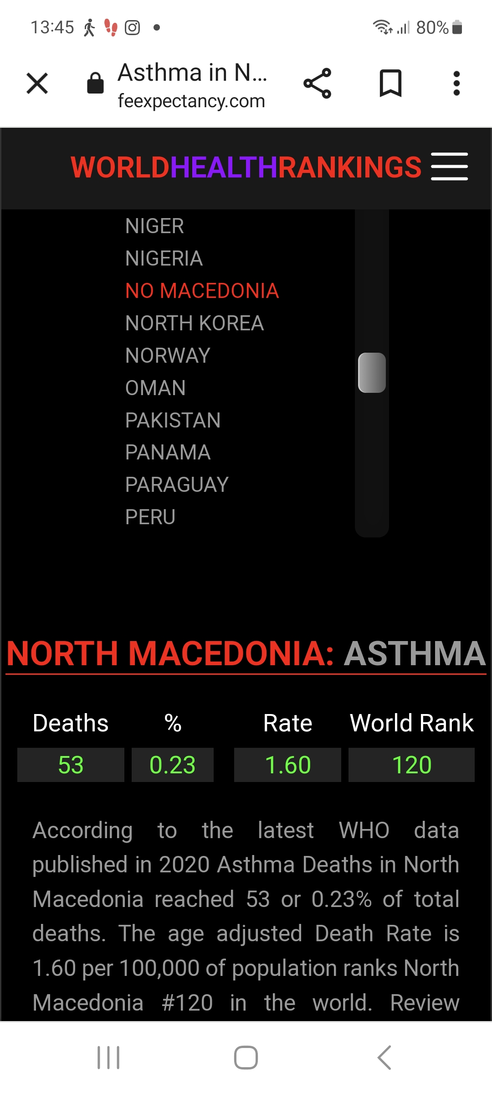
Asthma mortality
Lethal outcome occurs during
Exacerbations
Globaly 400 000/year
Macedonia 53/year

Slide 5
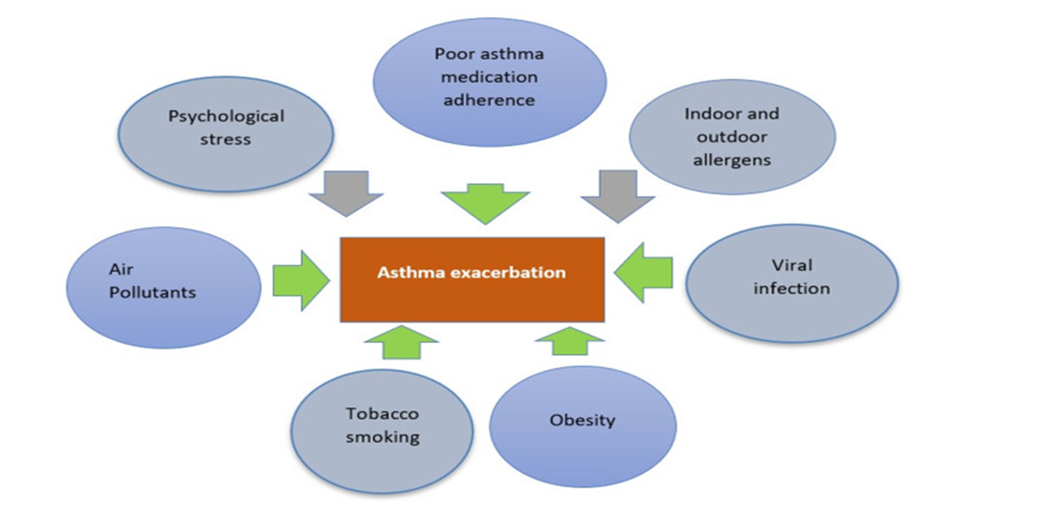

Slide 6
Definition
The World Health Organization (WHO) defines adolescence to be within the
ages of 10 and 19 years whilst others propose a more extended length of
10–24 years a more accurate representation .
Certainly, adolescence embodies young adulthood and a challenging time
of transition, marked by the pursuit for independence and autonomy with
transformations in social, emotional, and physical domains.
Ownership of health and self-care sharpens into focus,
becoming a greater priority.

Slide 7
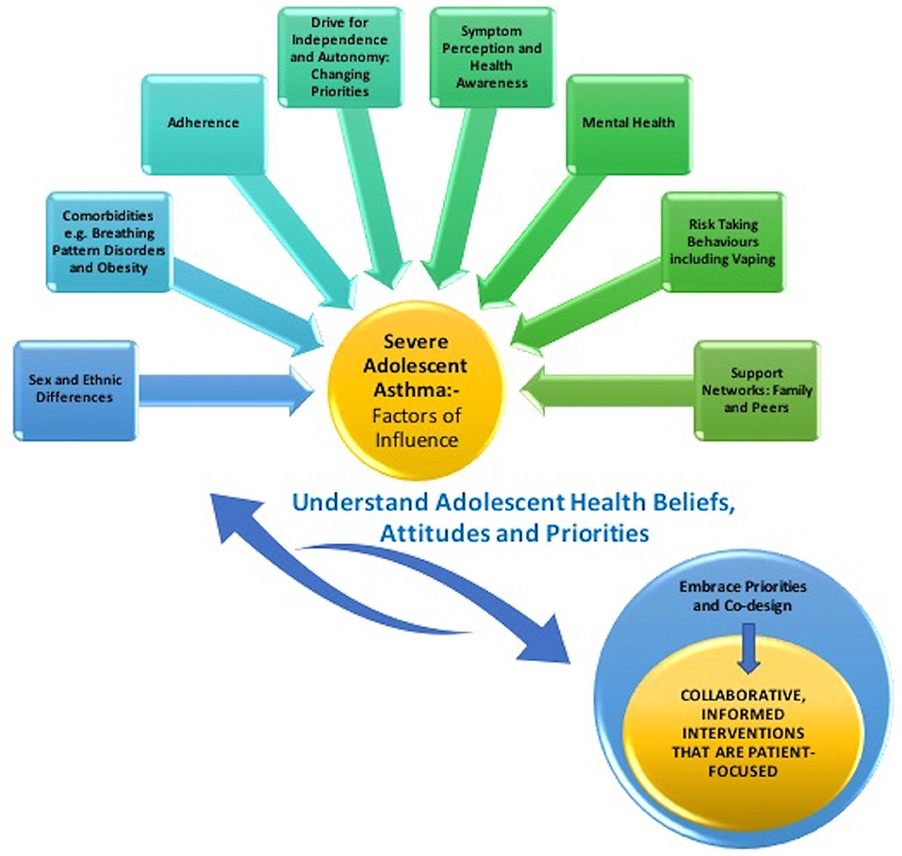

Slide 8
Factors that affect transition:
Nature of the diseases
Adolescent years of the patients
Patient’s parents
Health providers

Slide 9
Nature of the diseases
Adolescence is a time where asthma may change significantly.
Longitudinal studies of adolescents and young adults have demonstrated that bronchial hyperreactivity
as a child is a strong predictor of persistence of asthma in adult life.
Interestingly, the higher incidence of asthma in boys compared to girls tends to reverse after adolescence with
asthma becoming more common in women than men.
This may be related to male sex being a risk factor for late onset atopy and female sex a risk factor for later
onset bronchial hyperreactivity,
Remission of asthma can occur during adolescence , with some reporting that “most” children have remission
in adolescence and early adulthood,
Between 3–5% of people who wheeze in childhood continue to wheeze as adults,
Other groups have demonstrated that persistent asthma in adulthood was associated with lower lung function
in childhood, persistence of airway hyperresponsiveness, atopy by the age of 13 .
Asthma which has resolved in childhood may relapse later in life, even if asymptomatic as adolescents or young
adults.
Relapse of symptoms in adulthood was associated with smoking (particularly in those who were not atopic),
asymptomatic airway hyperresponsiveness at 13 years of age and atopy.
- In severe asthmatic adults, 69% reported asthma symptoms were present before the age of 20 years

Slide 10
Adolescent years of the patients
Why can adolescence be a challenging time for asthma? ● Hormonal changes: Hormones may affect asthma control especially around puberty. ● Increased physical activity: Many teens are involved in sports or other physical activities.
Exercise is often a trigger for asthma flare-ups. ● Social pressures: Some teens may feel embarrassed about using an inhaler in front of friends,
which can lead to skipping doses or downplaying symptoms. ● Learning self-management: This is the transition period where adolescents are expected to
have more responsibility for their health. Understanding medication schedules and avoiding triggers
are essential components of asthma management

Slide 11
Patient’s parents

Slide 12
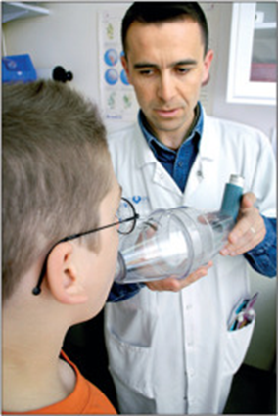
Health providers

Slide 13
Guidelines
In 1993 the Society for Adolescent Medicine published standards of care for transition,
the goals being to provide a transition process that was coordinated, uninterrupted,
psychosocially sound, developmentally appropriate, and comprehensive
In 2011 the American Academy of Pediatrics (AAP) with endorsement of the American Academy of
Family Physicians (AAFP) and American College of Physician (ACP) published a clinical report that described
preparation for transition, the process of transition and tracking of transition as well as appropriate follow up
post transition
This document was updated in 2018.
The purpose of these documents was to highlight the importance of planning for transition and to provide
a framework or model for transitioning adolescent and young adult patients from pediatric to adult care in
a standardized and effective manner.

Slide 14
Main points
Importance of transition being youth focused
Emphasis on self-determination, self-management and family/caregiver engagement
Acknowledging individual difficulties and complexities
Recognizing vulnerabilities and the need for a population health approach
Importance of shared accountability and care co-ordination between pediatric and adult centers
Recognition of the influence of cultural beliefs, attitudes and socio-economic status
Emphasis on achieving health equality, eliminating disparities
Parents/caregivers to support young people to develop health knowledge and skills.

Slide 15
Conclusions
Asthma is a complex, heterogenous medical condition which is very common in children and adults.
Transition is “the purposeful, planned movement of adolescents and young adults with chronic physical and
medical conditions from child-centered care to adult-oriented health care systems”.
The significant changes in physical and mental health during this time, as well as the many unique developmental
and psychosocial challenges that occur during adolescence can complicate and impede transition if not adequately
addressed and managed.
A successful transition, with minimal consequences, can only be achieved with
the continuous cooperation of pediatric and adult pulmonologists.

