Slide 1
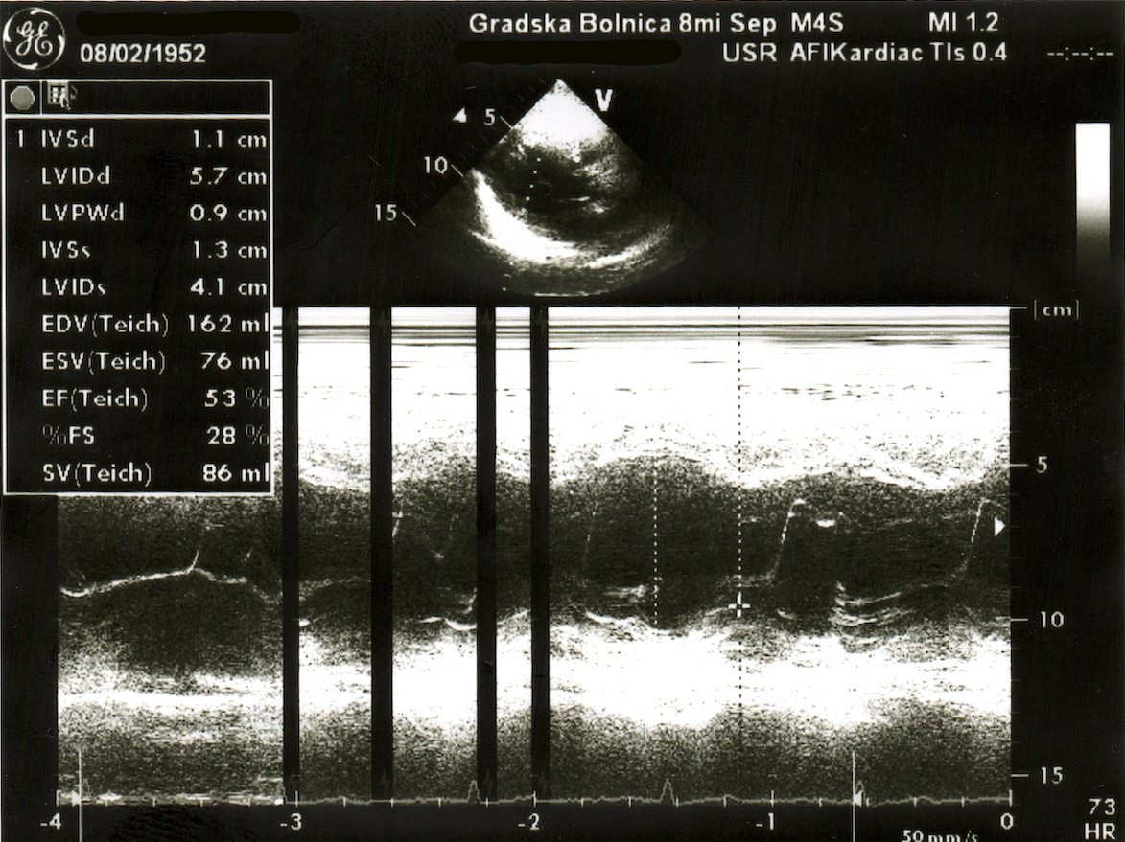
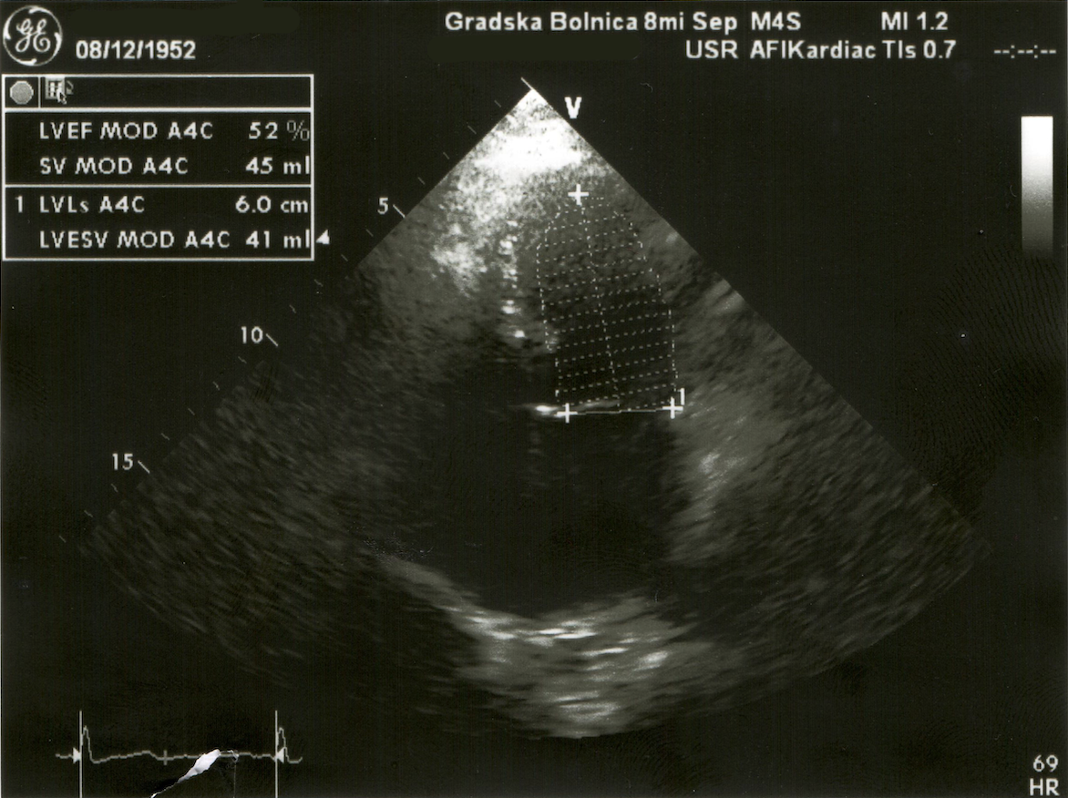
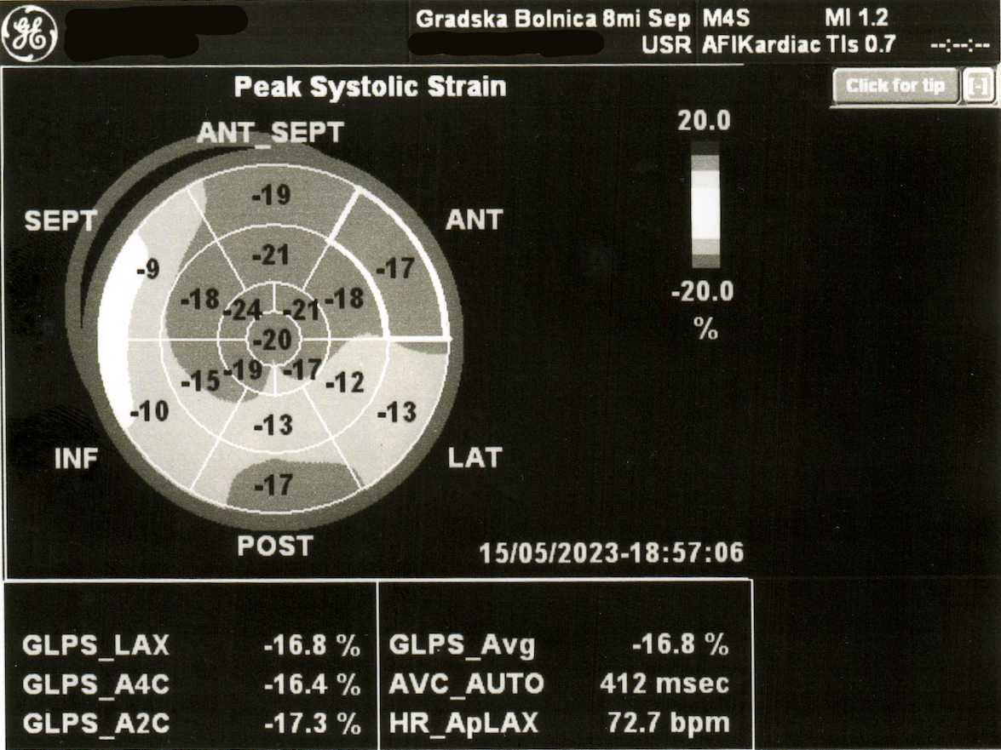
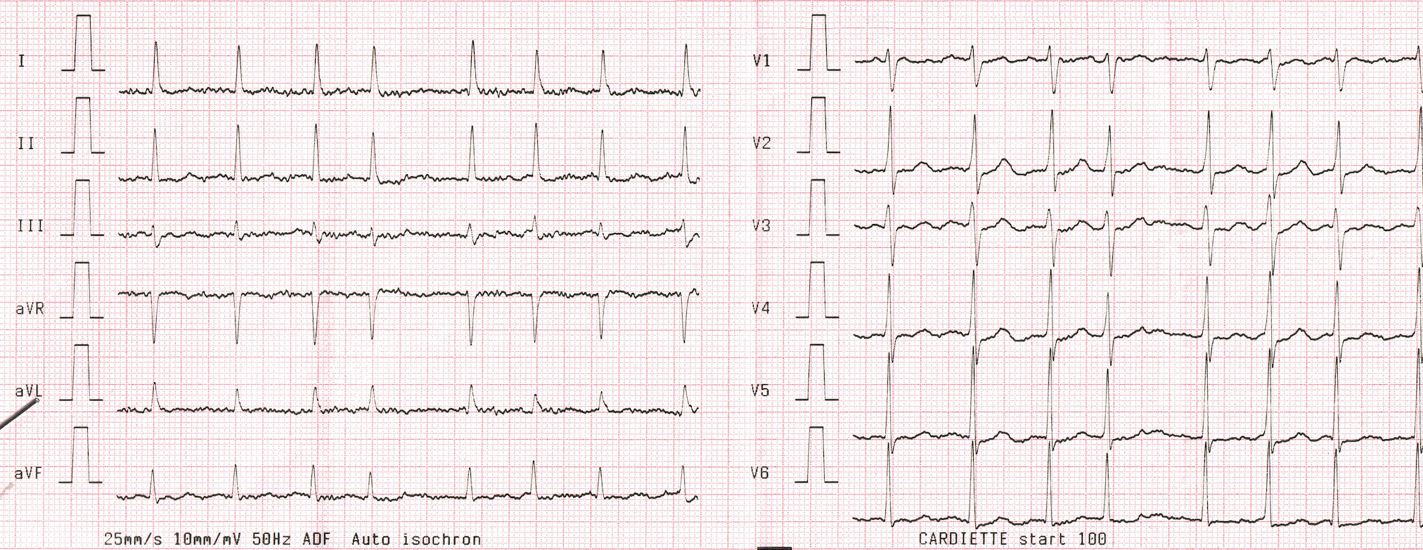
NEW-ONSET ATRIAL FIBRILATION IN ACTIVE BREAST CANCER PATIENT: THERAPEUTICAL CHALLENGE – A CASE REPORT
Irena Gigovska Dimova
INTRODUCTION
Breast cancer is the most common malignant disease in females. The specific cancer treatment protocol involves drugs with known cardiovascular toxicity. Patients with significant risk of cancer therapy-related cardiovascular toxicity (CRT-CVT) should be reported for cardiology referral.
CASE PRESENTATION
A 70-year-old, obese patient with a previous history of hypertension (HTA) and low normal left ventricular ejection fraction (LVEF) was diagnosed with stage III breast cancer and scheduled for baseline assessment before initiating cardiotoxic cancer treatment protocol. HFA-ICOS risk stratification was referred as high (low normal LVEF 52%, HTA, obesity, age 65-79) and baseline electrocardiogram (ECG) showed sinus rhythm with HR 70/min and left axis deviation. Baseline transthoracic echocardiography (TTE) revealed low-normal ranges of LVEF, lower values of global longitudinal strain (GLS%) with 16,8% and mild mitral regurgitation. Laboratory biomarkers (hsTn) were in reference ranges.
The patient was referred for AC60+taxol treatment protocol. After the 4th cycle of doxorubicin in total cumulative dose of 208,3mg/m2, the patient presented with new-onset paroxysmal atrial fibrillation. TTE did not show significant changes from baseline evaluation and serum biomarkers further excluded the diagnose of cancer therapy-related cardiac dysfunction. Considering the primary goal of completing the cancer treatment, the decision for rate control with beta blockers was not difficult. The decision for anticoagulation was more than challenging; with CHA₂DS₂VASc score 3, although low-molecular-weight heparin (LMWH) was not the preferable guideline-directed medical therapy, it was the only option for short-time anticoagulation where DOACs and acenocumarol were drugs to avoid. One week later the patient’s ECG showed sinus rhythm. Two weeks later, introducing the taxol, we switched the patient to dabigatran as the best therapeutic option. She successfully completed the whole treatment, underwent left-sided radiotherapy with total tumor dose of 41,25Gy, also. Nine months after check-up, revealed stabile cardiac condition, normal sinus rhythm and cancer free evaluation.
CONCLUSION
CRT-CVT complications are the second leading cause of death in breast cancer patients. Management of the adverse effects is challenging and complex due to the imperative of completing the cancer treatment and frequent drug-drug interactions. Early detection, multidisciplinary approach and close monitoring are the cornerstone for overall good outcomes.
REFERENCES
Farmakis, D., Papakotoulas, P., Angelopoulou, E., & Bischiniotis, T. (2022). Anticoagulation for atrial fibrillation in active cancer (review). Oncology Letters, 23(4). https://doi.org/10.3892/ol.2022.13244
López-Fernández, T., Martín-García, A., Roldán Rabadán, I., & Mitroi, C. (2019). Atrial fibrillation in active cancer patients: Expert position paper and recommendations. Revista Española de Cardiología (English Edition), 72(9), 749–759. https://doi.org/10.1016/j.rec.2019.03.019
Lyon, A. R., López-Fernández, T., Couch, L. S., & Asteggiano, R. (2022). 2022 ESC guidelines on cardio-oncology developed in collaboration with the European Hematology Association (EHA), the European Society for Therapeutic Radiology and Oncology (ESTRO) and the International Cardio-Oncology Society (IC-OS). European Heart Journal, 43(41), 4229–4361. https://doi.org/10.1093/eurheartj/ehac244
Kamaraju, S., Mohan, M., Zaharova, S., & Wallace, B. (2021). Interactions between cardiology and oncology drugs in Precision Cardio-Oncology. Clinical Science, 135(11), 1333–1351. https://doi.org/10.1042/cs20200309
Mauro, E., Lucà, F., Tetta, C., & Parise, O. (2022). Breast cancer and atrial fibrillation. Journal of Clinical Medicine, 11(5), 1417. https://doi.org/10.3390/jcm11051417
Delluc, A., Wang, T., Yap, E., & Ay, C. (2019). Anticoagulation of cancer patients with non‐valvular atrial fibrillation receiving chemotherapy: Guidance from the SSC OF THE ISTH. Journal of Thrombosis and Haemostasis, 17(8), 1247–1252. https://doi.org/10.1111/jth.14478

