Slide 1
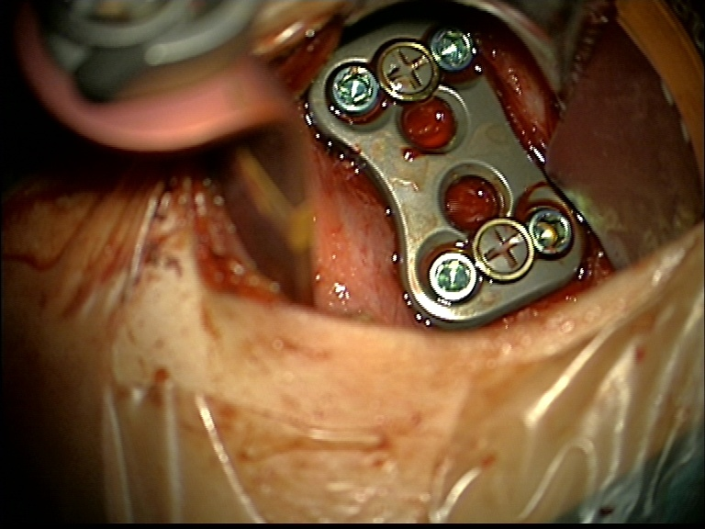
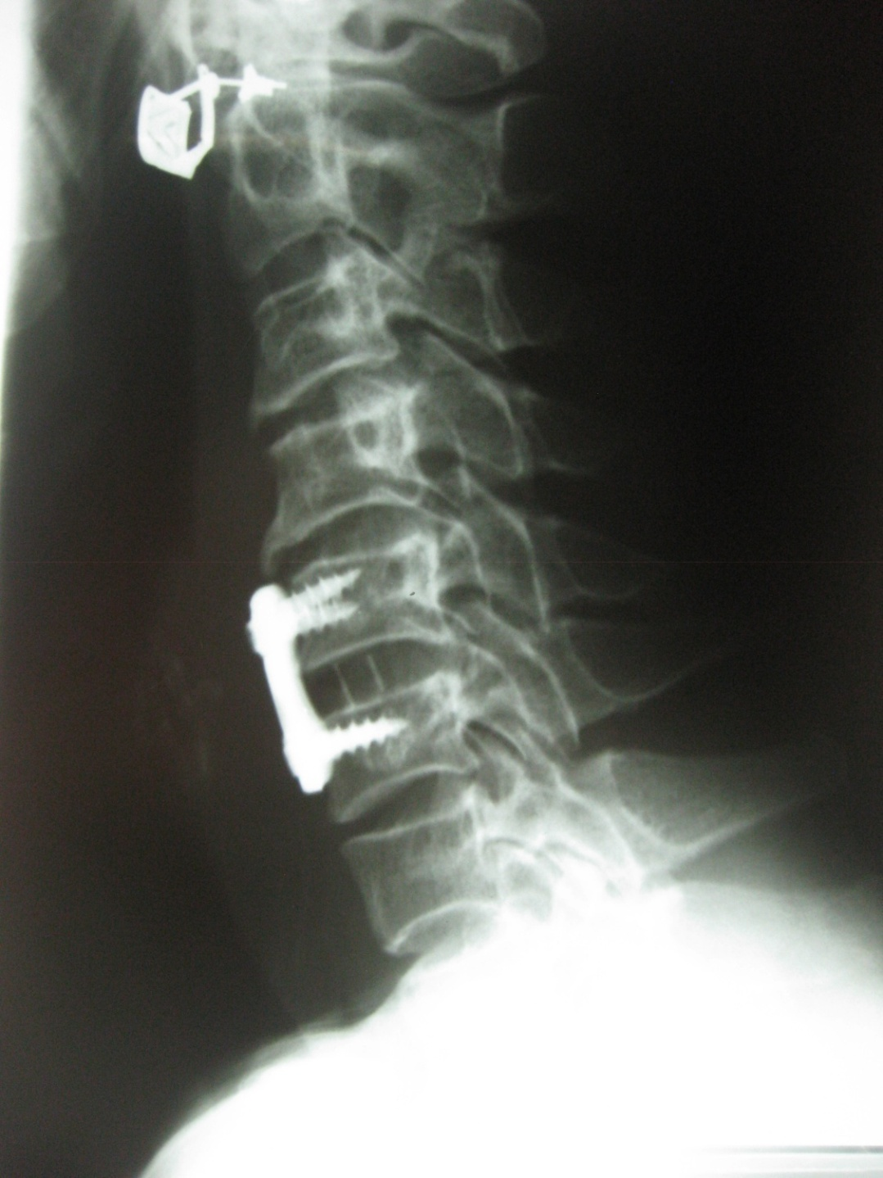
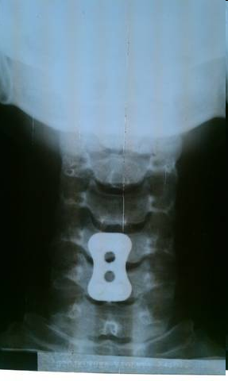
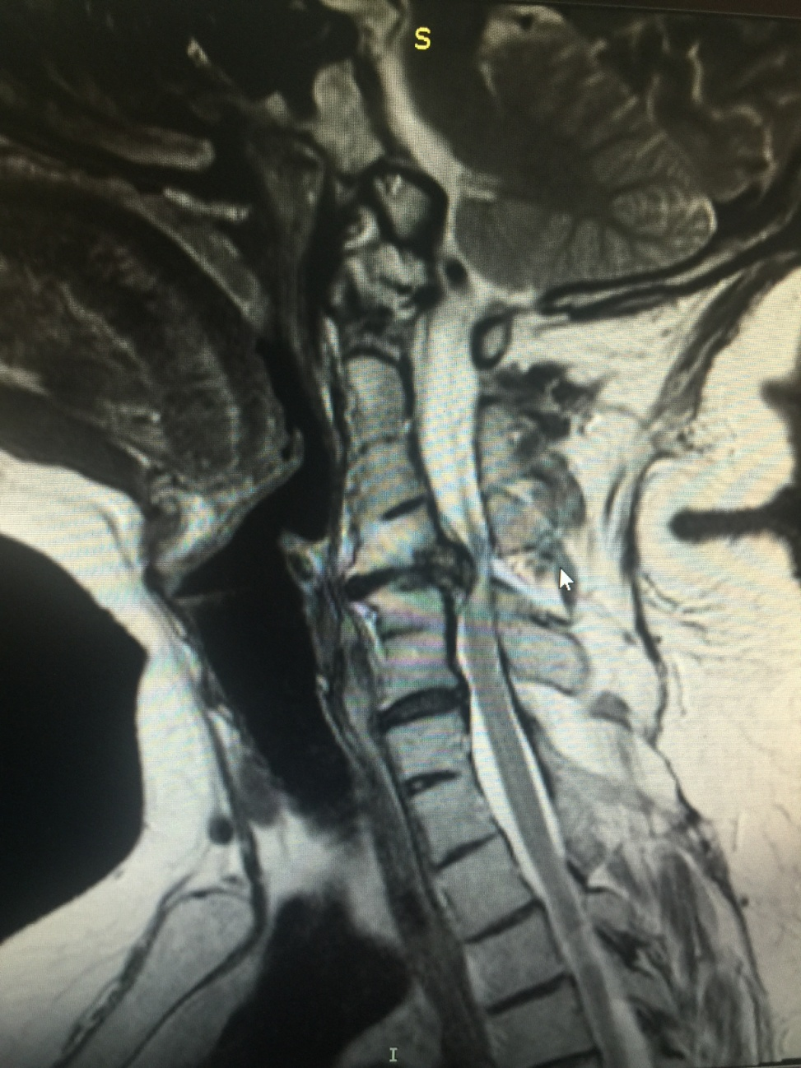
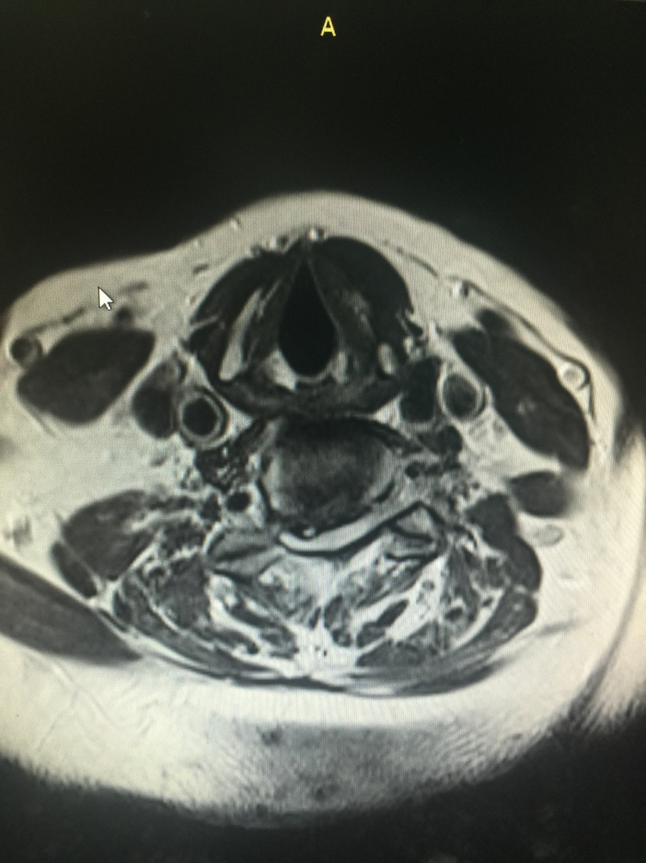
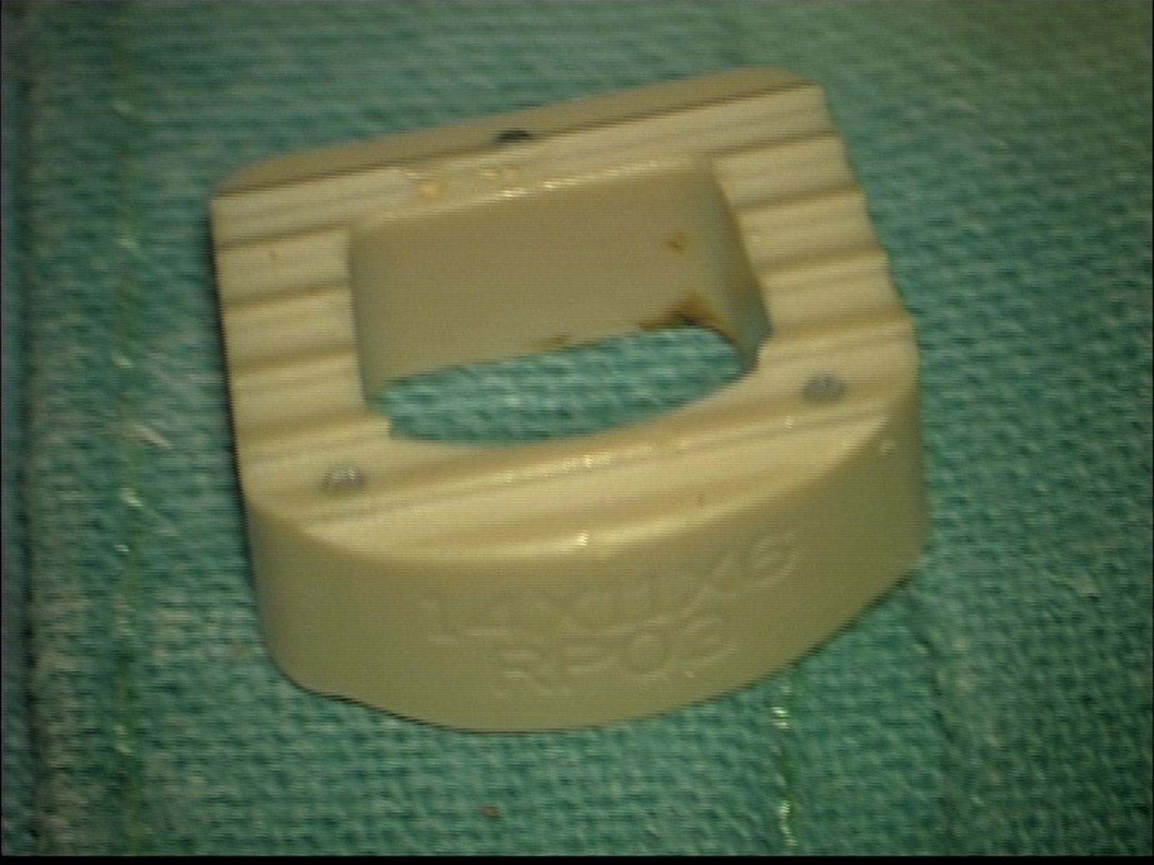
Surgical treatment of single level degenerative cervical disc disease treated with ACDFP
Chaparoski A¹., Filipce V¹., Gavrilovska A¹., Kostov M¹., Rendevski V¹., Elezi F¹., Shuntov B¹.
1 University clinic of Neurosurgery Skopje, Faculty of Medicine, University St Cyrilus and Methodius Skopje, R. of Macedonia
Introduction
Anterior cervical discectomy and fusion with plate (ACDFP) is a surgical procedure performed to remove herniated or degenerative disc in cervical ( neck) spine. After disk is removed , the vertebrae above and below the disc space are fused together. Cervical disc disease and spondylosis are common in adult patients. Symptoms are result from degenered cervical disc, herniated disc, bulging disk or disk-osteophyte complex. Depend of neural element involved in this process clinical presentation is with neck pain, radiculopathy, myelopathy or radiculomyelopathy. Most of the patients have good response on nonsurgical treatment which include drug therapy, nerve block, physical therapy and traction. Only 10 % of people with herniated disc problems have enough pain after two mouths of nonsurgical treatment to consider surgery.
Result(s)
All patients improved after surgery with reduction in neck and radicular pain and pain relieve after surgery. We evaluated the neck disability index which improved in all of our patients. Fusion rate after 3, 6 and 12 months after surgery was good to excellent in 50 pt (90%) of the patients and showing good osseous fusion. Lordosis was measured as an overall feature compared to the patients of the same age, and measured at the level of fusion compared to the whole cervical spine. Less lordosis was observed in all cases compared to age matched individuals. Also, less lordosis was observed at the level of fusion compared to overall cervical spine lordosis.
Symptoms before surgery: Pain – Preoperative neck pain in 16 patients (28,57%). Intensity of pain on scale from 1-10/ average -7 points, radiculopathy 14 pt (25%), weakness 10 pt (17,85%), numbness 8 pt (14,28%), myelopathy 8 pt (14,28%). Level (C3-C4)- 2 pt (3,57%), (C4-C5)- 19 pt (33,92%), (C5-C6)- 22 pt (39,28%), (C6-C7)- 13 pt (23,21%). None of the patients had any complication after surgery in 12 month period. Improvement in weakness was observed in 48 pt (85,71%).
According to literature review if we compare ACD vs ACDFP, on the short term ACD leads to satisfied outcome. Over longer term, patient report increasing complains. Incidence of kyphotic deformity in ACD is higher (Tewarie, Barteles). Now the trend is to treat degenerative cervical disc disease from anterior approach with subsequent fusion. Anterior cervical screw- plate systems have become an integral part of surgical management after ACD. In our experience anterior plating system for anterior cervical discectomy with interbody fusion and plating performs excellent fusion rates and clinical outcomes. We find that variable self drilling screw construct supports all anatomical and biomechanical needs.
Conclusion(s)
ACDFP is safe, effective treatment with good results in single level disc disease with intractable pain w/wo neurologic deficit. In our retrospective study of 56 patients, there wasn’t any complication observed. The estimated time from admission until discharge was 5,6 days. The use of allografts and plate fixation in combination for anterior cervical discectomy and fusion does not compromise the radiologic and clinical outcomes while providing the advantages of donor site morbidity elimination, restoration of cervical segmental lordosis, and not requiring postoperative immobilization.
Objective(s)
Authors present their experience through retrospective study of a series of 56 patients treated with ACDFP with Atlantis system caused by a degenerative disease of cervical spine presented with radiculopathy w/o myelopathy.
Acknowledgements
ACDFP prevent the disc space collapsing, minimize the risk of graft migration and extrusion, improve fusion rate, increase stability early after surgery, shorten the surgical time. The surgical management of cervical disk desease is still contraversal despite of many study publisched of this topic. Yet there is no consensus of the best surgical approach for this entity.
Method(s)
This is a retrospective study in which 56 patients were included, 30 were women and 26 were man. They all presented with signs and symptoms of cervical radiculopathy.
Out of all 8 presented with signs of cervical myelopathy in addition.
Patients underwent CT scan and magnetic resonance imaging which demonstrated single level disc herniation with evident radicular and or spinal cord compression.
All patients underwent single level discectomy with interbody fusion and plating. PEEK cage was used in all cases and plating system with locking screws as well.
The mean follow-up period was 15 months..
Figure 1. Intraoperative view of an single level C5-C6 ACDF.
Figure 2. Lateral and A-P X-ray plain film of the same patient from figure 1, shows good positioning of the plate and screxs.
References
1.Brodke DS, Zdeblick TA. Modified SmithRobinson procedure for anterior cervical discectomy and fusion. Spine. 1992 Oct;17(10 Suppl):S427-30.
2.Dan NG.Anterior cervical graftless fusion for soft disc protrusion. A review of 509 disc excisions in 476 patients. J Clin Neurosci. 1998 Apr;5(2):172-7
3.Donaldson JW, Nelson PB. Anterior cervical discectomy without interbody fusion. Surg Neurol. 2002 Apr;57(4):219- 24; discussion 224-5.
CONTACT INFORMATION
University clinic of Neurosurgery, Skopje, Faculty of Medicine, University St Cyrilus and Methodius Skopje, R. of Macedonia.
Tel +3892 3 147035, Fax +389233121899
Mail neurosurgery.skopje@yahoo.com

